Slide 1
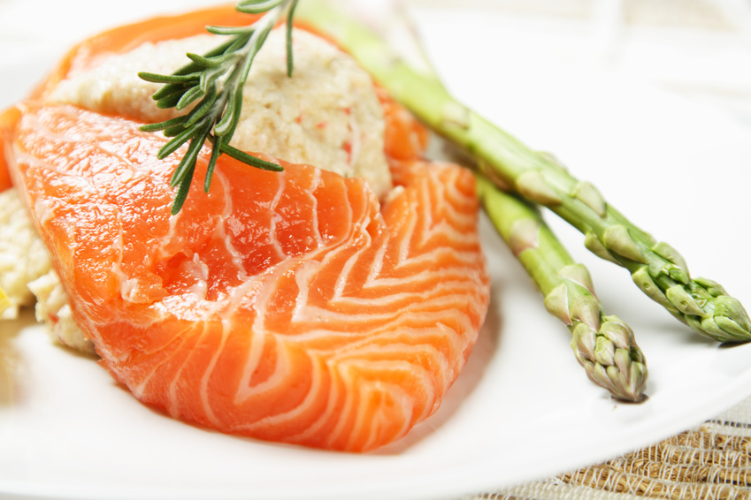
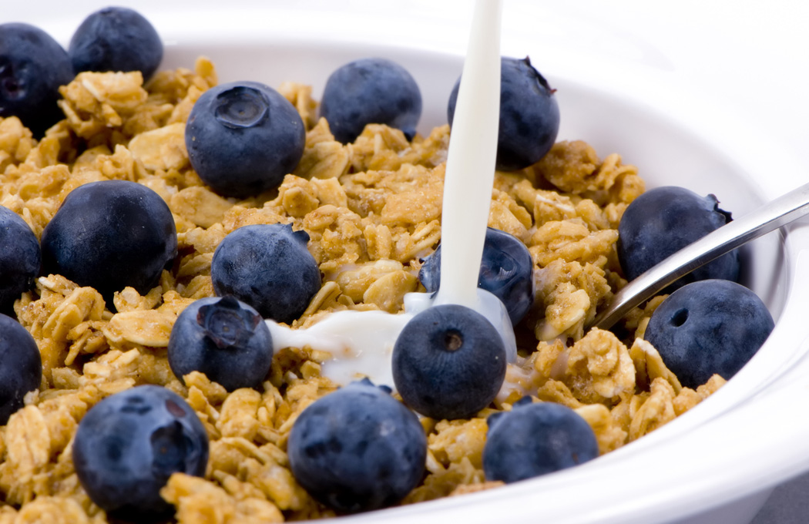


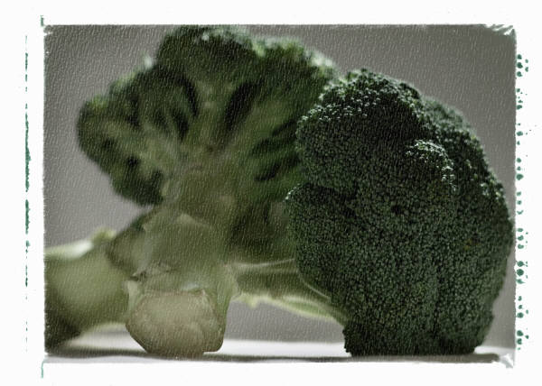

Best Heart Healthy Foods
Beth Kalicki
Heli J. Roy, PhD, MBA, RD
Pennington Biomedical Research Center
Notes:
Heart Healthy foods; they dose the body with multiple phytonutrients that prevent and repair damage to body cells. They also prevent heart disease.
Do : Encourage Students to answer what they think are some heart healthy foods

Slide 2
What do heart healthy foods have in common?
Heart healthy foods are low in fat and cholesterol, they are high in fiber and they have a lot of phytonutrients.
They are wholesome foods.
Most are from the vegetable kingdom.
Notes:
Heart healthy foods are low in fat and cholesterol, they are high in fiber and they have a lot of phytonutrients.
They are wholesome foods, i.e., they are not processed foods.
Most of them come from the vegetable kingdom.
Let’s take a look at some heart healthy foods.

Slide 3
Cold Water Fish
Salmon, Trout and Tuna
Rich in Omega-3 fatty acids, Folate, and Niacin
Notes:
Cold water fish are some of the best foods for the heart. They have a lot of omega-3 fatty acids, the kind of fat that is beneficial in lowering cholesterol and reducing the risk for heart disease. Omega-3 fatty acids actually change cell chemistry from inflammatory to non-inflammatory which helps in keeping our blood vessels healthy.

Slide 4
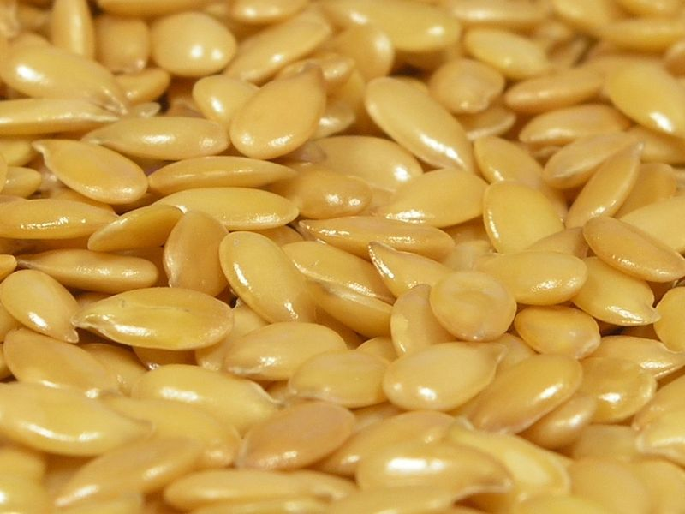
Flaxseed
Rich in Omega-3 fatty acids, fiber, and phytoestrogens
Notes:
Flaxseeds are another source of omega-3 fatty acids. You can include flax seeds when making any kind of baked product such as muffins, breads, biscuits, or even pancakes and waffles. You can also sprinkle some on cold cereal for an extra nutty taste.

Slide 5
Oatmeal
Rich in Soluble Fiber, Magnesium, Potassium, Folate, Niacin, Calcium, and Omega-3 fatty acids
Notes:
Oatmeal is high in soluble fiber which helps to remove built up cholesterol from the bloodstream. Oatmeal is a whole grain and therefore also rich in other important nutrients.

Slide 6
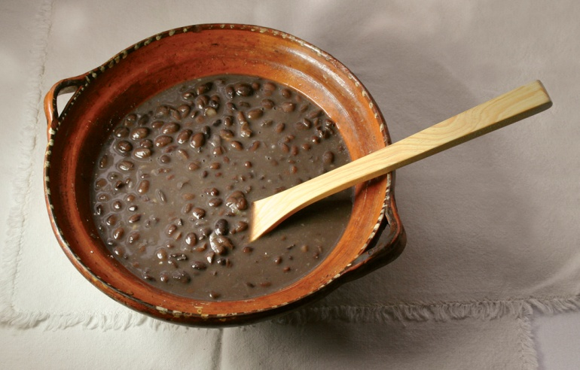
Black Beans &
Kidney Beans
Rich in Iron, Zinc, Thiamin, Folate, Magnesium, and Soluble fiber.
Notes:
Beans and lentils are an important source of soluble fiber, folic acid and the minerals iron and zinc. Beans are another excellent food to have that helps to remove built up cholesterol from the bloodstream. These hearty beans are a good source of protein, and when combined with a whole grain such as whole wheat pasta or brown rice provide protein comparable to that of meat or dairy foods without the high calories or saturated fat found in these foods. And, when you get your protein from kidney beans, you also get the blood sugar stabilizing and heart health benefits of the soluble fiber provided by these versatile legumes. A cup of kidney beans provides 15.3 grams of protein--that's 30.7% of the daily value for protein.

Slide 7
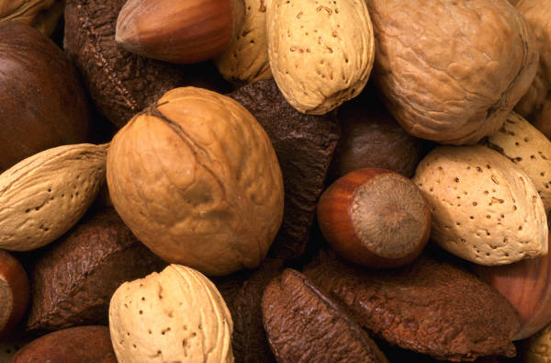
Almonds & Walnuts
Nuts
Rich in Potassium, Phosphorus, Magnesium, Vitamin E, Folate, Fiber, Omega-3 fatty acids, Polyunsaturated fatty acids, and Phytosterols.
Notes:
Women in a Harvard School of Public Health study who reported eating 5 or more 1 ounce servings of nuts/peanuts per week reduced their risk of Type 2 diabetes by almost 30 percent compared to those who rarely or never ate nuts. Women in the study who ate five tablespoons of peanut butter each week reduced their risk for Type 2 diabetes almost 20 percent. (Journal of the American Medical Association, Nov. 27, 2002.)
t's easy to nibble on nuts. Here are three quick ideas plus links to lots more. Store shelled or unshelled nuts in an airtight container in your refrigerator for up to 6 months or for a year in your freezer for best quality.
1. It's in the Bag!
You don't have to fire up the stove or get out your cookbook to enjoy nuts. Your handful of nuts may be enjoyed -- simply -- out of hand.
Divide a container of nuts into small snack bags for easy snacking at home, office or on the road. Simply count, measure a third cup, weigh 1 to 1.5 ounces of nuts on a kitchen scale or grab a handful and store in each snack bag. Keep in the refrigerator until you're ready to enjoy!
2. Just a Sprinkle
Sprinkle nuts into these foods: Salads, Yogurt, Cereal, Pasta, Cooked vegetables, Muffins and pancakes (toss a handful or two into your batter)

Slide 8
Red Wine
Rich in Catechins and Resveratrol (flavonoids)
Notes:
The antioxidants in red wines have been shown to provide certain health benefits. Antioxidants act like warriors, preventing the oxidation process in which reactive particles known as "free radicals" cause damage to healthy cells. For the moderate drinker, drinking one to two glasses of wine daily, the antioxidants in red wine offer some protection against heart disease.
Another health benefit of resveratrol is its ability to limit the oxidation of low-density lipoprotein (LDL) cholesterol. The oxidation of LDL is the first step to the production of plaques on the inside of the blood vessels. Plaque is the primary cause of atherosclerosis, or hardening of the arteries. New studies show that the antioxidant saponin, also found in red wine, may aid in reducing the levels of LDL cholesterol. Any reduction in the levels of LDL, or in its oxidation, can potentially decrease the build up of plaque.
Another health benefit of resveratrol is its ability to regulate nitric oxide. Nitric oxide is a gas that enables smooth muscles to relax. This relaxation of smooth muscle also occurs in the walls of the blood vessels and allows blood to flow smoothly through the vessel.
The results of a French study of men who had previous heart attacks indicates that the effects of resveratrol, through moderate red wine consumption, may help prevent future heart attacks.

Slide 9
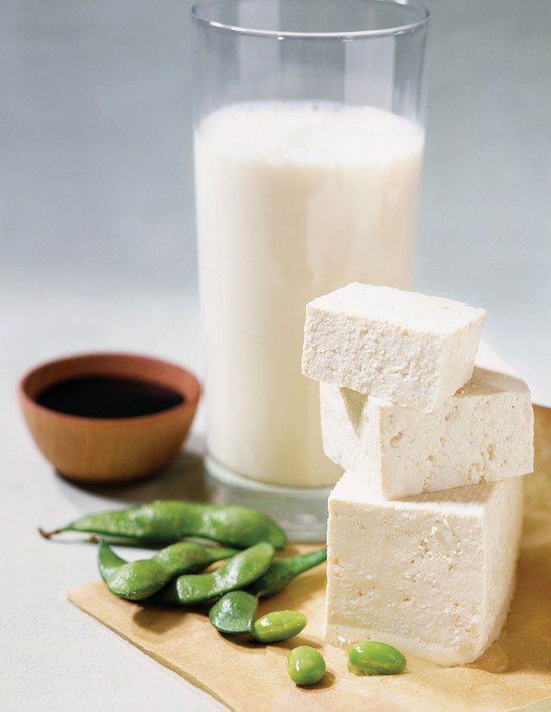
Soy
Tofu & Soy Milk
Rich in Niacin, Folate, Calcium, Magnesium, Potassium, Isoflavones, and Phytoestrogens
Notes:
The cholesterol lowering effect of soy milk and its role of heart disease was widely recognized in the mid 90s when the results of a meta-analysis of 38 clinical studies were published. The results demonstrated that a diet with significant soy protein reduces Total Cholesterol, LDL cholesterol (the "Bad" cholesterol) and Triglycerides.
The average consumption in these studies was 47 grams per day of soy protein, which is a considerable amount. One way to include this is to try a soy protein beverage or powder that may add 20 grams preserving. Soy protein was effective even in people who were already following the American Heart Association's 30 percent-fat diet. Soy protein appears to lower triglyceride levels while preserving HDL cholesterol.
Researchers Erdman & Potter in 1993 reported in the American Journal of Clinical Nutrition a 12 percent drop in cholesterol when 20 to 25 grams of soy protein and fiber were included in the diet. Soy beans contain soluble fiber, which is known to interfere with the absorption and metabolism of cholesterol.
As a result of these findings, in 1999, FDA authorized a health claim about the relationship between soy protein and Coronary Heart Disease (CHD) on labelling of foods containing soy protein.
A heart health claim can be found on qualified soy products.
Health Claim:
Diets low in saturated fat and cholesterol that include 25 grams of soy protein a day may reduce the risk of heart disease. One serving of [name of produce] provides [amount]g of soy protein.

Slide 10
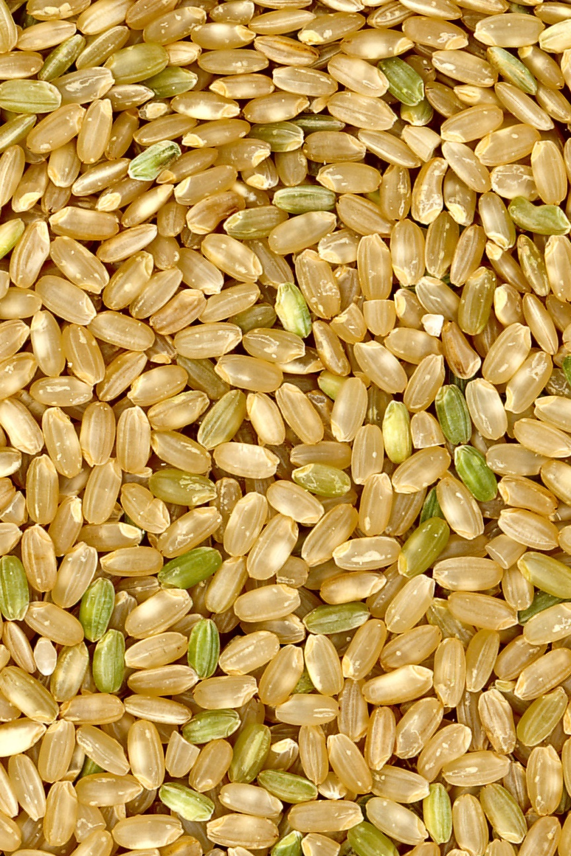
Brown Rice
Rich in B-complex Vitamins, Fiber, Niacin, Magnesium, and Fiber.
Notes:
Two kinds of rice -- brown and half-milled rice -- may reduce the risk of heart disease and high blood pressure by interfering with a protein linked to those conditions, research suggests.
Researchers report that brown rice is better than white rice when it comes to protecting the body from high blood pressure and artherosclerosis (hardening of the arteries). (Satoru Eguchi, an associate professor of physiology at Temple University School of Medicine in Philadelphia).
Eguchi and colleagues show that an ingredient in brown rice appears to combat a protein known as angiotensin II that contributes to high blood pressure and clogged arteries.
The ingredient is in a layer of rice that is stripped away when brown rice is converted to white rice.

Slide 11
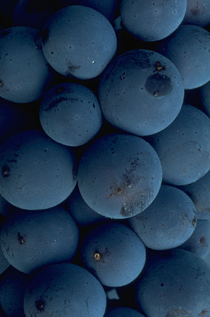
Blueberries
Rich in Beta Carotene, Lutein, Anthocyanin, Ellagic Acid, Vitamin C, Folate, Calcium, Magnesium, Potassium, and Fiber.
Notes:
A USDA team of researchers identified pterostilebene in blueberries Pterostilebene is chemically similar to another antioxidant found in the skin of blueberries and grapes (and red wine!) called resveratrol. Pterostilebene is significantly better at stimulating the PPAR-alpha receptor than reservatol (known to lower LDL cholesterol, blood fats, and blood sugar levels). Both resveratrol and pterostilbene are part of a group of compounds called phytoalexins that are produced by plants as protective devices against environmental stressors and to promote pollination.
Furthermore, in their study funded by the National Cancer Institute, Rimando's researchers maintained that the compound pterostilbene was more effective than the drug ciprofibrate, prescribed to lower LDL cholesterol. They noted that because pterostilbene targets a very specific structure in the body, it resulted in fewer side-effects than the prescription medication.
Anthocyanin, another powerful antioxidant known to prevent brain aging, is also found in blueberries. It is the same compound that gives the pterostilbene-rich blueberry skin its bright, vivid, blue color. Color in fruits and vegetables serves as a direct indicator of phytonutrient levels. Antioxidants are especially valuable to our health because of their ability to fight free-radical damage to cells, which may lead to cancer, heart disease, and chronic inflammation.
A study in the Journal of Agriculture and Food Chemistry found that blueberries had the highest antioxidant level per serving compared to 20 other fruits. One cup of blueberries has more antioxidants than one serving of cranberries, strawberries, prunes or raspberries. And, one serving of blueberries has as many antioxidants as five servings of carrots, apples, broccoli or squash. Blueberries are also great sources of dietary fiber, vitamin C, folic acid, and bacterial inhibitors.

Slide 12
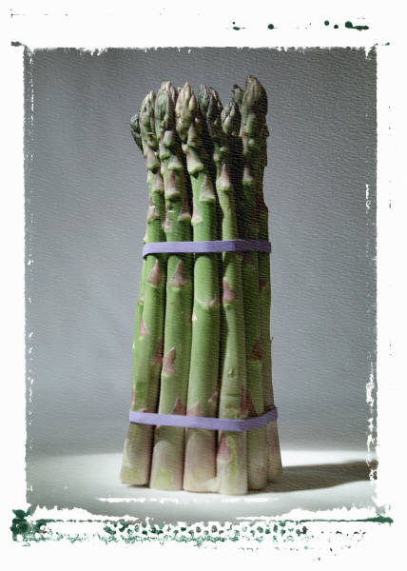
Green Vegetables
Asparagus,
Broccoli, Spinach
Rich in Beta-Carotene, Lutein, Vitamin C, Vitamin E, Folate, Magnesium, Potassium, Calcium, and Fiber.
Notes:
Regularly eating fruits and vegetables, in particular green leafy vegetables and fruits that contain vitamin C, reduces the risk of coronary heart disease, according to researchers from the Harvard School of Public Health. In a study, individuals who increased consumption of fruits and vegetables by one additional serving per day helped reduce their risk for coronary heart disease by 4 percent. And more appears to be better, at least where eating fruits and vegetables is concerned. Each added serving of vitamin C-rich fruits and vegetables was associated with a 6 percent reduction in coronary heart disease risk. Those people in the study who consumed eight or more servings of fruits and vegetables per day were at over 20 percent reduced risk of coronary heart disease compared to those who consumed less than three servings per day. The research was funded by grants from the National Institutes of Health, the Office of Dietary Supplements and the Florida Department of Citrus.
Adams MR. et. al. A Diet Rich in Green and Yellow Vegetables Inhibits Atherosclerosis in Mice. J Nutr. 136:1886-1889, July 2006.
The principle finding was that atherosclerosis extent was reduced 38% in mice consuming a diet that is rich in green and yellow vegetables. Consumption of the vegetable-rich diet also had modest influences on plasma lipoprotein profiles and body weight. Though differences in body weight were not evident until week 8, mice consuming the vegetable diet had gained 7% less weight than control mice by the end of the 16-wk study. Plasma total cholesterol, VLDL + ILDL cholesterol, and to a lesser extent LDL cholesterol, were reduced in mice fed the vegetable-rich diet. The 37% reduction in SAA (an acute phase protein and nonspecific marker of inflammatory activity in mice) indicates that vegetable consumption inhibited inflammatory activity. In this regard, it is well known that atherosclerosis progression is intimately linked with pro-oxidant and proinflammatory activity in the arterial intima.

Slide 13
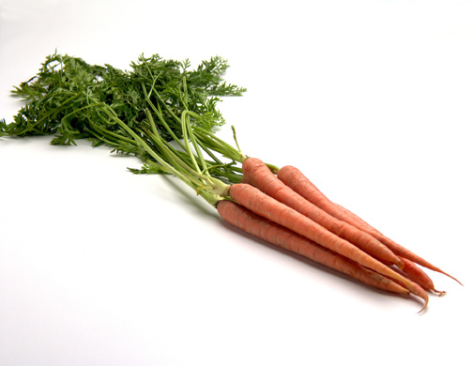
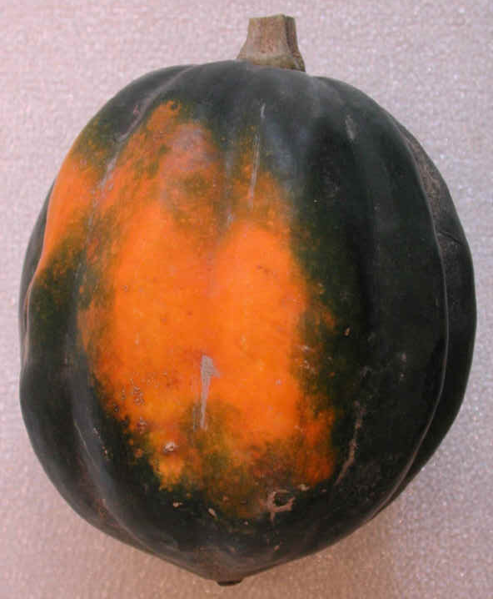
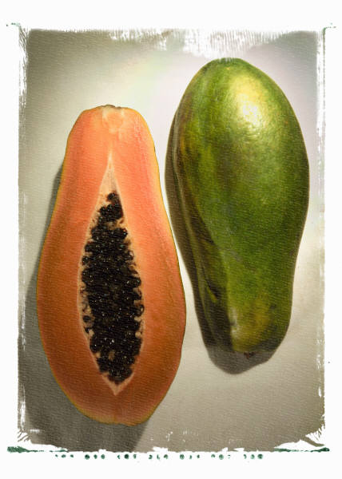
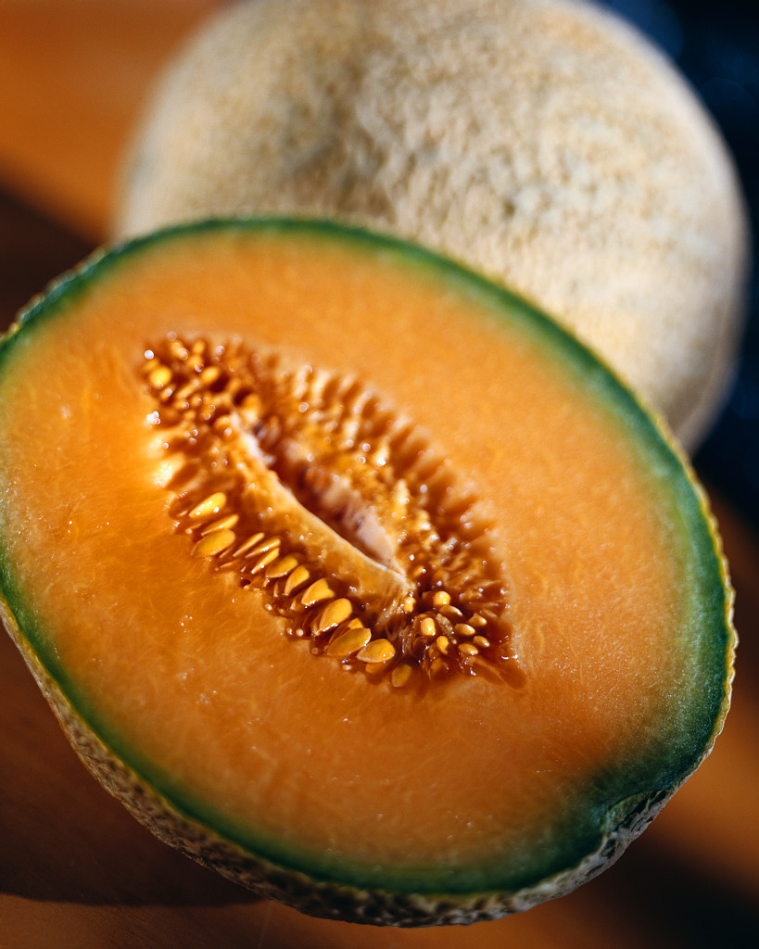
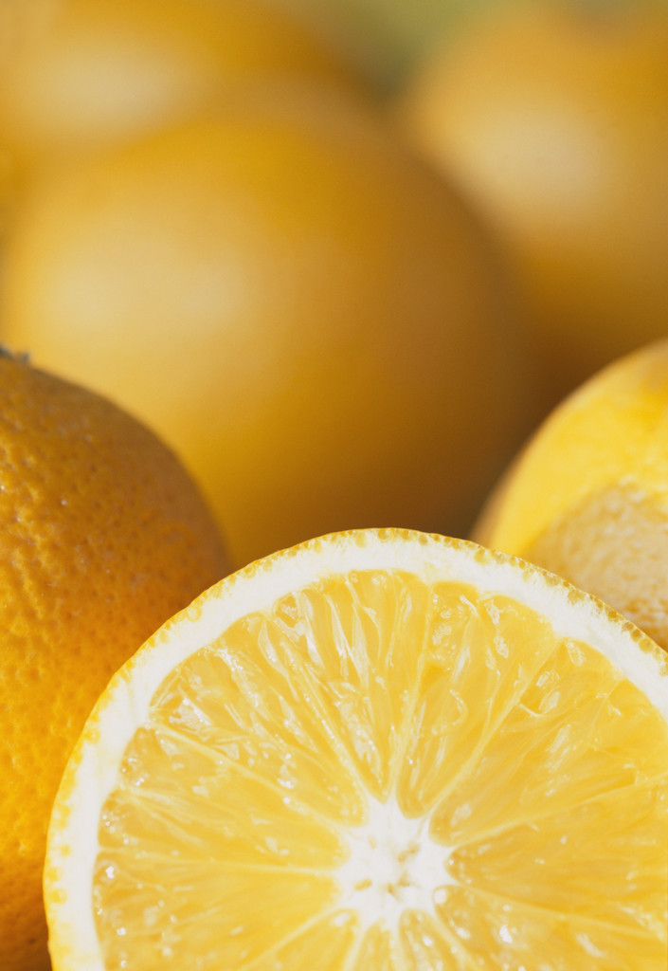
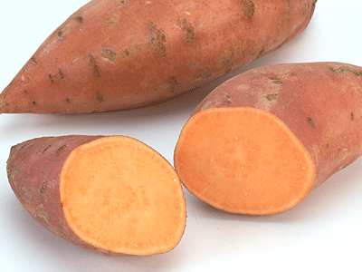
Yellow and Orange Vegetables and Fruits
Carrots, Cantaloupe,
Sweet Potatoes, Oranges,
Acorn Squash, Papaya
Rich in Alpha and Beta-Carotene, Beta-Cryptoxanthin, Vitamins A, C, and E, Lutein, B-Complex Vitamins, Folate, Calcium, Magnesium, and Potassium.
and Fiber.
Notes:
Yellow fruits and vegetables are teeming with carotenoids and bioflavonoids, which represent a class of water soluble plant pigments that function as antioxidants.
Along with antioxidants, sunny-colored foods also have an abundance of vitamin C. Studies suggest that these bountiful nutrients will help your heart, vision, digestion and immune system.
Other benefits of naturally yellow foods include maintenance of healthy skin, wound healing, and stronger bones and teeth.
Yellow and orange pigment can be found in corn, sweet potatoes, carrots, squash and tomatoes. These vegetables contain lutein, a carotenoid that protects against eye disorders that are associated with aging. Lutein can also protect the carotid artery from collecting plaque, which can lead to a heart attack. Some yellow/orange vegetables, like orange bell peppers, contain another carotenoid known as zeaxanthin, which also protects the eyes, especially from the harmful effects of sunlight. Although lutein supplements are available, eating yellow-orange vegetables is better because our bodes absorb lutein and other nutrients better from whole foods.
In addition to keeping your eyes healthy, dark yellow vegetables can also prevent cancer. They are rich in vitamin A and beta-carotene, both of which have been shown to protect against cancer and other degenerative diseases. Vitamin A can be toxic when it is taken at high doses in supplement form, but you can't overdose on it if you get it from natural sources. Therefore, eating dark yellow vegetables is a much safer than taking supplements.

Slide 14
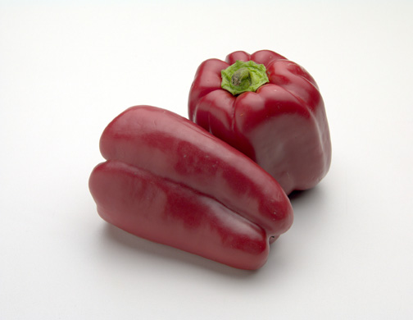
Red Bell Peppers
Rich in Beta-Carotene, Lutein, B-Complex Vitamins, Folate, Potassium, and Fiber.
Notes:
One small red, yellow or orange pepper provides three times the recommended daily allowance of vitamin C—way ahead of citrus. Possibly due to their vitamin C and beta carotene content, bell peppers have been shown to be protective against cataracts. Just like other nutrient-dense vegetables, bell peppers contain many different powerful phytochemicals. Bell peppers have also been shown to prevent blood clot formation and reduce the risk of heart attacks and strokes probably due to their content of substances such as vitamin C, capsaicin, and
flavonoids. Although chili peppers contain a higher amount of those substances, bell peppers should still be promoted especially for individuals with elevated cholesterol levels. Red bell peppers also contain lycopene, which is a carotene that helps to protect against cancer and heart disease. Lycopene, a carotenoid lowers the risk of various cancers, including prostate and cervical cancer. They also contain beta-carotene which is converted to vitamin A in the body and is essential for night vision. Nature’s best source of zeaxanthin, a compound known to protect against cataracts and macular degeneration, can be found in orange peppers.

Slide 15
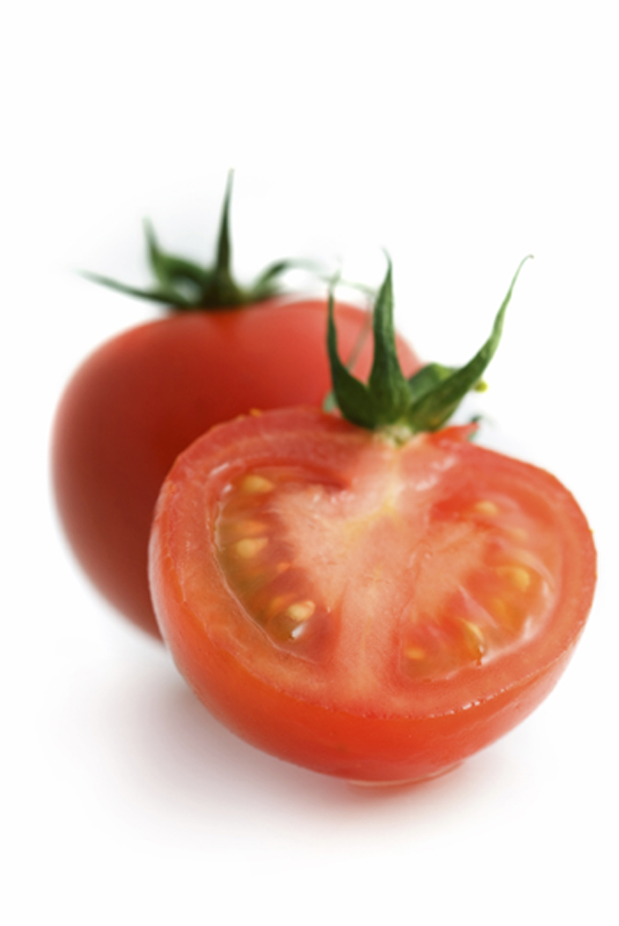
Tomatoes
Rich in Alpha-Carotene, Beta-Carotene, Lycopene, Lutein, Vitamin C, Potassium, Folate, and Fiber.
Notes:
Tomatoes contain large amounts of vitamin C, providing 40 percent of the daily value (DV). They also contain 15 percent DV of vitamin A, 8 percent DV of potassium, and 7 percent of the recommended dietary allowance (RDA) of iron for women and 10 percent RDA for men.
The red pigment contained in tomatoes is called lycopene. This compound appears to act as an antioxidant, neutralizing free radicals that can damage cells in the body. Lycopene may be twice as effective as beta carotene in its antioxidant capability. Studies conducted by Harvard researchers have discovered that men who consumed 10 servings of tomatoes a week, or the equivalent to 10 slices of pizza, can cut the risk of developing prostate cancer by about 45 percent. However, its benefits are not limited to the prostate. Italian researchers have found that those who consume more that 7 servings of raw tomatoes lower the risk of developing rectal or stomach cancers by 60 percent. Israeli researchers have found that lycopene is a powerful inhibitor of lung, breast, and endometrial cancer cells. Research has also indicated that the lycopene in tomatoes can help older people stay active longer.
New research is beginning to indicate that tomatoes may be used to help prevent lung cancer. Two powerful compounds found in tomatoes-coumaric acid and chlorogenic acid-are thought to block the effects of nitrosamines.

Slide 16

Dark Chocolate
Rich in Resveratrol and Cocoa Phenols
Notes:
Flavonoids help protect plants by shielding them from environmental toxins and helping repair damage. When we consume plant-based foods rich in flavonoids, it appears that we also benefit from this “antioxidant” power. Antioxidants are believed to help the body's cells resist damage caused by free radicals that are formed by normal bodily processes such as breathing and from environmental contaminants like cigarette smoke. When the body lacks adequate levels of antioxidants, damage from free radicals occurs and leads to increases in LDL (“bad)-cholesterol oxidation (oxidized LDL-cholesterol hurts the arteries) and plaque formation on the walls of the arteries.
Flavanols are the main type of flavonoid found in cocoa and chocolate. In addition to having antioxidant qualities, research indicates that flavanols have other positive influences on vascular health, such as lowering blood pressure and improving blood flow to the brain and heart, making blood platelets less sticky and able to clot, and lowering cholesterol.
Flavonoids are naturally-occurring compounds found in plant-based foods that offer certain health benefits. They are part of the polyphenol group (chemicals found in plants). There are more than 4,000 flavonoid compounds, which are found in a wide variety of foods and beverages, such as cranberries, apples, peanuts, chocolate, onions, tea and red wine. Flavanols are a type of flavonoid specifically found in cocoa and chocolate.
Flavanols, which give cocoa a pungent taste, "may be lost during cocoa processing". Some chocolate manufacturers are studying ways to keep high levels of flavanols in their products while still producing good-tasting chocolate.

Slide 17
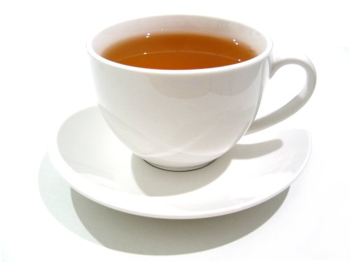
Tea
Rich in Catechins and Flavonols.
Notes:
Health Benefits of Tea
Tea contains high levels of antioxidants, called polyphenols, flavonoids, and catechins, and all of which take on the “free radicals” in the body and prevent them from harming the healthy cells on board. Because of green tea's minimal processing -- its leaves are withered and steamed, not fermented like black and oolong teas -- green tea has more epigallocatechin-3-gallate (EGCG), a powerful antioxidant.
There are antioxidants in teas and also in fruits, vegetables, nuts, meats, and even wines. Tea also contains fluoride which benefits your teeth and has bacteria killing properties which helps control bad breath and the formation of plaque.
Drinking tea can delay the development of the following chronic diseases:
cancer
rheumatoid arthritis
high cholesterol levels
cardiovascular disease
infection
impaired immune function
Weight control
Tooth decay

Slide 18
American Heart Association Recommendations
6 oz of cooked lean meat, poultry, fish, or seafood a day.
< 2,300 mg of sodium per day.
At least 25 to 30 grams of fiber in your daily diet.
Consume fish at least twice a week.
Notes:
American Heart Association Recommendations: The American Heart Association recommends that you eat no more than six ounces of cooked lean meat, poultry, fish, or seafood a day. They also note that you should try to consume less than 2,300 mg of sodium per day. This is in an effort to reduce the occurrence (or prevent further progression of) hypertension. They stress that it is very important for you to get at least 25 to 30 grams of fiber in your daily diet. A good rule of thumb to remember is that you should eat at least 14 grams of fiber for each 1,000 calories that you consume. They also recommend that fish is consumed at least twice a week, due to the multiple benefits of omega-3 fatty acids.

Slide 19
Fiber
Examples of Insoluble Fiber:
  Whole wheat breads
  Wheat cereals
  Wheat bran
  Cabbage
  Beets
  Carrots
  Brussels’ Sprouts
  Turnips
  Cauliflower
  Apple skin
Examples of Soluble Fiber:
  Oat bran
  Oatmeal
  Beans
  Peas
  Rice bran
  Barley
  Citrus fruits
  Strawberries
  Apple Pulp
Notes:
Fiber is either soluble or insoluble. When eaten regularly, fiber has been shown to lower blood cholesterol and may help to decrease the risk of diabetes and colorectal cancer.
It is recommended that we consume more raw vegetables and fresh fruit, including the skins when appropriate. This is because the skins are packed with both valuable nutrients and fiber.
Some examples of soluble fiber include : oat bran, oatmeal, beans, peas, rice bran, barley, citrus fruits, strawberries, and apple pulp.
Some examples of insoluble fiber include: whole wheat breads, wheat cereals, wheat bran, cabbage, beets, carrots, Brussels’ sprouts, turnips, cauliflower, and apple skin.
Cooking vegetables can decrease fiber content, and skins are a good source of fiber.

Slide 20

Facts About the Meat You Eat
Choose the leanest cuts of meat.
  Beef: sirloin, chuck, loin and round.
  Pork: loin chops, tenderloin
  Lamb: leg, arm, loin
Notes:
The leanest beef cuts include: sirloin, chuck, loin, and round. You should choose “choice” and “select” grades of meat over “prime”.
The leanest pork cuts include: loin chops and tenderloin.
The leanest lamb cuts include: leg, arm, and loin.
You should always remove visible fat from meat before cooking.
White meat is better for you than dark meat, in regards to poultry.
Eating fish that is oily, usually contains omega-3 fatty acids (ex: salmon, trout, herring). This helps lower your risk of dying from coronary artery disease.

Slide 21

Key Terms to Remember when Shopping for Food.
“Free”
“Very Low” and “Low”
“Reduced” or “Less”
Notes:
There are some key terms that we must keep in mind when we are shopping for food. These include:
“Free”, which means that the product has the least possible amount of a particular nutrient.
“Very Low” and “Low”, which means that there is a small amount of a particular nutrient; not quite small enough to be considered “free”.
“Reduced” or “Less”, which means that the food has 25% less of that nutrient than the original version of the food.

Slide 22
Healthy Living Guidelines
Minimize the intake of whole fat dairy products, such as butter and whole milk or 2% full fat dairy products.
Cholesterol should be less than 300 mg daily.
Use low fat cooking methods: baking, broiling, grilling, or boiling, rather than breading and frying.
Use liquid vegetable oil and soft margarine in place of hard margarine or shortening.
Notes:
Dairy Recommendation: It is recommended that you minimize your intake of whole fat dairy products, such as butter and whole milk or 2% full fat dairy products.
Cholesterol Recommendations: Your overall intake of cholesterol should be less than 300 mg daily. It is said that egg whites do not contain cholesterol, and they are a good source of protein. You can substitute 2 egg whites for each egg yolk in many recipes that call for eggs. Also, organ meats, such as liver and heart, are very high in cholesterol.
Dietary Substitutions: Prepare fish by baking, broiling, grilling, or boiling, rather than breading and frying. You should use liquid vegetable oil and soft margarine in place of hard margarine or shortening.

Slide 23
Superfoods For Men
Seafood
Nuts
Whole Grains
Tomatoes
Red-Orange Vegetables
Berries and Cherries
Cruciferous Vegetables
Greens
Dry Beans and Lentils
Green Tea
Notes:
Seafood: Seafood and fatty fish have omega-3 fatty acids that can benefit the cardiovascular, circulatory, and immune systems. Omega-3 fatty acids are potent anti-inflammatory foods that can help reduce the risk for prostate cancer, triglyceride (blood fat) levels, aches and pains in athletes, and certain kinds of arthritis. The American Heart Association recommends that everyone eat fish twice per week.
Nuts : Nuts such as pecans, almonds, and walnuts added to your diet can lead to a reduction in LDL cholesterol (bad cholesterol) and a reduction in the risk of coronary heart disease. Nuts can also increase HDL, the good cholesterol.
Whole Grains : A diet rich in whole grains provides fiber, vitamin E, folic acid, thiamin, riboflavin, and the minerals iron, magnesium, and zinc. These are necessary for a healthy heart and building muscle. The type of fiber and complex carbohydrates in whole grains also maintains our blood sugar level, which can reduce abdominal fat and help keep our waistlines small.
Tomato : Tomatoes are an excellent source of many nutrients, such as Lycopene and vitamin C. Lycopene may lower your risk for prostate cancer by as much as 35%. Cooked tomato products are the best sources of Lycopene, such as spaghetti sauce, pizza, and chili sauce.
Red-Orange Vegetables : Vitamin C and Beta-carotene in red and orange fruits and vegetables are antioxidants that help preserve healthy skin cells and prevent sun damage. Vitamin C helps keep our skin firm by building collagen, while beta-carotene repairs damaged skin cells. Beta carotene is also necessary for night vision.
Berries and Cherries : Berries have many different compounds that have antioxidant properties beyond vitamin C. The violet, blue, and red colors in berries and cherries are responsible for their healthy properties. Red and blue berries are full of the health-protecting flavonoid, anthocyanin. Adding berries to the diet may even slow the decline in brain function that can occur with aging. Try to add berries to cereal in the morning.
Cruciferous Vegetables : Cruciferous vegetables, like broccoli, cabbage, and Brussels’ sprouts, are full of valuable nutrients. At the top of the list is a compound called sulforaphane, a chemical that increases your body’s production of enzymes that disarm cell-damaging free radicals and reduces your risk of cancer. Other important nutrients include vitamin C, beta-carotene, and potassium.
Greens: Dark green leafy vegetables are very concentrated sources of many nutrients. They are rich sources of minerals including: iron, calcium, potassium, and magnesium; not to mention vitamin K, vitamin C, and vitamin E, as well as many of the B vitamins, such as folic acid. They also provide a variety of phytonutrients including beta-carotene, lutein, and zeaxanthin, which protect our cells from damage and our eyes from age-related problems. Dark green leaves even contain small amounts of omega-3 fats. One of the most important nutrients in greens is folic acid. Folic acid is required for the metabolism of several important amino acids. Without folic acid, a compound called homocysteine can build up in the bloodstream, which has been linked to an increase in risk for heart disease.
Dry Beans and Lentils : One serving of beans is a half of a cup. Each half of a cup serving of dry beans provides six to seven grams of protein and about a quarter of our daily dietary fiber. Most of the fiber is insoluble, which may reduce the risk of colon cancer. The remaining fiber is soluble fiber, which may reduce blood cholesterol. Studies have confirmed that beans are effective hypocholesterolemic agents when added to the diet. One serving size of beans contains less than 0.5 grams of mostly polyunsaturated fat and no cholesterol, about a third of the Recommended Daily Intake (RDI) for thiamin. A serving of beans contains large amounts of iron, phosphorus, magnesium, manganese, potassium, copper, calcium, and zinc. Beans are high in isoflavones, which protect prostate health and have been shown to lower prostate cancer risk.
Green Tea : Green tea is the handyman of health foods. It has a good effect on arthritis, antibiotic-resistant bacteria, and prostate-cancer cells. The secret of green tea lies in the fact that it is rich in catechin polyphenols, particularly epigallocatechin gallate (EGCG). EGCG is a powerful anti-oxidant; besides inhibiting the growth of cancer cells, it kills cancer cells without harming healthy tissue. It has also been effective in lowering LDL cholesterol levels, and inhibiting the abnormal formation of blood clots. It also helps with weight control by inhibiting fat absorption in the intestinal tract and increasing energy expenditure without increasing heart rate.

Slide 24
Superfoods for Women
Green Leafy Vegetables
Dairy Products
Lean Red Meat
Whole Grains
Green Tea
Orange Fruits and Vegetables
Seafood
Berries and Cherries
Cruciferous Vegetables
Nuts
Notes:
The Superfoods For Women:
Green Leafy Vegetables:
Folate is a B Vitamin that prevents birth defects, heart disease, dementia, and colon cancer (the third most common cause of cancer in women). Folate also prevents vision loss, and protects skin and bones. Another compound, lutein, helps prevent macular degeneration, a leading cause of age-related vision loss, and it can help prevent cataracts. Lutein also helps protect your skin from the damaging effects of sun exposure. It appears that lutein protects the fats in the top layer of skin, preventing dehydration, roughness, and possibly even wrinkles over time. Green leafy vegetables are also an excellent source of Vitamin K, a nutrient essential for bone development
Dairy Products:
Calcium is necessary for proper bone development and to reduce the risk of osteoporosis. It is also needed for muscle contraction, blood clotting, and proper nervous system function. Milk and Dairy products are an excellent source of calcium and eight additional essential nutrients, including protein, potassium, phosphorus, Vitamin A, Vitamin D, Vitamin B12, Riboflavin, and Niacin. Milk and dairy products help build strong bones, teeth, and muscles. Research shows that when cutting calories to lose weight, three servings of milk , cheese, or yogurt, can help people burn more fat and lose more weight than just cutting calories alone. Dairy foods also reduce the risk for kidney stones and PMS.
Lean Red Meat:
Iron is necessary for transporting oxygen in the blood to tissues, including the brain, muscles, heart, and liver. It helps to convert food to energy for normal cell activities. A healthy diet should include up to 6 ounces of protein a day or equivalents such as eggs, nuts, or legumes. Lean beef and lamb are excellent sources of protein. Lean meat is high in iron, zinc, and niacin. It is a good source of Vitamin B6 and selenium, and the best source of Vitamin B12.
Whole Grains:
A diet rich in whole grains provides fiber, Vitamin E, folic acid, thiamin, riboflavin, and the minerals iron, magnesium, and zinc. These are necessary for a healthy heart and for building muscle. The type of fiber and complex carbohydrates in whole grains also maintains our blood sugar level, which can reduce abdominal fat and help to keep our waistlines small.
Green Tea:
Green tea has many biological functions. The secret of green tea lies in the fact that it is rich in catechin polyphenols, particularly epigallocatechin gallate (EGCG). EGCG is a powerful antioxidant; besides inhibiting the growth of cancer cells, it kills cancer cells without harming healthy tissue. As an anti-oxidant, it can help with a disease such as arthritis and in killing antibiotic-resistant bacteria. It also lowers LDL cholesterol levels, and inhibits the abnormal formation of blood clots. It also helps with weight control by inhibiting fat absorption in the intestinal tract and increasing energy expenditure without increasing heart rate.
Orange Fruits and Vegetables:
Beta-carotene in orange vegetables and fruits such as sweet potatoes, squash, pumpkin, carrots, mangos, oranges, and papaya is an antioxidant that helps preserve healthy skin cells and prevent sun damage. Beta carotene is essential for healthy skin and lining of membranes in the mouth, throat, lungs, stomach, intestine, urinary tract, and the reproductive tract. It repairs damaged skin cells. Beta carotene is also necessary for night vision. Other nutrients in orange fruits and vegetables are manganese, copper, fiber, Vitamin B6, potassium, and iron.
Seafood:
Seafood and fatty fish have omega-3 fatty acids that can benefit the cardiovascular, circulatory, and immune system. Omega-3 fatty acids are potent anti-inflammatory foods that can help reduce the risk for cancer, high triglyceride (blood fat) levels, aches and pains in athletes, and certain kinds of arthritis. The American Heart Association recommends that everyone eat fish at least twice per week.
Berries and Cherries:
Berries have many different compounds that have antioxidant properties beyond Vitamin C. Vitamin C helps keep our skin firm by building collagen. The violet, blue, and red colors in berries and cherries are responsible for their healthy properties. Red and blue berries are full of the health protecting flavonoid, anthocyanin. Adding berries to the diet may even help slow the decline in brain function that can occur with aging. Try adding berries to cereal in the morning.
Cruciferous Vegetables:
Cruciferous vegetables, like broccoli, cabbage, and Brussels‘ sprouts are full of valuable nutrients. At the top of the list is a compound called sulforaphane, an enzyme in the body that detoxifies carcinogens before it damages cells. It may help to lower your risk of getting cancer. Cruciferous vegetables have the ability to stop the growth of cancer cells for tumors in the breast, uterine lining (endometrium), lung, colon, liver, and cervix, and they are particularly effective in preventing breast cancer development in post-menopausal women. As cruciferous vegetable intake goes up 20 percent in a population, cancer rates drop 40%. Isthiocyanates from cruciferous vegetables help the body transform estrogen and other hormones into forms that are more easily excreted from the body. Diets rich in cruciferous and dark yellow vegetables may also help to protect against cardiovascular disease. Other important nutrients include Vitamin C, beta-carotene, and potassium.
Nuts:
Nuts, such as pecans, almonds, and walnuts added to your diet can lead to a reduction in LDL cholesterol (bad cholesterol) and a reduction in the risk of coronary heart disease. Nuts can also have good antioxidants that can help prevent aging and chronic diseases. Although nuts are high in calories and fat, they have heart healthy fat that can help increase satiety and can actually reduce the risk of diabetes.

Slide 25
Things to remember
The less processed that a food is, the better that it is for you.
Whole grains, beans, legumes, nuts, fatty fish, and teas offer complex heart protective phytonutrients.
It is easier to stick to a heart healthy diet when there is variety.
Fresh produce have phytochemicals that remove free radicals, offering protection against chronic diseases.

Slide 26
Things to remember
Unsaturated fats within foods do not increase blood cholesterol as saturated and trans fats do, but they still should contribute calories.
Beverages and foods with added sugars may actually increase the desire for more sweets.
Foods low in salt reduce the risk for high blood pressure.

Slide 27

Pennington Biomedical Research Center
Authors: Beth A. Kalicki
Heli J. Roy, PhD, RD, MBA
Division of Education
Phillip Brantley, PhD, Director
Pennington Biomedical Research Center
Claude Bouchard, PhD, Executive Director
PBRC 2010

Slide 28

About Pennington
The Pennington Biomedical Research Center is a world-renowned nutrition research center.
Mission:
To promote healthier lives through research and education in nutrition and preventive medicine.
The Pennington Center has several research areas, including:
Clinical Obesity Research
Experimental Obesity
Functional Foods
Health and Performance Enhancement
Nutrition and Chronic Diseases
Nutrition and the Brain
Dementia, Alzheimer’s and healthy aging
Diet, exercise, weight loss and weight loss maintenance
The research fostered in these areas can have a profound impact on healthy living and on the prevention of common chronic diseases, such as heart disease, cancer, diabetes, hypertension and osteoporosis.
The Division of Education provides education and information to the scientific community and the public about research findings, training programs and research areas, and coordinates educational events for the public on various health issues.
We invite people of all ages and backgrounds to participate in the exciting research studies being conducted at the Pennington Center in Baton Rouge, Louisiana. If you would like to take part, visit the clinical trials web page at www.pbrc.edu or call (225) 763-3000.

Slide 29
References
Adams MR. et. al. A Diet Rich in Green and Yellow Vegetables Inhibits Atherosclerosis in Mice. J Nutr. 136:1886-1889, July 2006.
American Heart Association. (2009). Make Healthy Food
Choices. Healthy Lifestyle. Retrieved August 11, 2009,
from http://www.americanheart.org/print_presenter.
jhtml;jsessionid=0N1DWVLFRLCUUCQF
Davis, Jeanie. (2007). 25 Top Heart Healthy Foods. Health and
Cooking. Retrieved August 11, 2009, from
http://www.webmd.com/food-recipes/features/25-top-heart-
healthy-foods?print=true
Zelman, Kathleen. (2005). Build these five heart healthy foods into your daily diet for taste and better health. Heart Disease Health Center. Retrieved August 11, 2009, from
http://www.webmd.com/heart-disease/features-5-heart- healthy-foods?print=true
Journal of the American Medical Association, Nov. 27, 2002.

