Slide 1
Alcohol and your heart
Beth A. Kalicki
Heli J. Roy, RD, PhD
Pennington Biomedical Research Center

Slide 2
Key thoughts
Several large studies show that alcohol consumption results in a U-shaped curve. Both abstainers and heavy drinkers have higher mortality than moderate drinkers. Heavy drinking can result in deleterious effects such as cirrhosis of the liver, increased rates of cancer and accidents. Those that consume no or little alcohol, are at a higher risk of mortality from cardiovascular disease

Slide 3
Key thoughts
Relative Risk of Mortality
Alcohol has both good and bad effects.
It can have good effects at small intake levels.
High intake can quickly lead to very harmful effects.
Drinks/week

Slide 4
Alcohol consumption and relative risk of death from heart disease and cancer
With increased alcohol consumption, the relative risk of mortality increases for cancer (red) vs heart disease (blue).
Relative risk of mortality
Drinks/day

Slide 5
Recommendations
Due to the U-shaped curve, the recommendations for alcohol intake are:
Women – no more than 1 drink a day.
Men – no more than 2 drinks a day.
This recognizes the fact that alcohol has some protective effect on cardiovascular disease, but the risk for other diseases increases quickly with increased consumption.

Slide 6
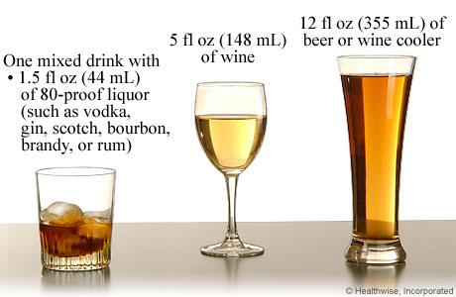
Alcohol serving sizes
Notes:
One drink is defined as 12 fl oz of beer or wine cooler, 5 fl oz of wine, or 1.5 fl oz of 80-proof spirits.
Photo courtesy of : myhealth.ucsd.edu

Slide 7
Benefits of moderate alcohol consumption
Increases HDL (good) cholesterol (~ 12%)
Resveratrol – prevents stickiness of platelets
  Decreases risk of a heart attack
  Reduces risk of diabetes
  Reduces risk of heart disease
  Lowers risk of dementia
  May prevent silent strokes
Notes:
The Benefit of Moderate Alcohol Consumption:
The best known effect of alcohol is a small increase in HDL (good) cholesterol (about 12%); however, regular physical activity is another way to raise HDL cholesterol levels. Reduced cholesterol helps in decreasing the amount of plaque build-up within the arteries; thus delaying the progression of atherosclerosis (which is caused by a build-up of fatty plaque within the arteries.) and heart disease. Reduced fat can also lead to reduced dementia and strokes. The phytonutrients in some alcoholic beverages such as red wine, resveratrol, can help reduce oxidative damage to nerve cells and delay and prevent dementia. It can prevent lipid accumulation in the arteries and therefore reduce strokes and heart disease.

Slide 8
Benefits of moderate alcohol consumption
Inhibits the constriction of the coronary arteries
  limits clot formation
  decreases levels of homocysteine
Lowers rate of obesity
Notes:
Alcohol Benefits (Cont’d) :
Alcohol or substances within some alcoholic beverages, such as Resveratrol, may prevent platelets in the blood for sticking to one another. This may reduce clot formation; thus decreasing the risk of a heart attack.
Alcohol may protect against heart attack by inhibiting the constriction of the coronary arteries, limiting clot formation (as stated above), and decreasing levels of homocysteine; which is an amino acid that is commonly linked to an increase in heart attack risk.
Moderate alcohol consumption has been shown to lead to a lower rate of obesity.

Slide 9
Benefits of moderate alcohol consumption
There is a change in biological markers for coronary heart disease.
Alcohol increased concentrations of high density lipoprotein cholesterol, apolipoprotein A I, and triglyceride.
A survey of research shows that an intake of 30 g of alcohol a day (two drinks) would cause an estimated reduction of 24.7% in risk of coronary heart disease.
Alcohol intake lowers the risk of coronary heart disease through changes in blood lipids and blood flow factors.
BMJ 1999;319:1523-1528
Notes:
In a study performed by the journal Addiction, 427 men who recently had a nonfatal heart attack were compared with 905 similar men who had never had a heart attack. The men who drank alcohol daily in the previous two years were 59% less likely to have a heart attack than lifelong abstainers. Those who drank alcohol less frequently, including those who drank less than once a week, also had a decreased risk of heart attack.

Slide 10

Benefits of moderate alcohol consumption
Men
  reduced risk of heart attack and heart disease
Women
  decreased risk of
  death from cardiovascular disease
Notes:
Men who drank two alcoholic drinks per day were fifty percent less likely to die of any cause over ten years, when compared to those who only drank once per week or less.
Women who drank alcohol about one to six drinks per week or less were twenty-eight percent less likely to die from any cause than those who drank alcohol less frequently. Women must be careful though, as alcohol may cause breast cancer.

Slide 11
Pattern of alcohol consumption is important
Small amount daily is associated with better health and increased longevity
Consuming seven to fourteen drinks once a week is associated with negative health (binge drinking).
Notes:
Simply looking at the total quantity of alcohol consumed over time obscures the importance of the pattern of alcohol consumption. One or two drinks each day is associated with better health and greater longevity whereas consuming the same quantity (seven to fourteen drinks) once a week is associated with negative health. The same quantity of alcohol can have either beneficial or harmful consequences depending on the pattern of its consumption.

Slide 12
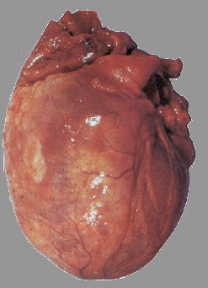
Harmful effects of alcohol
> 3 drinks = direct toxic effect on the heart
High intake of alcohol results in
  high blood pressure
  high triglyceride levels
  congestive heart failure
  alcoholic cardiomyopathy (enlarged and diseased heart)
  increased incidence of heart disease and stroke
Notes:
Drinking more than 3 drinks a day results in direct toxic effect on the heart since this is a larger load of alcohol than what most people can metabolize immediately. The toxic metabolic intermediates, acetaldehyde, builds in the blood and causes negative side effects. The negative side effects that result from high intake on alcohol are:
high blood pressure
high TG levels
heart disease
stroke
alcoholic cardiomyopathy (enlarged and diseased heart),
congestive heart failure
When acetaldehyde builds in the blood, it leads to increased free radical formation in the body and the negative changes seen due to high and/or chronic alcohol intake.

Slide 13

Binge Drinking
Binge drinking = more than 3 or 4 drinks in a short time.
Increases risk of:
  atrial fibrillation
  cardiac arrhythmia (irregular heart beat)
Notes:
Binge drinking places you at a higher risk of atrial fibrillation, a cardiac arrhythmia (irregular heart beat), that is usually fatal if left untreated.

Slide 14

Excessive alcohol intake
Can lead to:
weakening of heart muscle
hemorrhagic stroke
cirrhosis of the liver
pancreatitis
certain cancers
trauma
suicide
homicide
Notes:
Excessive alcohol intake is linked to the weakening of heart muscle, hemorrhagic stroke, cirrhosis of the liver, pancreatitis, certain cancers, trauma, suicide, and homicide. It also increases blood pressure, which may lead to heart failure. These changes are due to chronic high intake of alcohol and the resultant free radical formation and the damage to the cell structure from high level of free radicals. Long term heavy use of alcohol and the resulting free radical build up destroys the cerebellum of the brain, causing irreversible brain damage, impaired thinking, unsteady walk, or slowed speech.

Slide 15
Excessive alcohol intake
Long term excessive alcohol use:
  irreversible brain damage
  impaired thinking
  unsteady walk
  slowed speech
These results are irreversible even if a person discontinues alcohol consumption.

Slide 16
When not to consume alcohol
The American Heart Association recommends
that you do not consume alcohol if you have:
Personal or strong family history of alcoholism.
Uncontrolled high blood pressure
High blood triglyceride levels
Pancreatitis
Liver disease
Porphyria
Heart Failure
Pregnancy
Are using medications that can have adverse reactions with alcohol.
Notes:
The American Heart Association recommends
that you do not consume alcohol if you have:
Personal or strong family history of alcoholism.
Uncontrolled high blood pressure
High blood triglyceride levels
Pancreatitis
Liver disease
Porphyria (a defect of blood pigment metabolism in which porphyrins are produced in excess, are present in the blood, and are found in the urine.)
Heart Failure
Pregnancy
Are using meds that can have adverse reactions with alcohol.

Slide 17
Recommendations by the
American Heart Association
The American Heart Association recommends traditional methods for preventing heart disease. These include:
  Consuming a healthy diet
  Exercising
  Controlling blood cholesterol
  Remaining a healthy weight
  Controlling blood pressure within normal ranges

Slide 18
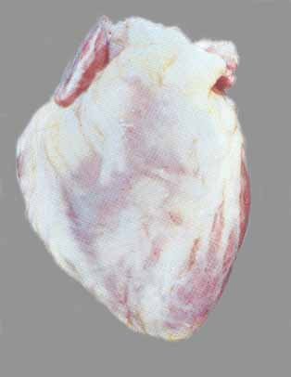
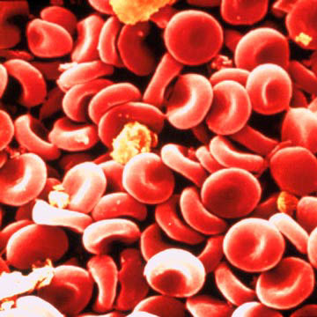
Normal Heart vs. Alcoholic Heart
The Enlarged Heart of an Alcoholic
A Normal Size Human Heart
Notes:
Notice how the alcoholics heart is much larger than the heart of a nonalcoholic. The alcoholic heart, though the muscle is relaxed, appears
as if it is full of blood and ready to burst, while the nonalcoholic’s heart appears to be more relaxed and less stressed.
Photos courtesy of:
http://www.womensheart.org/images/alcoholheart.gif

Slide 19

Pennington Biomedical Research Center
Authors:
Beth A. Kalicki
Heli J. Roy, RD, PhD
Division of Education
Phillip Brantley, PhD, Director
Pennington Biomedical Research Center
Steven Heymsfield, MD, Executive Director

Slide 20
About Pennington
The Pennington Biomedical Research Center is a world-renowned nutrition research center.
Mission:
To promote healthier lives through research and education in nutrition and preventive medicine.
The Pennington Center has several research areas, including:
Clinical Obesity Research
Experimental Obesity
Functional Foods
Health and Performance Enhancement
Nutrition and Chronic Diseases
Nutrition and the Brain
Dementia, Alzheimer’s and healthy aging
Diet, exercise, weight loss and weight loss maintenance
The research fostered in these areas can have a profound impact on healthy living and on the prevention of common chronic diseases, such as heart disease, cancer, diabetes, hypertension and osteoporosis.
The Division of Education provides education and information to the scientific community and the public about research findings, training programs and research areas, and coordinates educational events for the public on various health issues.
We invite people of all ages and backgrounds to participate in the exciting research studies being conducted at the Pennington Center in Baton Rouge, Louisiana. If you would like to take part, visit the clinical trials web page at www.pbrc.edu or call (225) 763-3000.

Slide 21

References
American Heart Association. (2009). Alcohol, Wine, and Cardiovascular Disease. Alcohol Cardiovascular Disease. Retrieved August 12, 2009, fromhttp://www.americanheart.org/
print_presenter.jhtml?identifier=4422
Johns Hopkins Medicine. (2005). Alcohol and Heart Attacks: Does a Drink a Day Lower Your Risk? Health Alerts. Retrieved August 12, 2009, from http://www.johnshopkinshealthalerts.com/reports/
heart_health/265-1.html?type=pf
Women’s Heart Foundation. (2007). Alcohol and Heart Disease. Heart Disease. Retrieved August 12, 2009, from
http://www.womensheart.com/content/HeartDisease/
alcohol_and_heart_disease.asp
Breslow, R.A., and Smothers, B.A. Drinking pattern and body mass index in never smokers: National Health Survey, 1997-2001. American Journal of Epidemiology, 2005, 161(4), 368-376.
Liu B, et al "Body mass index and risk of liver cirrhosis in middle aged UK women: prospective study" BMJ 2010; DOI: 10.1136
Wall TL, Carr CG, and Ehlers CL.Protective Association of Genetic Variation in Alcohol Dehydrogenase With Alcohol Dependence in Native American Mission Indians . Am J Psychiatry 160:41-46, January 2003.
Forn-Frías C, Sanchis-Segura C. The possible role of acetaldehyde in the brain damage caused by the chronic consumption of alcohol. Rev Neurol. 2003 Sep 1-15;37(5):485-93.
National Institute on Alcohol Abuse and Alcoholism. NIH. Alcohol Alert. No 72, July 2007.

