Slide 1
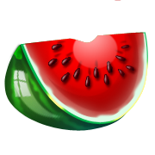

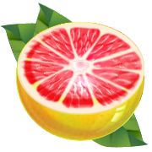
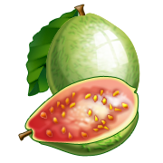
Vitamin C
Notes:
Say: Does anyone know anything about Vitamin C?
(Pause to let students speak)

Slide 2
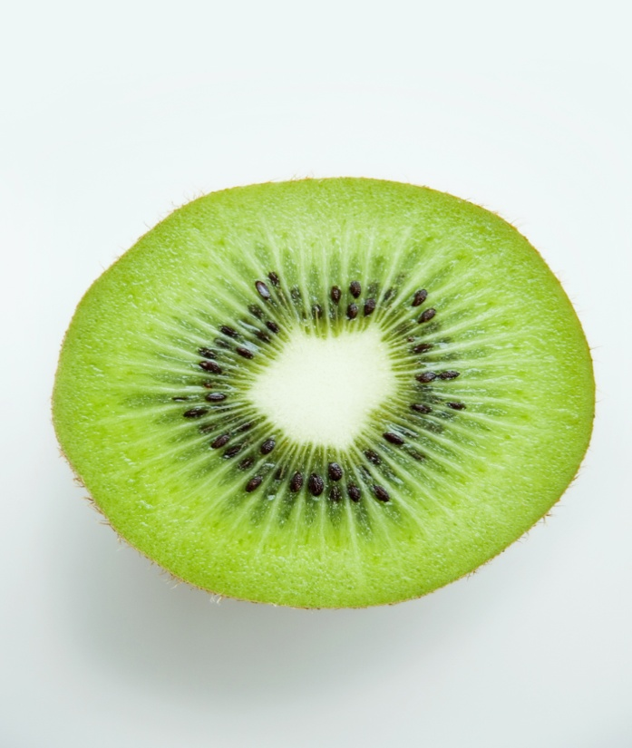
What is Vitamin C?
Vitamin C is a water soluble vitamin that is commonly found in fruits and vegetables.
Notes:
Say: Vitamin C is a water soluble vitamin commonly found in fruits and vegetables. The kiwi is one fruit in particular that contains high levels of Vitamin C.

Slide 3
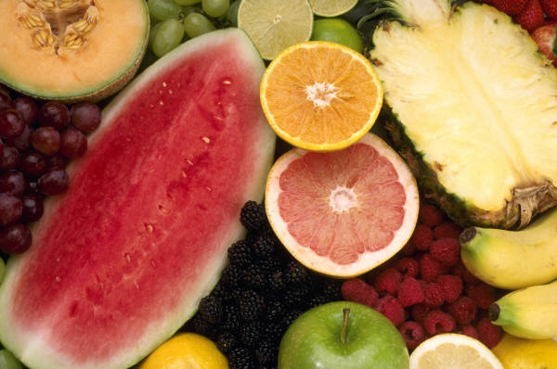
Where Does It Come From?
Kiwi
Oranges
Sweet potatoes
Lemons
Tomatoes
Strawberries
Turnip Greens
Broccoli
Red peppers
Cantaloupe
White potatoes
Papaya
Blueberries
Mango and many others
Notes:
Say: We are able to get Vitamin C through eating a variety of different fruits and vegetables. Some of the sources of Vitamin C include: Kiwi, oranges, sweet potatoes, lemons, tomatoes, strawberries, turnip greens, broccoli, red peppers, cantaloupe, white
potatoes, papaya, mango, winter squash, watermelon, Brussels sprouts, cauliflower, cabbage, raspberries, blueberries,
cranberries, and pineapples.

Slide 4



Why Do We Need It?
Vitamin C helps us:
Grow
Repair broken tissue when we get hurt
Make collagen – heal cuts and bones
Boost immunity
Notes:
Say: You may ask, why do we need Vitamin C? Does anyone know why Vitamin C is good for us?
(Allow students to respond)
Say: We should eat food containing Vitamin C every day. This valuable nutrient helps us grow and also aides in repairing tissues
when we get hurt. It is used to make collagen, a protein that is used by our skin, bones, blood vessels, and tendons. It even
helps to produce scar tissue when we get hurt or we have a cold.

Slide 5
What is Its Role in The Body?
Antioxidant
Decreasing the risk of certain conditions
Strengthen the immune system
Notes:
Say: You may be wondering what Vitamin C’s role in within your body. Does anyone have any ideas?
(Allow students to respond)
Say:
Vitamin C is an antioxidant, which helps protect the cells of our body from damage.
It can decrease the risk for conditions such as heart disease, stroke, cancer, cataracts, and gout; just to name a few.
Vitamin C can help to strengthen the immune system and prevent colds and flu.
How many of you get Vitamin C in your daily diet?
(Allow students to respond)

Slide 6
Recommendations for
Dietary Intake
Ages 4 to 8 : 15 mg/day
Ages 9 to 13: 25 mg/day
Females 14 to 18: 65 mg/day
Males 14 to 18: 75 mg/day
Females 19 < : 75 mg/day
Males 19 < : 90 mg/day
Source: American Dietetic Assoc.
Notes:
Say: Everyone should try to get the recommended amounts of Vitamin C within their daily diet. Children who are between the ages
of 4 and 8 should consume 15 milligrams per day. This is equivalent to about three or four average size strawberries. Those
who are between the ages of 9 and 13 should consume 25 milligrams per day. This is equal to half of a kiwi. Girls who are
between the ages of 14 and 18 should try to get about 65 milligrams daily, which is about a cups worth of cantaloupe cubes. Boys within this age group have an even greater requirement of 75 milligrams per day, which is equal to an orange. Women who are 19 and older should get 75 milligrams of Vitamin C, which is roughly a half a cup of broccoli. Men who are 19 and older need to consume 90 milligrams of Vitamin C per day, which is equal to a half cup of red sweet pepper.

Slide 7
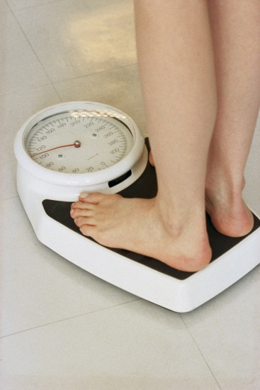
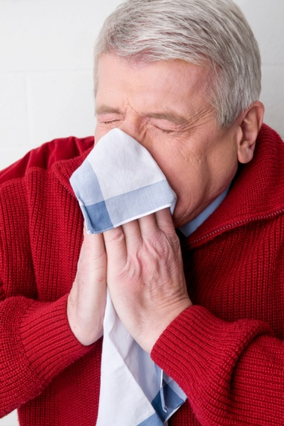
How Do I Know If I Might Not Be Getting Enough?
Some signs of deficiency:
Bleeding gums
Rough and dry skin
Slow healing when hurt
Easy bruising
Nosebleeds
Weight gain
Increased chance of infection
Notes:
Say: Since Vitamin C is readily available through common foods such as orange juice, fruits and vegetables, most people today do not experience Vitamin C deficiency. Vitamin C deficiency may occur only under strict dietary restrictions or certain medical conditions. In order to know whether or not you are getting enough Vitamin C in your diet, you may want to refer to these common symptoms. Some of these signs may also be associated with other deficiencies or ailments, so you may want to consult your
physician if many of them occur.
Signs of deficiency include:
Bleeding gums
Rough and dry skin
Slow healing when hurt
Easy bruising
Nosebleeds
Weight gain
Increased chance of infection

Slide 8

Mission:
To promote healthier lives through research and education in nutrition and preventive medicine.
The Pennington Center has several research areas, including:
Clinical Obesity Research
Experimental Obesity
Functional Foods
Health and Performance Enhancement
Nutrition and Chronic Diseases
Nutrition and the Brain
Dementia, Alzheimer’s and healthy aging
Diet, exercise, weight loss and weight loss maintenance
The research fostered in these areas can have a profound impact on healthy living and on the prevention of common chronic diseases, such as heart disease, cancer, diabetes, hypertension and osteoporosis.
The Division of Education provides education and information to the scientific community and the public about research findings, training programs and research areas, and coordinates educational events for the public on various health issues.
We invite people of all ages and backgrounds to participate in the exciting research studies being conducted at the
Pennington Center in Baton Rouge, Louisiana. If you would like to , visit the clinical trials web page at www.pbrc.edu or call (225) 763-3000.
Authors:
Heli Roy, PhD, RD
Beth Kalicki
Division of Education
Pennington Biomedical Research Center

