Slide 1
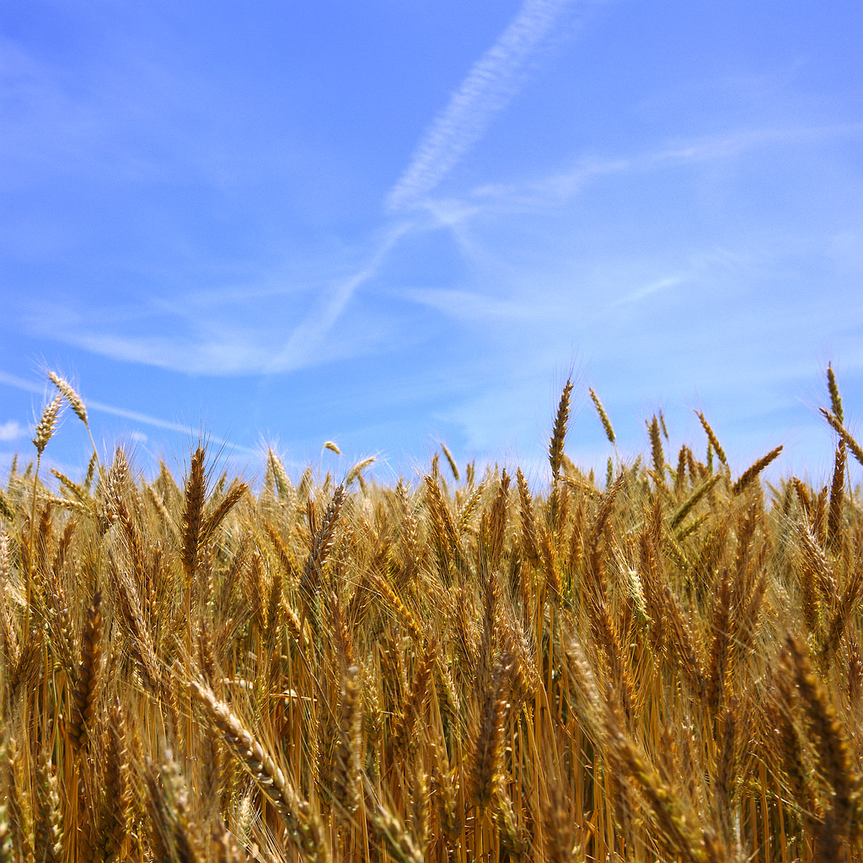
The Importance of
Whole Grains
Notes:
Say: Whole grains are important to us for a multitude of reasons. Does anyone have any ideas why they are beneficial?
(Allow students to respond)

Slide 2
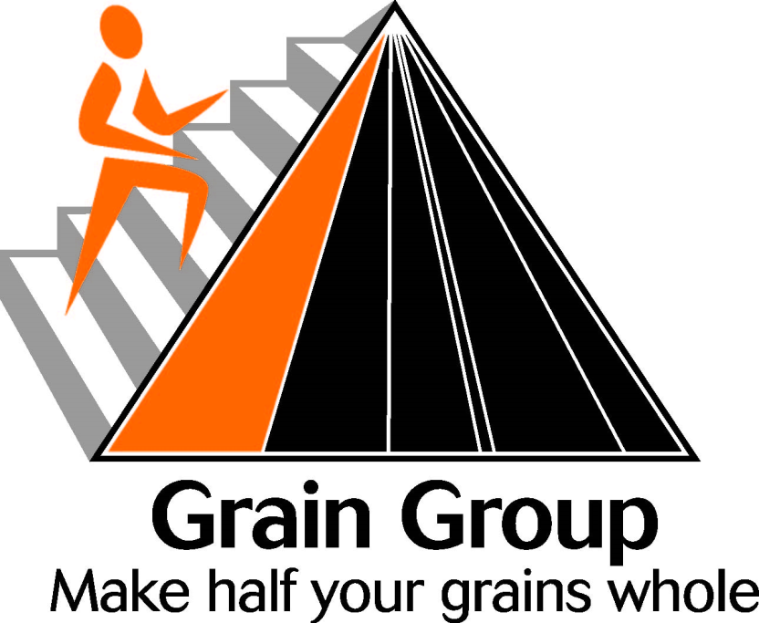
MyPyramid
Whole grains come from the Grain Group of MyPyramid.
Notes:
Say: Grains and whole grains belong to the Grain Group of MyPyramid. When it says Make half of your grains whole, it means to eat whole grain products such as brown rice, oatmeal, popcorn, and wheat bread.

Slide 3
Benefits
Energy
Reduce risk of disease
Antioxidant properties
Fiber
Helps control blood sugar
Weight control
Slows progression of atherosclerosis
Notes:
Say: Whole grains are one of the healthiest foods available. They give you energy for daily activities and reduce your risk of getting
many diseases as you age. Whole grains contain antioxidants, which help to protect you from the damaging effects of free
radicals. The fiber in whole grains helps your digestive system function better. Recent studies have shown that eating whole
grains can help to lower your risk of heart disease, cancer, or diabetes. Whole grains are also useful in controlling blood sugar
levels and weight. They can even slow the build-up of plaque within arteries, which could lead to atherosclerosis if left
untreated.

Slide 4
How Much Should I Have?
Consumption
Calorie Consumption per day | Amount of Grains per Calories Consumed | Amount of Grain that Should be Whole Grains
1400 to 1600 Calories | 5 ounces | 2.5 ounces
1800 to 2200 Calories | 6 to 7 ounces | 3 to 3.5 ounces
2400 Calories and Greater | 8 or more ounces | 4 or more ounces
Notes:
Say: Half of your grains consumed daily should be whole grains. The amount overall that you should have varies with your caloric
level. This is determined by the amount of calories you must consume in order to maintain a healthy weight.
Those who consume between 1400 and 1600 calories per day, should have about 5 ounces of grains, 2.5 ounces of which
should be whole grains, within their daily diet. People who have 1800 to 2200 calories per day, should have between 6 to 7
ounces of grains daily, with 3 to 3 ½ being whole grains. Finally, those who consume 2400 calories or greater per day should
have 8 or more ounces of grain daily, with 4 or more ounces being whole grains!

Slide 5

What is an Ounce of Grain?
The Following Each Count as 1 Ounce Equivalent of Grains:
½ cup cooked rice, pasta, or cooked cereal
1 slice of bread
1 small muffin
1 cup of ready to eat cereal flakes cereal
Notes:
Say: You may wonder, what is an ounce of grain? Does anyone have an idea?
(Allow students to respond and correct if necessary.)
Say: Some examples that count as 1 serving, at a 1 ounce equivalent, include: ½ cup of cooked rice/pasta/cooked cereal; 1 slice of
bread; 1 small muffin; 1 cup of ready to eat cereal flakes, cooked pasta, rice, or other grain.

Slide 6
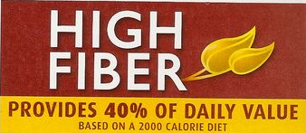
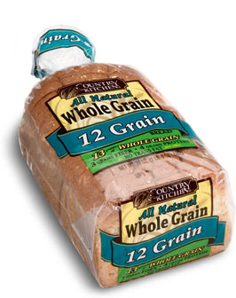
How Can I Tell if a Product is Whole Grain?
=
It is important to remember that just because it may state high fiber, it does not mean that it is whole grain.
When searching for whole grain foods, choose products that state they are “whole grain”.
Notes:
Say: It is important to remember that the label “high fiber” does not mean that it is whole grain. To determine whether a product is
whole grain, you should look at the ingredients label, and the first few ingredients should state “whole wheat” on the label.

Slide 7
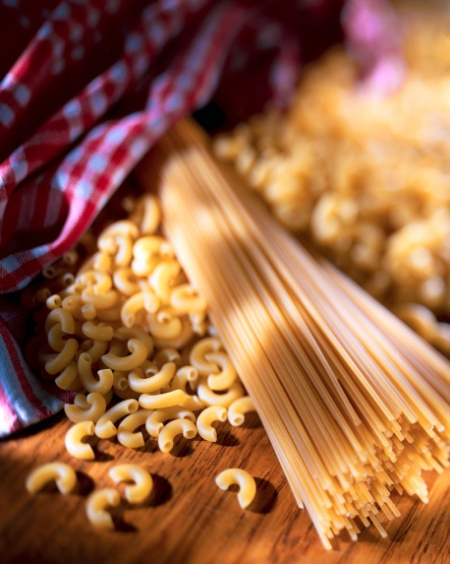
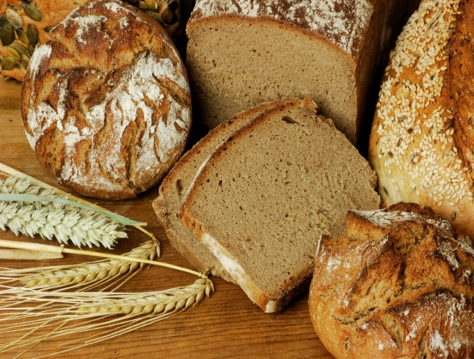

Examples of Whole Wheat
Products
Brown Rice
Oatmeal
Popcorn
Whole Wheat Breads and Pastas
Whole Grain Barley Products
Whole Grain Rye Products
Whole Grain Corn or Cornmeal Products
Notes:
Say: Some common examples of whole grain foods include: brown rice, oatmeal, popcorn, whole wheat breads and pastas, wild
rice, buckwheat products, products made with Whole grain barley, whole rye products, and whole grain corn or cornmeal.

Slide 8
Recap
Whole grains belong to the Grain Group of MyPyramid.
Whole grains give you many health benefits.
Half of your grains should be whole.
Look for the words ‘whole grain’ on the label.

Slide 9

Mission:
To promote healthier lives through research and education in nutrition and preventive medicine.
The Pennington Center has several research areas, including:
Clinical Obesity Research
Experimental Obesity
Functional Foods
Health and Performance Enhancement
Nutrition and Chronic Diseases
Nutrition and the Brain
Dementia, Alzheimer’s and healthy aging
Diet, exercise, weight loss and weight loss maintenance
The research fostered in these areas can have a profound impact on healthy living and on the prevention of common chronic diseases, such as heart disease, cancer, diabetes, hypertension and osteoporosis.
The Division of Education provides education and information to the scientific community and the public about research findings, training programs and research areas, and coordinates educational events for the public on various health issues.
We invite people of all ages and backgrounds to participate in the exciting research studies being conducted at the
Pennington Center in Baton Rouge, Louisiana. If you would like to take part, visit the clinical trials web page at www.pbrc.edu or call (225) 763-3000.
Authors:
Beth Kalicki
Heli Roy, PhD, RD
Division of Education
Pennington Biomedical Research Center
10/10

