Slide 1
The Importance of Dairy Products
Notes:
Say: Dairy products are important for building healthy bones and for maintaining a healthy weight. Dairy is also beneficial for your teeth and gums because it can reduce your risk for gum disease. Does anyone know some vitamins or minerals commonly associated with dairy products?

Slide 2
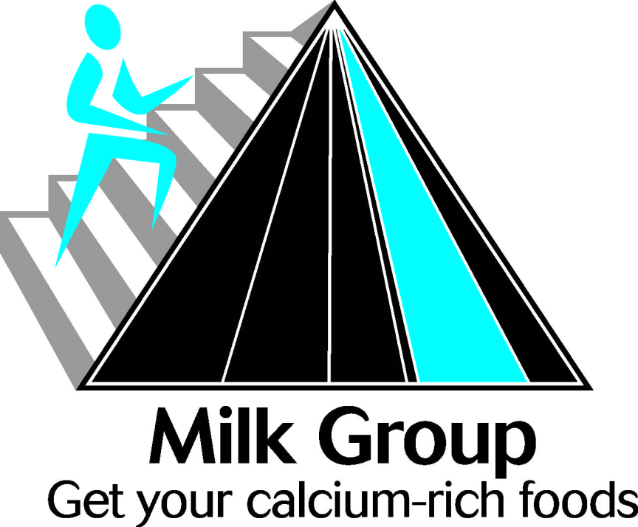
MyPyramid
All dairy products belong to the Milk Group of MyPyramid.
Notes:
Say: All dairy products belong to the Milk Group of MyPyramid. All milks, yogurts, frozen yogurts, dairy desserts, cheeses (except cream cheese), including lactose-free and lactose-reduced products. Most choices should be fat-free or low-fat. Calcium-fortified soy beverages are an option for those who want a non-dairy calcium source.

Slide 3
What Nutrients are Found in
Dairy Products?
Calcium
Vitamin D
Vitamin A
Magnesium
Zinc
Protein
Notes:
Say: We already heard about calcium, but dairy products have many other nutrients other than calcium. They have vitamin D, vitamin A, magnesium, zinc, and protein. All of which are necessary in our daily diet for us to have energy, to grow, and to fight infection.

Slide 4

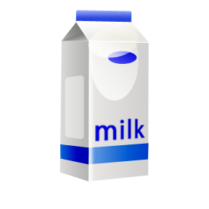

Calcium
We use the calcium that we get from dairy products to build our bones, help our blood clot, make sure our nerves work well, and help build strong muscles.
Notes:
Say: Calcium is important because our bodies use the calcium we get from dairy products to help build our bones, promote blood
clotting, make sure our nerves work well, and help to build strong muscles.

Slide 5
What if I am lactose intolerant?
If you are lactose intolerant, you can still have dairy foods like yogurt and cheese and milk where lactose is removed.
If you cut back on milk, you must make sure that you get enough calcium from other sources such as fruits and vegetables, nuts, and dried beans.
Notes:
Say: If you are lactose intolerant, this should still not prevent you from having select dairy foods like yogurt and cheese. Alternate
forms are available, such as soy milk and even almond milk. You must make sure that you get enough calcium from other
sources such as fruits and vegetables, nuts, and dried beans.

Slide 6
Other Ways to Get Calcium
Spinach
Turnip Greens
Broccoli
Dry Beans
Supplements
Notes:
Say: Green leafy vegetables, such as spinach, turnip greens, and broccoli are excellent sources of Calcium. Use these in addition to
dairy products to ensure that you have the recommended daily intake of Calcium. Calcium supplements can also be taken to
make sure that individuals get enough calcium every day.

Slide 7
How Much Should I Have?
Recommended Daily Allowance Of Calcium
Adults | 1200 milligrams
Children | 1300 milligrams
Notes:
Say: For adults, the recommended daily allowance of calcium is 1200 milligrams. For children, 1300 milligrams is recommended.
Just remember, one glass of milk has about 300 milligrams of Calcium.

Slide 8
Ways to Reach Your
1200 or 1300 a day!
Daily Total of Calcium Intake
Food | Milligrams of Calcium
1 pancake at breakfast | 100 milligrams
1 glass of milk at breakfast | 300 milligrams
1 sandwich with cheese at lunch | 200 milligrams
1 glass of milk at lunch | 300 milligrams
1 cup of ice cream for dessert | 200 milligrams
1 string cheese as a snack at night | 200 milligrams
Total | 1300 milligrams
Notes:
Say: Let’s look at a day’s food intake to see how we could get enough calcium in a day. Let’s say for breakfast you have one pancake (100 milligrams), you have 1 glass of milk with it (300 milligrams). You have already had 400 milligrams. If you have a sandwich with cheese for lunch (200 milligrams) and a glass of milk, (300 milligrams) you have had 900 milligrams already. If you then have 1 cup of ice cream (200 milligrams) when you get home from school, and then later 1 string cheese for snack, you have had a Total of 1300 milligrams a day. And that is listing only the

Slide 9

What are the Best Sources of Calcium?
200 mg/1 ounce
Milk
Cheese
300 mg/cup
Yogurt
90 mg/1 cup
Greens
400 mg/cup

Slide 10
Recap
Dairy products have many nutrients including calcium, protein, and other minerals.
Dairy products are the best sources of calcium.
If you are lactose intolerant, you can still consume dairy products, and there are vegetable sources that are high in calcium.
We should consume about 1300 mg of calcium/day.

Slide 11

Mission:
To promote healthier lives through research and education in nutrition and preventive medicine.
The Pennington Center has several research areas, including:
Clinical Obesity Research
Experimental Obesity
Functional Foods
Health and Performance Enhancement
Nutrition and Chronic Diseases
Nutrition and the Brain
Dementia, Alzheimer’s and healthy aging
Diet, exercise, weight loss and weight loss maintenance
The research fostered in these areas can have a profound impact on healthy living and on the prevention of common chronic diseases, such as heart disease, cancer, diabetes, hypertension and osteoporosis.
The Division of Education provides education and information to the scientific community and the public about research findings, training programs and research areas, and coordinates educational events for the public on various health issues.
We invite people of all ages and backgrounds to participate in the exciting research studies being conducted at the
Pennington Center in Baton Rouge, Louisiana. If you would like to learn more, visit the clinical trials web page at www.pbrc.edu or call (225) 763-3000.
Authors:
Heli Roy, PhD, RD
Beth Kalicki
Division of Education
Pennington Biomedical Research Center
10/10

