Slide 1

Healthier Diet for Young
Children

Slide 2
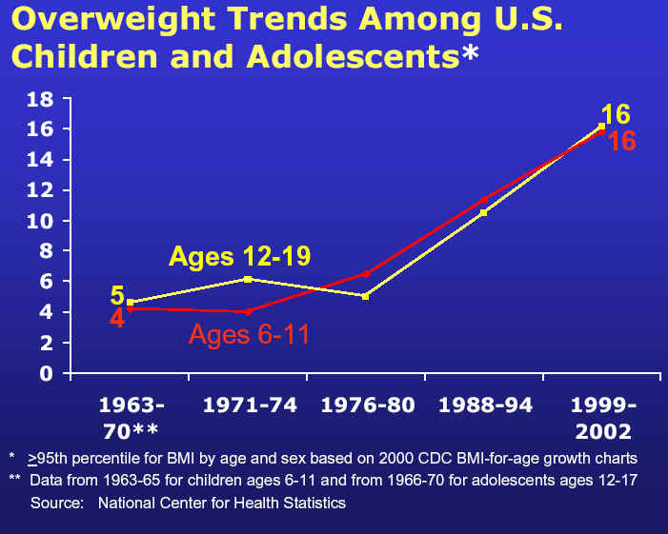
Overweight and Obesity in Children
Since 1980 the rates of obesity have doubled for children & tripled for teenagers.
More than 15% of all children 6 to 9 years of age are overweight.
Notes:
Say: Overweight and obesity in children have become the most prevalent nutritional problems in the United States. Since 1980, the rates have doubled for children and triples for teenagers. More than 15% of children ages 6 to 10 years old are overweight. More than 23% of African American and Mexican American teens are overweight.

Slide 3
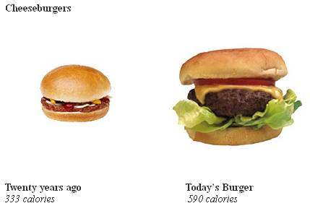
Reasons for Increased Obesity Rates
Increased availability of snack foods
Increased sitting time
  TV
  Videogames
  Phone
Larger portions
Eating out more
Lack of physical activity

Slide 4
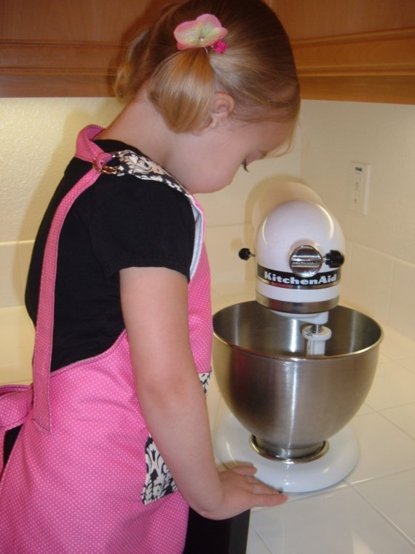
How to change eating behavior
Involve children in food preparation
Making healthy substitutions
Finding the right portion sizes
Offering healthy snack choices
Offering healthy meal choices
Increasing activity for the child and the family

Slide 5



Getting Kids Interested in Food and Meals
Involve you child
in the kitchen,
In meal planning, and
grocery shopping.
Grow a garden and allow your child to plant the seeds and attend to the plants as they grow.
Notes:
Say: To get children interested in food and meals, involve your child in the kitchen, in meal planning, and grocery shopping. Having children involved in meal preparation will increase the likelihood of them trying new foods. They will be interested in trying food they have helped buy and prepare. Bring them to farmer’s markets, fruit and vegetable stands and allow them to pick their own favorite vegetables and fruits to bring home.
Grow a garden and allow your child to plant the seeds and attend to the plants as they grow. Having hands-on experiences with a variety of fruits and vegetables will increase the likelihood that the child will eat it.

Slide 6
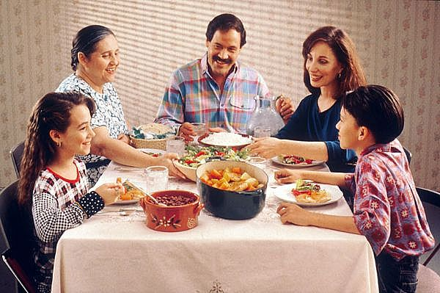
Set meal times
To cut down on constant snacking “grazing”, eat meals around the kitchen or dining room table at set times.
Give appropriate low calorie snacks between meals.
Notes:
To cut down on constant snacking, also known as grazing, eat meals around the kitchen or dining room table at set times. When preparing family meals, think about cutting down on fat and sugar and increasing fruits, vegetables, and fiber. Discourage eating between meals other than an arranged snack. Build a healthy 100 to 150 calorie snack between meals for active children. Children need a lot of energy for activity and they need energy to grow, so they should eat a meal every 3 to 4 hours and have a small snack between meals to keep them from getting too hungry.

Slide 7
Substitutions for Commonly
Used Foods
Instead of | Use
Butter, Margarine, or Cream Cheese | Light Butter, Light Margarine, or Light Cream Cheese
Mayonnaise | Low-fat or Fat Free Mayonnaise
Frying | Baking, Sautéing or Grilling
Whole Milk | Skim or Low-fat Milk
Cheese | Low-fat and Reduced-fat Cheese
Cookies | Animal Crackers, Vanilla Wafers, and Graham Crackers
Ice Cream | Fruit Bars, Low-fat Frozen Yogurt, Fruit Juice Popsicles
White Bread | Whole-wheat bread
Soda, Punch, Fruit Drinks, or Sports Drinks | Water and 100% Fruit Juice
Sugared Cereal | Whole-grain Cereal
Candy Bars, Chocolate | Dried Fruit, Fruit Cocktail, or Apple Sauces
Notes:
Say: Here are some suggestions for substitutions in meal planning and preparation. (Discuss Chart)
When it comes to making healthier choices for the whole family, there are many things that can be simultaneously. You can reduce the amount of fried foods that are prepared, you can change the cereal to whole grain and you can change the type of spread used on sandwiches to make the meals healthier. Everything counts and making leaner choices in food preparation, serving and what is offered can have a big impact on the total calories served in one day.

Slide 8
Meal Comparison
Typical daily meals
Healthy daily meals
Omelet, sausage, biscuits, and juice.
Bologna sandwich on white bread, soft drink and chips.
Fried chicken, coleslaw and French fries.
Whole grain cereal, skim milk, juice.
Turkey sandwich on whole wheat bread, baked chips and juice.
Baked chicken, brown rice, steamed broccoli and unsweetened tea with lemon.
2187 Calories, 131 grams of fat
1480 Calories, 17.5 grams of fat

Slide 9
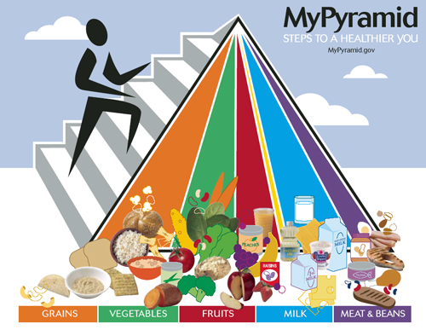

The MyPyramid
Notes:
Say: Let’s talk about how we can eat the Healthy Meals we just saw. USDA’s Dietary Guidelines for Americans are revised every 5 years. The latest guidelines are from 2005 and include a healthy meal plan fro everyone from age 2 on. It has recommendations on certain number of serving sizes of fruits and vegetables, grain, the amount of protein required based on calorie levels. The levels start at 1000 Calories, which is appropriate for children, and goes up to 3200 Calories for those that are very physically active every day.
Foods are grouped into: Fruits, Vegetables, Grains, Meat, Milk, Oils and Discretionary Calories. Depending on gender, age, activity level, and size, it can help determine the amount of food to include in a healthy meal every day from each of the major groups.

Slide 10

Using the Food Guide Pyramid
The Pyramid Food Groups and Serving Sizes
Food Group | Servings Recommended | Example of Serving Size
Bread, Cereal, Rice, and Pasta Group | 6 servings | 2 to 3 Tbsp of pasta, rice, macaroni, ¼ to ½ slice of bread, 1 to 2 graham crackers
Vegetable Group | 3 servings | 2 to 3 Tbsp of peas, corn, green beans, mashed potatoes, ½ cup of lettuce
Fruit Group | 2 servings | ¼ cup blueberries or raspberries, ½ cup of 100% citrus juice (orange), ½ medium orange, 4 to 6 medium strawberries, 1 medium tangerine, ½ cup of watermelon pieces, ½ of medium size apple/banana/peach/pear/ nectarine, 6 to 8 grapes, ½ cup of cut-up fresh/canned/cooked fruit
Milk Group | 2 servings | 1/4 to 1/3 cup of nonfat or low-fat milk, yogurt, pudding made with milk, 1/2 to 1/3 ounce of cheese
Meat Group | 2 servings | ½ to ¾ ounce of meat, chicken, or fish
Notes:
Say: The MyPyramid way of eating can be used to plan meals for the whole family, and can also be used to plan children’s meals. The only difference is, a child-sized serving is 1/4 to 1/3 of an adult serving size. Teenagers need full adult serving sizes. Another measure of food is to serve a tablespoon for each year of a child’s life. (Discuss Chart)

Slide 11

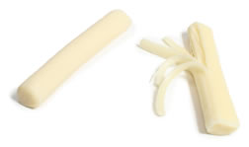
Snacking
Young children need more frequent meals than adults, and they need snacks between meals to support growth and development.
When snacks are planned, the child will be more likely to have a healthier snack
Notes:
Say: Snacks are an important part of a child’s diet. It is important to understand that young children need more frequent meals than adults, and they need snacks between meals to support growth and development. A mid-morning and mid-afternoon snack can increase a child’s intake of dairy, fruits, and vegetables. When the snacks are planned, the child will most likely have a healthier snack. Also, having snacks will cut down on the feeling of hunger and less likelihood of overeating at mealtimes by going for second helpings.

Slide 12
Healthy Snack Ideas
Milk
Low-fat Fruited Yogurt
String Cheese
Instant Pudding made with Non-fat Milk
Frozen Fruit Bars
Fresh Fruit
(Peeled and Cut up)
Fruit Juice
Individual Servings of Applesauce or Canned Fruit
Raisins
Dried Pineapple Rings
Cut-up Vegetables with Low-fat Salad Dressing
Baby Carrots
Graham Crackers
Pretzels
Dry Cereal
Vanilla Wafers
Animal Crackers
Soft Pretzels
Chicken Taco
Half of a Grilled Cheese Sandwich
Notes:
Say: These are some health snack ideas that meet the pyramid guidelines and are low in fat and sugar. (Discuss slide)

Slide 13
Healthy Breakfasts
Cereals Made From Whole Grains
All Bran or High Bran Cereals
Cheerios
Wheat Chex
Grape Nuts
Healthy Choice Toasted Brown Sugar Squares
Just Right with Fruit and Nuts
Kashi
Raisin Squares Mini-Wheats
Frosted Mini-Wheats (Reg. and Bite Size)
Muesli
Golden Wheat Nutri-Grain
Almond-Raisin Nutri-Grain
Almond Oatmeal Crisp
Apple Cinnamon Oatmeal Crisp
Raisin Oatmeal Crisp
Oatmeal Squares
Puffed Wheat
Shredded Wheat
Shredded Wheat and Bran
Frosted Shredded Wheat (reg. and spoon size)
Crispy ‘n’ Raisins Wheaties
100% Bran
Bran Buds All-Bran
Extra Fiber All-Bran
Original All-Bran
Bran Flakes
Multi-Bran Chex
Complete Wheat Bran Flakes
Complete Oat Bran Flakes
Fiber One
Oat Bran
Oat Bran Flakes
Oat Bran Flakes with Raisins
Organic Bran with Raisins
Raisin Bran
Raisin Bran Flakes
Whole Grain Wheat Raisin Bran
Raisin Bran Total
Notes:
Say: Cereal and milk with fruit on the side make a nutritious and filling breakfast. It is fast, nutritious, and easy to prepare. Just make sure the cereal is made from whole grains and does not have a lot of added sugar and salt. You can do that by checking the list of ingredients carefully. The FIRST ingredient on the label should be a whole grain. (Discuss cereals on the slide)

Slide 14

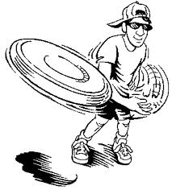
Increasing Activity
Limit TV and videogame times.
Provide equipment for outdoor activity: bikes, roller blades, balls, Frisbees and kites.
Include the whole family when taking bike rides, outings to the park, beach and mountains.
Arrange hiking trips.
Include the children when taking the dog for a walk.

Slide 15

Comprehensive Approach
A healthy lifestyle for children includes an appropriate amount of healthy, unprocessed foods and drinks, adequate amount of physical activity and limiting screen time.
  Children should engage in at least 60 minutes of physical activity on most, preferably all days of the week.
Set consistent patterns of being physically active and consume healthy foods as an example to your child.

Slide 16

Mission:
To promote healthier lives through research and education in nutrition and preventive medicine.
The Pennington Center has several research areas, including:
Clinical Obesity Research
Experimental Obesity
Functional Foods
Health and Performance Enhancement
Nutrition and Chronic Diseases
Nutrition and the Brain
Dementia, Alzheimer’s and healthy aging
Diet, exercise, weight loss and weight loss maintenance
The research fostered in these areas can have a profound impact on healthy living and on the prevention of common chronic diseases, such as heart disease, cancer, diabetes, hypertension and osteoporosis.
The Division of Education provides education and information to the scientific community and the public about research findings, training programs and research areas, and coordinates educational events for the public on various health issues.
We invite people of all ages and backgrounds to participate in the exciting research studies being conducted at the
Pennington Center in Baton Rouge, Louisiana. If you would like to learn more, visit the clinical trials web page at www.pbrc.edu or call (225) 763-3000.
Authors:
Beth Kalicki
Heli Roy, PhD, RD
Division of Education
Pennington Biomedical Research Center

