Slide 1
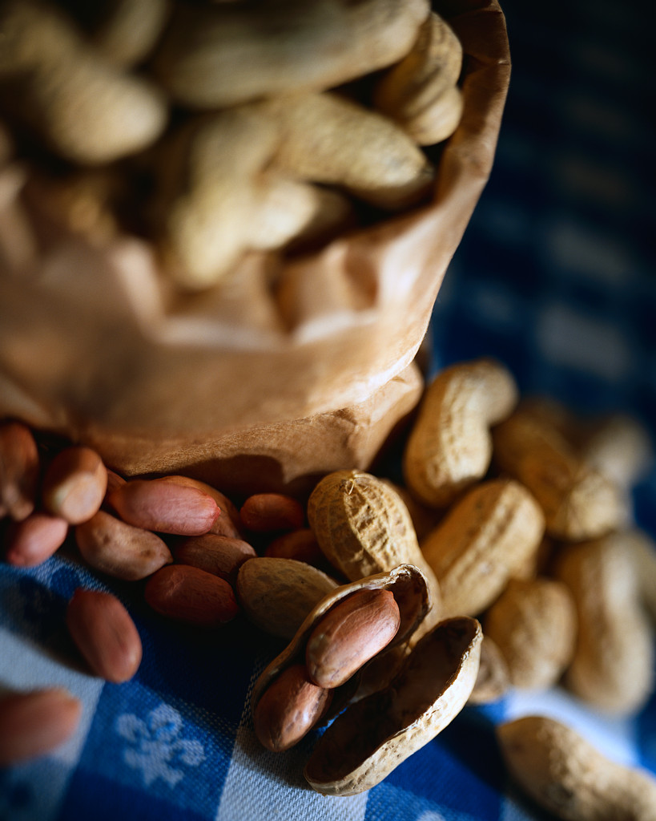
The Benefits of Nuts
Notes:
Say: Do you like peanuts, walnuts, or pecans? What about cashews or almonds?
(Allow students to respond)

Slide 2
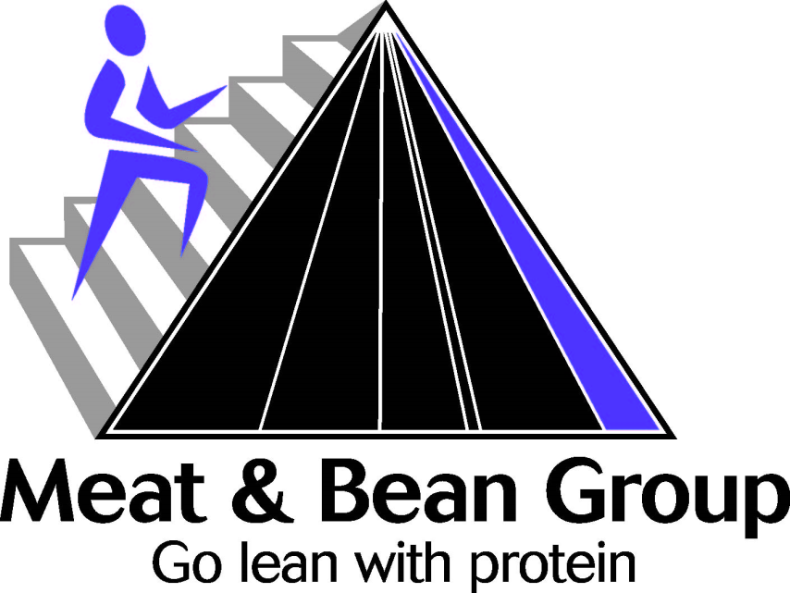
MyPyramid
Meat and beans - The following each count as 1 ounce-equivalent:
  1 ounce lean meat, poultry, or fish;
  1 egg;
  ¼ cup cooked dry beans or tofu;
  1 Tbsp peanut butter;
  ½ ounce nuts or seeds.
Notes:
Say: Where to nuts and seeds fall in MyPyramid? These foods belong to the meat and bean group of the food guide pyramid and they are very nutritious! We tend to forget that these can also be used as protein sources and in many vegetarian diets and meals, beans, nuts and seeds are an important source of protein.
Sunflower seeds, almonds, and hazelnuts (filberts) are the richest sources of vitamin E in this food group. To help meet vitamin E recommendations, make these your nut and seed choices more often.

Slide 3
Research Data
Eating nuts can lower your risk of having many serious health conditions as you get older such as a heart attack, stroke, memory loss, and gallstones.
If you eat nuts regularly, you may be able to postpone getting heart disease by months or years!
Notes:
Say: Ever wonder if you are getting beneficial nutrients while eating nuts?
(Pause to let students respond)
Say: Studies have proven that eating nuts can lower your risk of having a heart attack, stroke, memory loss, and gallstones. It is also noted that if you eat nuts regularly, you may be able to postpone getting heart disease by months or years!

Slide 4
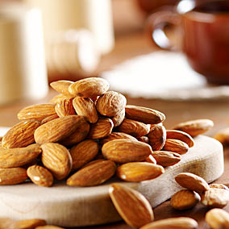
Almonds
Almonds are able to lower your bad cholesterol (LDL) levels. They have also been found to help satisfy hunger cravings.
Photo Courtesy of: http://www.lesliebeck.com
Notes:
Say: Almonds are able to lower your bad cholesterol (LDL) levels. They have also been found to help satisfy hunger cravings.

Slide 5
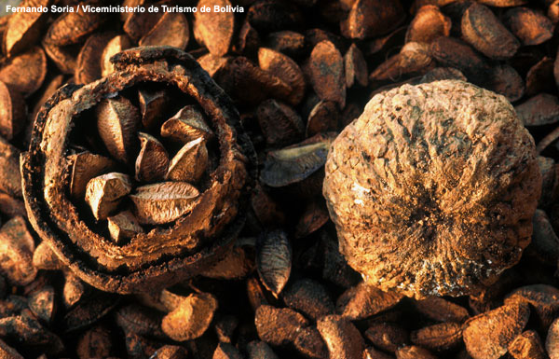
Brazil Nuts
Studies at the University of Illinois have shown that eating Brazil nuts can help in the prevention of different types of cancer.
Photo Courtesy of: http://www.amnh.org
Notes:
Say: Studies at the University of Illinois have shown that eating Brazil nuts can help in the prevention of different types of cancer.

Slide 6
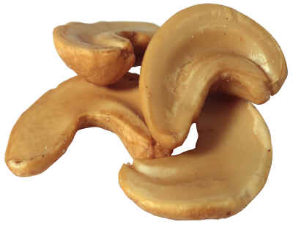
Cashews
Cashews provide a great source of iron, which helps maintain red blood cells. They also contain magnesium, which is needed for energy and bone growth. Cashews even contain phosphorus to help build bones and teeth, as well as zinc, which aides in digestion.
Photo Courtesy of: http://www.thenutfactory.com
Notes:
Say: Cashews provide a great source of iron, which helps maintain red blood cells. They also contain magnesium, which is needed for energy and bone growth. Cashews even contain phosphorus to help build bones and teeth, as well as zinc, which is needed for normal growth, for fighting infection and as an aide in digestion.

Slide 7
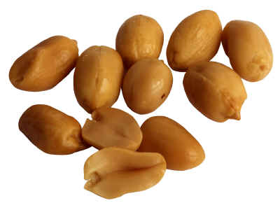
Peanuts
Peanuts are a great source monounsaturated fats, which help maintain heart health. Red skin peanuts have folate and resveratrol which protect the heart. They also contain fiber, Vitamin E, and several important minerals that help maintain healthy blood pressure.
Photo Courtesy of: http://www.thenutfactory.com
Notes:
Say: Peanuts are a very good source of monounsaturated fats, the type of fat that is emphasized in the heart-healthy Mediterranean diet. Studies of diets with a special emphasis on peanuts have shown that this little legume is a big ally for a healthy heart. In one such randomized, double-blind, cross-over study involving 22 subjects, a high monounsaturated diet that emphasized peanuts and peanut butter decreased cardiovascular disease risk by an estimated 21% compared to the average American diet.
In addition to their monounsaturated fat content, peanuts feature an array of other nutrients that, in numerous studies, have been shown to promote heart health. Peanuts are good sources of vitamin E, niacin, folate, protein and manganese. In addition, peanuts provide resveratrol, the phenolic antioxidant also found in red grapes and red wine that is thought to be responsible for the French paradox: the fact that in France, people consume a diet that is not low in fat, but have a lower risk of cardiovascular disease compared to the U.S. With all of the important nutrients provided by nuts like peanuts, it is no wonder that numerous research studies, including the Nurses' Health Study that involved over 86,000 women, have found that frequent nut consumption is related to reduced risk of cardiovascular disease. A number of studies have shown that nutrients found in peanuts, including folic acid, phytosterols, phytic acid (inositol hexaphosphate) and resveratrol, may have anti-cancer effects.

Slide 8
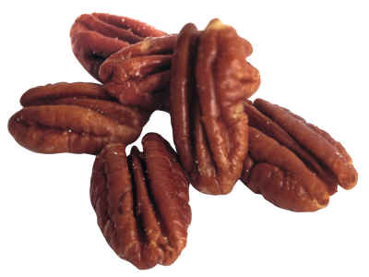
Pecans
Pecans are a good source of polyunsaturated fats, Vitamin E, fiber, folic acid, and several minerals such as manganese, magnesium, copper, phosphorus, potassium and zinc.
Photo Courtesy of: http://www.thenutfactory.com
Notes:
Say: One of the most significant facts of pecans nutrition is that these nuts are the best antioxidants. If you add a handful of pecan nuts to your daily diet, it will help your heart health. Pecan nut contains vitamin E which is a natural antioxidant that protects blood lipids from getting oxidized. No wonder, pecan nuts are topmost ranked nuts with highest antioxidant capacitance, among all the other nuts.
Another distinct factor of pecans nutrition is that they have cholesterol lowering properties. This is why pecans are called 'heart-healthy' nuts. The unsaturated fats in pecan help lower cholesterol. Sixty percent of the fat content in pecans is mono unsaturated and the leftover thirty percent is polyunsaturated. This means that the saturated fat content in pecan nuts is very low. Besides, pecans contain zero trans fats.
Research has also confirmed that pecan nuts help in weight loss. According to research, consumption of these nuts help in increasing the metabolic rate of the body and improves satiety.

Slide 9
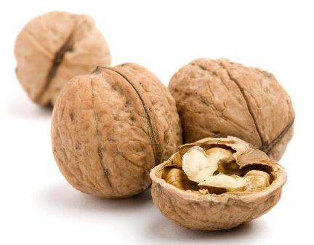
Walnuts
Walnuts have a lot of Omega-3 fatty acids, which promote overall health.
Photo Courtesy of: http://whatscookingamerica.net
Notes:
Say: Walnuts may be more beneficial that other nuts because they contain more Omega-3 fatty acids than other nuts, which promote overall good health and heart health in particular.

Slide 10

What Are The Benefits of
Consuming Nuts?
Cholesterol Levels
Preventing Heart Disease
Ability to be used as a substitute for dairy and meat products, as in the case of Veganism.
Photo Courtesy of: http://www.topnews.in
Notes:
Say: Nuts are very beneficial because they have the good kinds of fat, they don’t have any cholesterol, and they have many other nutrients that we need every day such as magnesium, zinc and iron. The great thing about nuts is also the fact that they are healthy and can be used as a meat substitute in vegetarian diets.

Slide 11
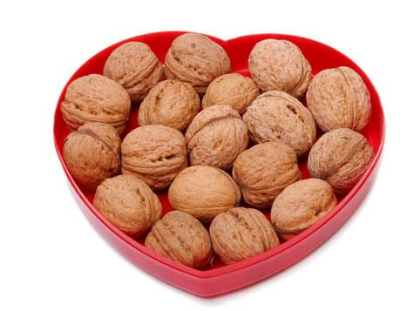
How Many Nuts Should
We Consume Per Day?
1 ounce of Nuts
It is recommended that we eat 30 to 60 grams (1 to 2 ounces) of nuts per day.
Photo Courtesy of: http://assets.kaboose.com
Notes:
Say: as a member of the Meat Group, we can eat nuts and seeds in place of meat at meals. The following each count as 1 ounce-equivalent of meat: 1 ounce lean meat, poultry, or fish; 1 egg; ¼ cup cooked dry beans or tofu; 1 Tbsp peanut butter; or ½ ounce nuts or seeds. This is about 12 almonds, 24 pistachios, or 7 walnut halves.

Slide 12
Recap
Nuts and seeds belong to the meat group in MyPyramid.
Nuts and seeds can be used as a meat substitute.
Nuts have good fats, many nutrients such as magnesium and zinc.
A portion size of nuts is one ounce.

Slide 13

Mission:
To promote healthier lives through research and education in nutrition and preventive medicine.
The Pennington Center has several research areas, including:
Clinical Obesity Research
Experimental Obesity
Functional Foods
Health and Performance Enhancement
Nutrition and Chronic Diseases
Nutrition and the Brain
Dementia, Alzheimer’s and healthy aging
Diet, exercise, weight loss and weight loss maintenance
The research fostered in these areas can have a profound impact on healthy living and on the prevention of common chronic diseases, such as heart disease, cancer, diabetes, hypertension and osteoporosis.
The Division of Education provides education and information to the scientific community and the public about research findings, training programs and research areas, and coordinates educational events for the public on various health issues.
We invite people of all ages and backgrounds to participate in the exciting research studies being conducted at the
Pennington Center in Baton Rouge, Louisiana. If you would like to take part, visit the clinical trials web page at www.pbrc.edu or call (225) 763-3000.
Authors:
Heli Roy, PhD, RD
Beth Kalicki
Division of Education
Pennington Biomedical Research Center
10/10

