Slide 1
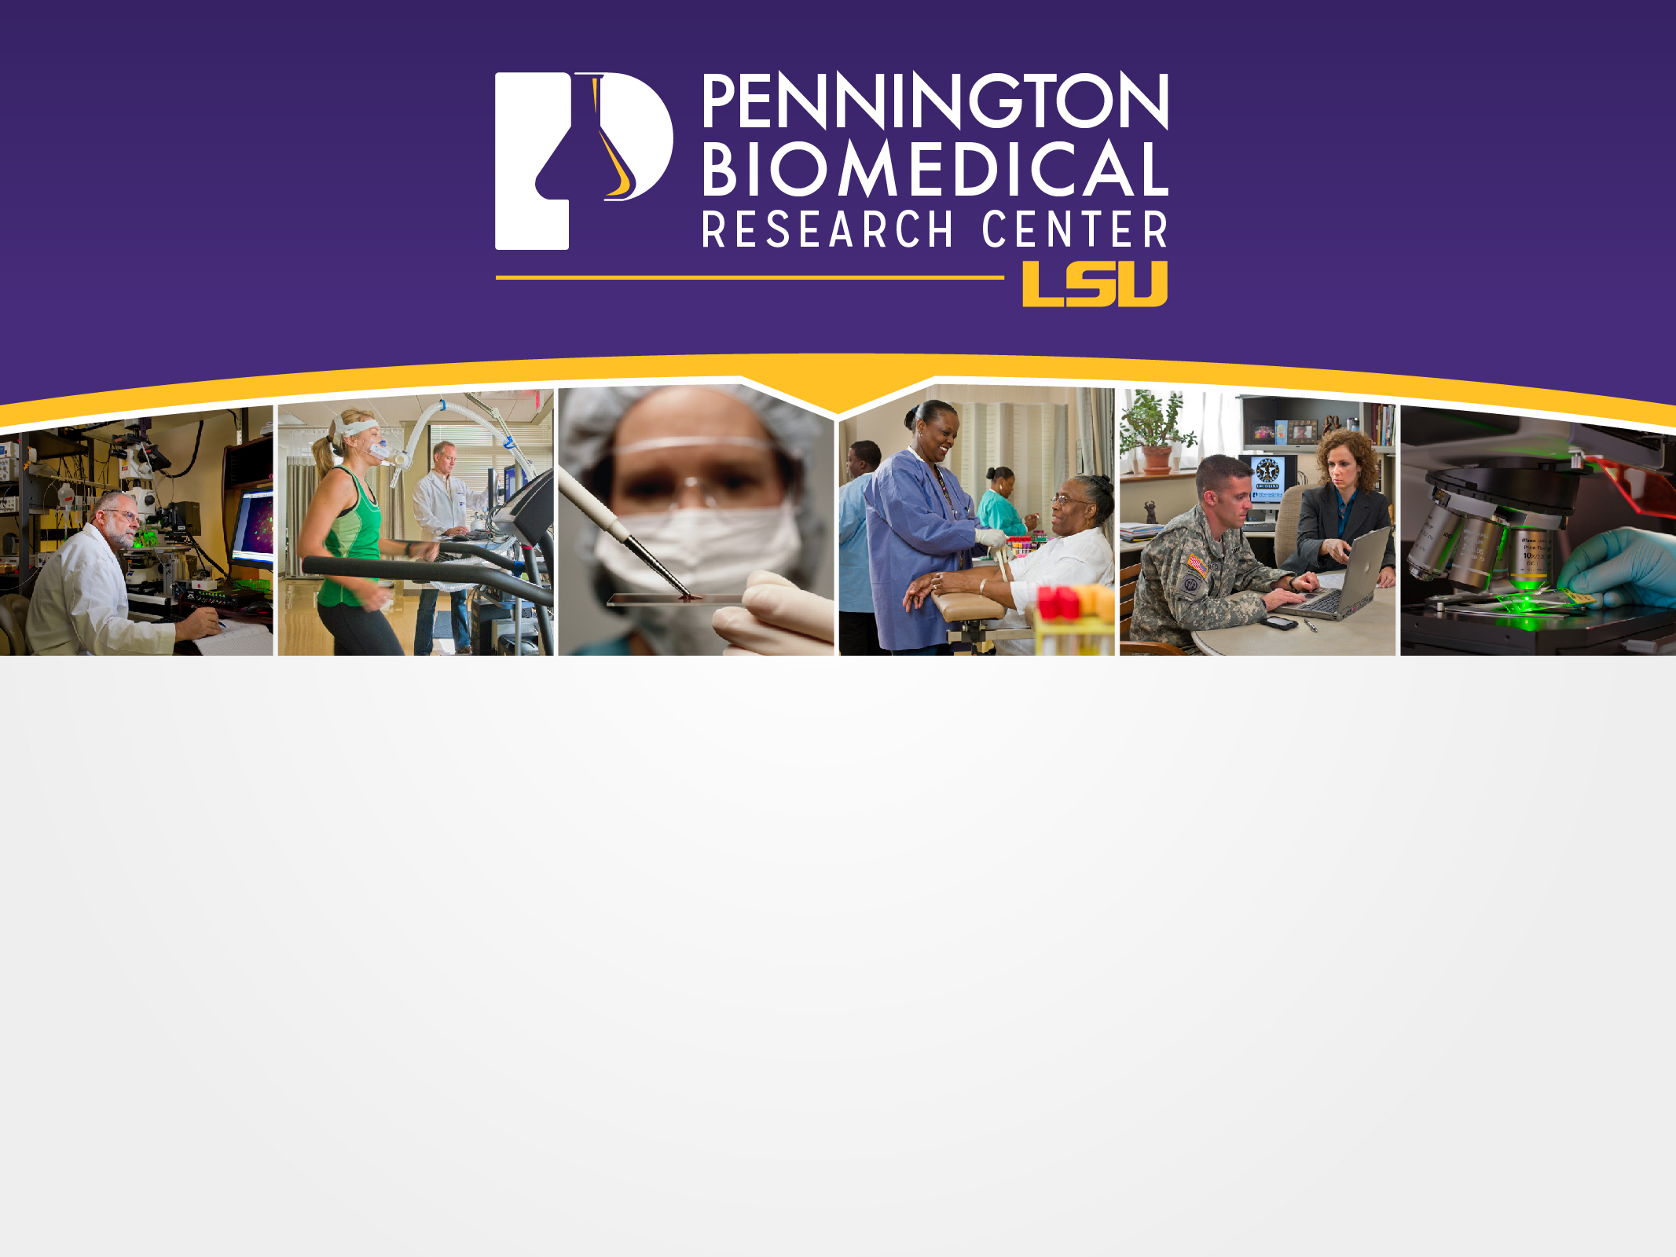
Superfoods For Women
Heli J. Roy, PhD, RD
Pennington Biomedical Research Center

Slide 2
What are Superfoods?
Superfoods provide a host of benefits to help us live longer, healthier lives. They are high in phytonutrients, chemicals that occur naturally in food. They protect against cancer, diabetes, heart disease and hypertension and may also boost your immune function and perhaps lower your risk for infection. Here are 10 superfoods that offer a good start to a balanced diet for women.

Slide 3
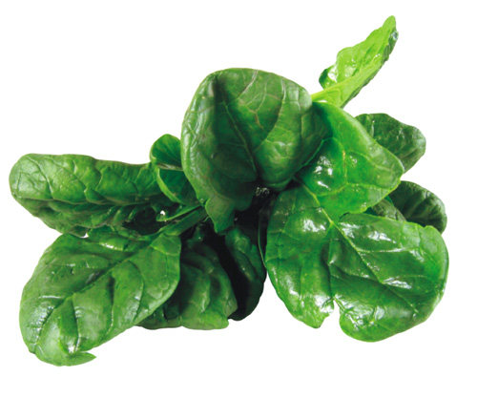
1. Green Leafy Vegetables
Prevents neural tube defect!
Notes:
Dark greens supply a significant amount of folate. Folate is a B vitamin that promotes heart health and helps prevent neural tube defects. Research also suggests that diets low in folate may increase the risk of cancers of the breast (particularly among women who drink alcohol), cervix and lung.

Slide 4
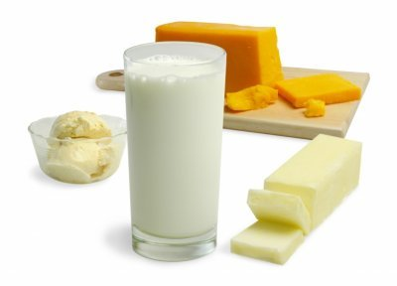
2. Dairy Products
Contains calcium!
Notes:
High blood pressure or hypertension is a common disorder affecting many Americans, both children and adults. Because of its high prevalence, serious health consequences, and economic burden, lifestyle changes, including dietary modifications, are recommended to help prevent and treat hypertension. Over the past decade, the importance of consuming a healthful diet containing three daily servings of low-fat or fat-free milk or equivalent milk products – as recommended in the 2005 Dietary Guidelines for Americans – has emerged as a potential effective strategy together with recommended lifestyle practices to help lower blood pressure.
The Dietary Approaches to Stop Hypertension (DASH) Trial demonstrated that a low-fat dietary pattern high in low-fat or fat-free dairy foods (two to three servings/day) and fruits and vegetables (eight to ten servings/day) – the so-called DASH dietary pattern – produced significant reductions in systolic and diastolic blood pressure in adults with pre-hypertension or hypertension. The blood pressure-lowering effect of the DASH dietary pattern was particularly effective for those with hypertension and African Americans, a group at high risk for hypertension. A number of health professional organizations, including the American Heart Association, support the DASH dietary pattern to help prevent and treat hypertension.
Experimental animal, in vitro, epidemiological, and clinical studies suggest a protective role for dairy foods and dairy food nutrients such as calcium and vitamin D in colorectal cancer.
The bone health advantage of food sources of calcium (primarily dairy products) compared to calcium supplements was recently demonstrated in a cross-sectional study of healthy postmenopausal women. Other recent studies support a favorable effect of dairy products on bone health. Researchers attribute this beneficial effect to many nutrients in milk (e.g., calcium, vitamin D, protein, phosphorus, magnesium, potassium, zinc, vitamins A, C, and K) that support bone health. A number of government and health professional organizations encourage three daily servings of dairy products for bone health.

Slide 5
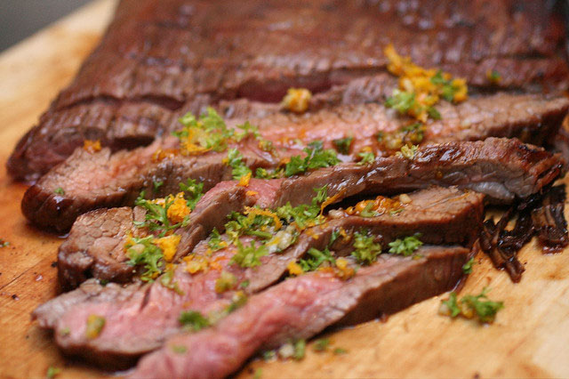
3. Lean Red Meat
Contains iron!
Thebittenword.com Flickr
Notes:
Iron is a mineral and is essential for good health and physical well-being. It is found in a variety of foods, including lean beef and lamb. The redder the meat, the higher the iron content.
Too little iron in the body can lead to low iron stores and iron deficiency known as anaemia: symptoms include tiredness, poor appetite, irritability, and a lower attention span. If you are constantly tired or think you may have iron deficiency anaemia, please consult your doctor. Quick Fact
A teenage girl's requirement increases during adolescence due to growth spurts and the onset of menstruation.
Iron has three main roles in the body:
To carry oxygen around the body in haemoglobin found in the blood
Ensures a healthy immune system. The cells that fight infection depend on adequate iron stores. If your iron levels are low, your body is prone to more infections
Iron is essential for the production of energy in the body from nutrients
Where there is an increased demand for iron: Women of child-bearing age
Babies - Iron stores in newborn babies begin to deplete between 4-6 months old
Toddlers - Young children undergo rapid growth and development, so extra iron is required
Boys - Adolescent growth spurts increase iron requirements
Girls - During puberty, especially after the onset of menstruation
Eat lean red meat 2-3 times per week to ensure the maximum absorption of haem ironEat plenty of vitamin C rich foods (like fruit and vegetables) to assist the body with the absorption of non-haem iron found in plant foods (vegetables, pasta, rice, cereals, bread, pulses, such peas, beans and lentils and fruit)Eat lean red meat and vegetables together. Eat a combination of red meat and plant foods. This will assist the body with the absorption of non-haem iron by up to four times

Slide 6

4. Whole Grains
Contains fiber and minerals.
Photo by mystuart Flickr
Notes:
Cardiovascular Disease
Eating whole instead of refined grains substantially lowers total cholesterol, low-density lipoprotein (LDL, or bad) cholesterol, triglycerides, and insulin levels. Any of these changes would be expected to reduce the risk for cardiovascular disease. In the Harvard-based Nurses' Health Study, women who ate 2 to 3 servings of whole-grain products (mostly bread and breakfast cereals) each day were 30 percent less likely to have a heart attack or die from heart disease over a 10-year period than women who ate less than 1 serving per week
Type 2 Diabetes
In a study of more than 160,000 women whose health and dietary habits were followed for up to 18 years, those who averaged 2 to 3 servings of whole grains a day were 30 percent less likely to have developed type 2 diabetes than those who rarely ate whole grains (3). When the researchers combined these results with those of several other large studies, they found that eating an extra 2 servings of whole grains a day decreased the risk of type 2 diabetes by 21 percent.
Cancer
The data on cancer are mixed, with some studies showing a protective effect and others showing none (4). A large, five-year study among nearly 500,000 men and women suggests that eating whole grains, but not dietary fiber, offers modest protection against colorectal cancer (5, 6).
Digestive Health
By keeping the stool soft and bulky, the fiber in whole grains helps prevent constipation, a common, costly, and aggravating problem. It also helps prevent diverticular disease (the development of tiny pouches inside the colon that are easily irritated and inflamed) by decreasing pressure in the intestines.
Staying Alive
An intriguing report from the Iowa Women's Health Study linked whole-grain consumption with fewer deaths from noncardiac, noncancer causes. Compared with women who rarely or never ate whole-grain foods, those who had at least two or more servings a day were 30 percent less likely to have died from an inflammation-related condition over a 17-year period (7).

Slide 7

5. Green Tea
Contains a powerful antioxidant EGCG.
Notes:
Drinking a cup of tea a few times a day to absorb antioxidants and other healthful plant compounds. In green-tea drinking cultures, the usual amount is three cups per day. Allow tea to steep for three to five minutes to bring out its catechins. The best way to get the catechins and other flavonoids in tea is to drink it freshly brewed.
Breast cancer. Clinical studies in animals and test tubes suggest that polyphenols in green tea inhibit the growth of breast cancer cells. In one study of 472 women with various stages of breast cancer, researchers found that women who consumed the most green tea experienced the least spread of cancer (particularly premenopausal women in the early stages of breast cancer). They also found that women with early stages of the disease who drank at least 5 cups of tea every day before being diagnosed with cancer were less likely to suffer recurrences of the disease after completion of treatment. However, women with late stages of breast cancer experienced little or no improvement from drinking green tea. In terms of breast cancer prevention, the studies are inconclusive. In one very large clinical study from Japan, researchers found that drinking green tea was not associated with a reduced risk of breast cancer.
Ovarian cancer. In a clinical study conducted on ovarian cancer patients in China, researchers found that women who drank at least one cup of green tea per day survived longer with the disease than those who didn’t drink green tea. In fact, those who drank the most tea, lived the longest.
Weight loss
Clinical studies suggest that green tea extract may boost metabolism and help burn fat. One study confirmed that the combination of green tea and caffeine improved weight loss and maintenance in overweight and moderately obese individuals. Some researchers speculate that substances in green tea known as polyphenols, specifically the catechins, are responsible for the herb's fat-burning effect.

Slide 8
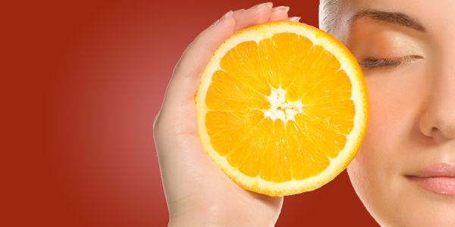
6. Orange Fruits and Vegetables
Loaded with Vitamin C and Beta-carotene.
Notes:
Orange fruits & vegetables also contain some other important nutrients and phytochemicals.
Orange fruits & vegetables are most well known for having lots of beta-carotene. Beta carotene is an antioxidant that is good for your whole body. It keeps the heart healthy and protects against cancer and other harmful diseases.
Beta carotene is also converted to Vitamin A in your body. Vitamin A is important for your vision, immune system and your skin.
Aside from helping your eyes, orange fruits and veggies are great for your skin and your general health. Beta carotene can prevent sun damage and Vitamin C rebuilds the skin. Vitamin C promotes and protects collagen. Collagen provides support and elasticity to your skin ... delaying the onset of wrinkles!

Slide 9

7. Seafood
Reduces heart disease.
Notes:
Scientific research is clear about the positive effects that omega-3 fatty acids have on the risk of heart attacks, strokes, kidney disorders, Alzheimer’s disease, certain cancers, rheumatoid arthritis, type-2 diabetes, low birth weight, post-partum depression, and pre-term delivery.
Beyond omega-3s, fish also offers consumers an excellent source of protein, Vitamin B12, potassium, selenium, and, in some seafood varieties, iron. (Prenatal vitamins all contain generous amounts of VitaminB12 because it is so vital for fetal brain and nervous-system development.) B12 is also necessary for adults to maintain healthy nerve cells and red blood cells. Potassium is key for its benefits to muscle and nerve function and helps lower the risk for high blood pressure. Selenium, an antioxidant, helps guard against heart disease and boosts the immune system.
Nonetheless, some large long-lived fish contain high levels of a form of mercury called methyl mercury that may potentially harm an unborn baby's developing nervous system. The FDA advises that pregnant women, women who may become pregnant, nursing mothers, and young children should avoid eating shark, swordfish, king mackerel and tilefish due to high levels of mercury in these fish.

Slide 10
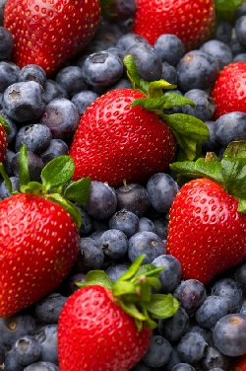
8. Berries and Cherries
Contains anthocyanins, strong antioxidants.
Notes:
Concentrated cranberries, blueberries and bilberries provide an antioxidant boost and dietary support for urinary health. Cranberries or prevent urinary tract infection, blueberries to protect against Alzheimer's, strawberries to lower your blood pressure, black raspberries to ward off cancer. Sounds like you'll be running marathons at if you could just manage to eat a big bowl of berries every day. Perhaps.

Slide 11
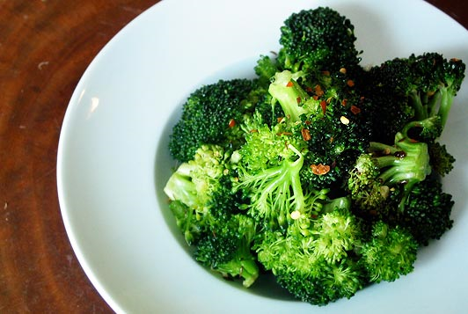
9. Cruciferous Vegetables
Eliminates free radicals!
Notes:
Nutrition experts often refer to brassica vegetables as "functional foods." Functional foods are foods that have benefits beyond basic nutrition - for instance, health benefits such as preventing certain diseases. Like all vegetables, crucifers possess high levels of antioxidants, including vitamin C, vitamin A, calcium, iron, folate, soluble fibre, and lignans. All these compounds may help reduce the risk of cardiovascular disease, since studies show that crucifers reduce plasma homocysteine levels, and higher homocysteine levels increase the risk for heart disease. Additionally, because of the high amount of calcium found in crucifers (especially kale, Chinese cabbage, and broccoli), they protect bone density and may help prevent the onset of osteoporosis, particularly in women.
Researchers found that among more than 6,000 Chinese women, those with the highest intake of cruciferous vegetables had a somewhat lower risk of postmenopausal breast cancer than those with the lowest intake.

Slide 12
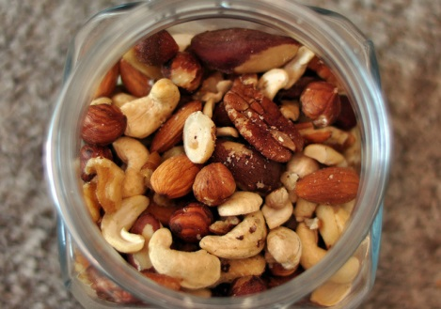
10. Nuts
Nuts are excellent in reducing LDL (bad cholesterol).
Picture by Adam Wyles Flickr
Notes:
Diabetes
Women in a Harvard School of Public Health study who reported eating 5 or more 1 ounce servings of nuts/peanuts per week reduced their risk of Type 2 diabetes by almost 30 percent compared to those who rarely or never ate nuts. Women in the study who ate five tablespoons of peanut butter each week reduced their risk for Type 2 diabetes almost 20 percent. (Journal of the American Medical Association, Nov. 27, 2002.)
It is also important for women to increase intake of foods that help with cholesterol control as we age to reduce the risk for heart disease as women move past the menopause years.
Heart Disease
Several research studies have shown that total and LDL cholesterol are reduced with a small intake of nuts without additional gain in weight. Nuts provide healthy monounsaturated and polyunsaturated fatty acids that have shown to reduce cholesterol.

Slide 13
Where can you find these superfoods?
They are available at local supermarkets, served at local restaurants, and they are easy to grow in a garden. Since superfoods are easy to find, they can be added to your daily diet.
Just think about adding color and variety consistently to meals, and you will be adding many of the important chemicals that are in superfoods!
Do it for you!

Slide 14
