Slide 1
Superfoods for Men
Heli J. Roy, PhD, RD
Pennington Biomedical Research Center

Slide 2
What are superfoods?
Superfoods provide a host of benefits to help us live longer, healthier lives. They are high in phytonutrients, chemicals that occur naturally in food. They protect against cancer, diabetes, heart disease and hypertension and may also boost your immune function and perhaps lower your risk for infection. Here are 10 superfoods that offer a good start to a balanced diet for men.

Slide 3
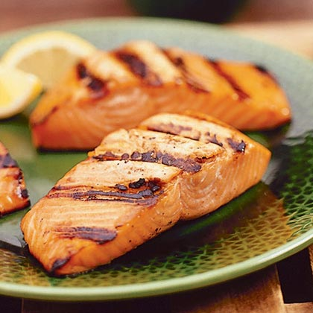
1. Seafood
Contains heart healthy omega-3 fatty acids!
Notes:
Cold water fish has omega-3 fatty acids which are good for you. Omega-3 fatty acids make blood vessel walls more pliable and this helps in preventing high blood pressure and stroke. More pliable cell walls also help in preventing diabetes because insulin and glucose can get in and out of cells better and faster.
Benefits of a seafood rich diet
Reduces the risk of heart disease
May prolong life after a heart attack
Lowers blood triglycerides (fats)
May improve heart function and reduce damage from heart disease
Can lower blood pressure
May improve symptoms of inflammatory diseases, arthritis and psoriasis
Nutrition from Seafood Seafood is a rich source of protein, vitamins, and minerals; many varieties of seafood are also low in sodium and cholesterol.
Not only is seafood delicious, but it's nutritious as well. It's a delightful addition to any meal and is an excellent, low-calorie source of many essential nutrients.
Seafood contains about twenty percent of the high quality proteins of red meat and poultry. It is also low in fat and most of the fat it has is poly-unsaturated.
Because many diets now specify poly-unsaturated fat, rather than saturated fat, fish and shellfish make excellent main dishes. Some fish are relatively high in fat such as salmon, mackerel and catfish. However, the fat is primarily unsaturated.
Cholesterol The cholesterol content of most fish is similar to red meat and poultry, about twenty milligrams per ounce. Some shellfish contain more cholesterol than red meat. However, the fat is mainly poly -unsaturated, shellfish may be allowed for some fat and cholesterol-restricted diets.
Vitamin source Fish is also a good source of "B" Vitamins "B-6", "B-12", biotin and niacin. Vitamin A" is found mainly in fish liver oils, but some high fat fish are good sources of Vitamin "A".
Mineral source Fish is a good source of several minerals, especially iron, phosphorus, potassium and zinc. Canned fish with edible bones, such as salmon or sardines, are also rich in calcium.

Slide 4
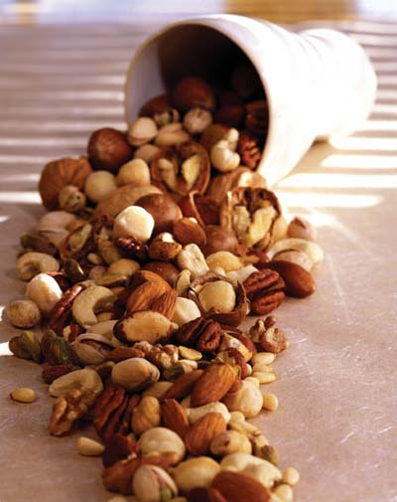
2. Nuts
Nuts are excellent in reducing LDL (bad cholesterol).
Notes:
Nuts have fiber and monounsaturated fats which help in cholesterol control. Although nuts are high in fat, they have the good kinds of fats that can actually help the bloodstream get rid of cholesterol.
Heart Health
In 2003, the U.S. Food and Drug Administration (FDA) approved this package label "qualified" health claim for nuts:
“Scientific evidence suggests but does not prove that eating 1.5 ounces per day of most nuts, as part of a diet low in saturated fat and cholesterol, may reduce the risk of heart disease.”
A "qualified" health claim means FDA evaluated the data and determined "though there is scientific evidence to support this claim, the evidence is not conclusive." A qualified health claim is issued by FDA when it is determined that consumers will benefit from more information on a dietary supplement or conventional food label concerning diet and health even though the claim is based on "somewhat settled science rather than just on the standard of significant scientific agreement, as long as the claims do not mislead the consumers." For more information about qualified health claims, go to: www.cfsan.fda.gov/~dms/labqhcqa.html
According to FDA, "Types of nuts eligible for this claim are restricted to almonds, hazelnuts, peanuts, pecans, some pine nuts, pistachio nuts and walnuts. Types of nuts on which the health claim may be placed is restricted to those nuts that were specifically included in the health claim petition, but that do not exceed 4 g saturated fat per 50 g of nuts."
Though nuts are a higher-fat food, it is mostly heart-healthy unsaturated fat and may help lower low-density lipoproteins (LDL or "bad" cholesterol).
Nuts also are recommended as part of the DASH diet (Dietary Approaches to Stop Hypertension), a dietary plan clinically proven to significantly reduce blood pressure. The DASH diet is supported by the National Heart, Lung, and Blood Institute and recommends 4 to 5 servings per week from its "nuts, seeds and legumes" grouping.
Weight Control
Researchers at Brigham and Women's Hospital and the Harvard School of Public Health found three times as many people trying to lose weight were able to stick to a Mediterranean-style moderate-fat weight loss diet that included nuts, peanuts and peanut butter versus the traditionally recommended low-fat diet. (International Journal of Obesity, Oct. 5, 2001).
As long as you control total calories, eating a handful of nuts daily may help prevent weight gain and possibly promote weight loss. The fat, protein and fiber in nuts help you feel full longer, so you may eat less during the day. By helping induce a feeling of satiety, nuts may help people feel less deprived and not like they're "dieting." Just limit your portion to a healthy handful.

Slide 5
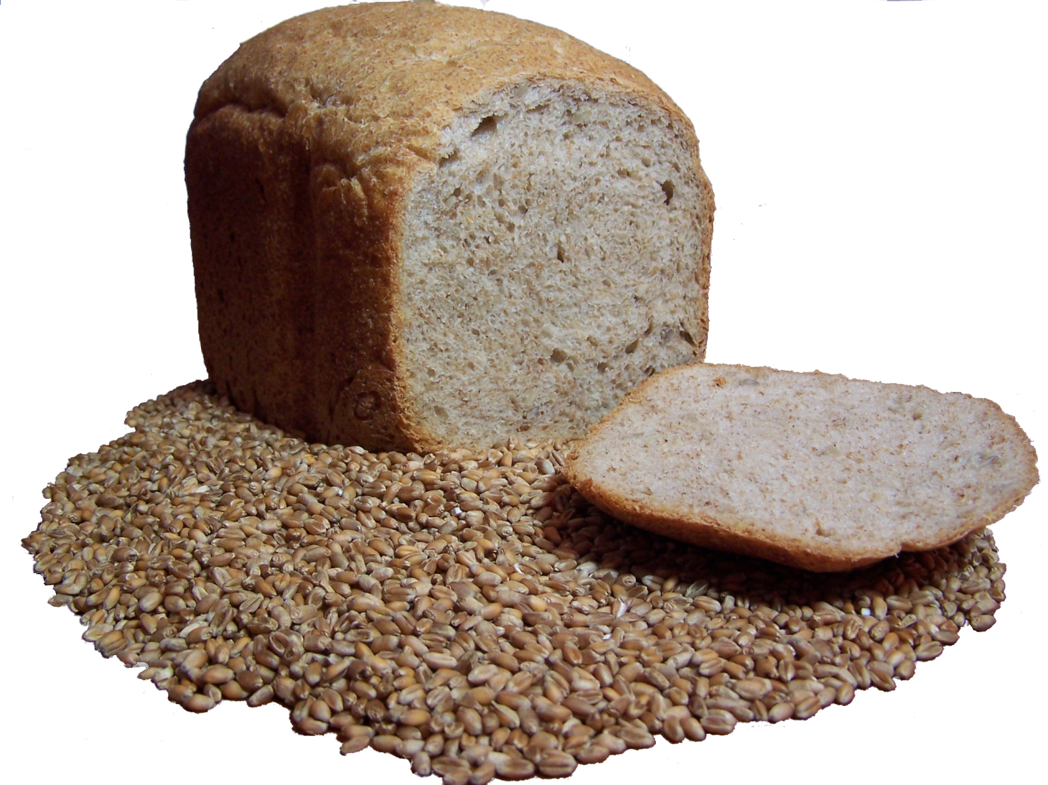
3. Whole Grains
Whole grains provide many vitamins and minerals as well as fiber.
Notes:
Wheat and grains have gotten a bad rap in the last few years, but they are actually very good for you. Whole grains are excellent sources of fiber, some of the best sources of fiber as a matter of fact. Whole wheat bread has twice the fiber of white bread (1.9 grams vs 0.6 grams). Whole grains have both soluble and insoluble fiber. Insoluble fiber is good for your intestinal track and for moving waste out. Insoluble fiber is found in foods such as brown rice, popcorn, and whole grain breads, pasta and cereals. It provides bulk to stools and helps to prevent constipation, hemorrhoids and diverticulosis. It is also protective against colon cancer. Soluble fiber is found in oatmeal, barley and rye. It helps to lower cholesterol and reduces the risk of heart disease and stroke. Soluble fiber can also slow the absorption of glucose, which is beneficial in stabilizing blood sugar.
What makes a whole grain whole? Grains are made up of three parts: bran, germ and endosperm.
The bran is the outer shell that provides a rich source of fiber, trace minerals, phytochemicals and B vitamins.
The germ nourishes the grain and is packed with antioxidants, the B vitamins and vitamin E. It is also a source of heart healthy unsaturated fats.
Finally, the endosperm is the largest portion of the grain and contains complex carbohydrates and protein to provide energy.
How to know if a food is made from whole grains
Read the ingredient list. Look for foods that list a whole grain as the first ingredient.
Check the Dietary Fiber content on the Nutrition Facts. If a product has a minimum of 2 grams of fiber per serving, then it is likely a whole grain product.
Another clue is to look for products that carry the FDA-regulated health claim: “Diets rich in whole grains and other plant foods and low in fat, saturated fat and cholesterol may reduce the risk of heart disease and some cancers.”
Look past the color of the product. Brown bread does not mean whole grain bread. Breads and other products can be colored using ingredients like molasses or food colorings.

Slide 6
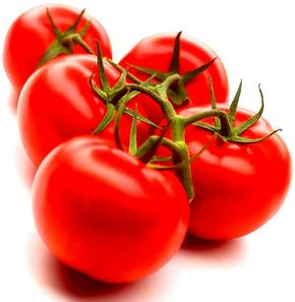
4. Tomatoes
Tomatoes are the best source of lycopene which is linked to reduced risk of prostate cancer.
Notes:
Tomatoes are excellent in terms of the nutrients they offer. They are a good source of Vitamin E (Alpha Tocopherol), Thiamin, Niacin, Vitamin B6, Folate, Magnesium, Phosphorus and Copper, and a very good source of Dietary Fiber, Vitamin A, Vitamin C, Vitamin K, Potassium and Manganese.
Tomatoes are a source of lycopene, a valuable nutrient. In laboratory studies, lycopene stands out as a potent weapon against cancer. As one of the carotenoid phytochemicals (related to beta-carotene), lycopene seems to protect our cells’ DNA with its strong antioxidant power and its ability to stimulate enzymes that deactivate carcinogens before they can get cancer started.
Lycopene is found in several reddish fruits and vegetables, including red and pink grapefruit, guava and watermelon. But tomatoes provide by far the majority of most Americans’ lycopene intake, and studies evaluating lycopene consumption almost always mean tomato consumption.

Slide 7
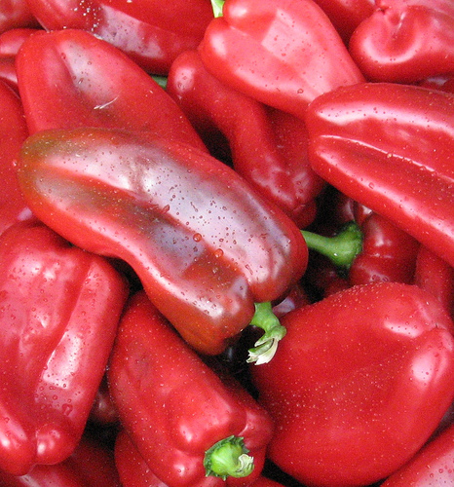
5. Red and Orange Vegetables
Loaded with Vitamin C and Beta-carotene

Slide 8
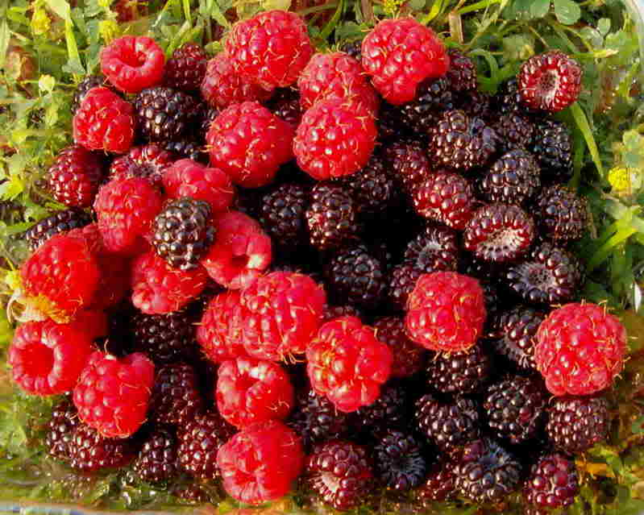
6. Berries and Cherries
Contains anthocyanins and vitamin C, strong antioxidants.
Notes:
If you have ever had the pleasure of picking berries right from a garden or gathering wild berries in the woods, you already know how wonderful fresh berries are. Most berries are naturally sweet and require little effort to prepare. Just rinse them under water and serve for a nutritious snack or dessert.
One cup of strawberries contains over 100 mg of vitamin C, almost as much as a cup of orange juice. We need vitamin C for immune system function and for strong connective tissue. Strawberries also add a bit of calcium, magnesium, folate and potassium and only 53 calories.
One cup of blueberries offers a smaller amount of vitamin C, minerals and phytochemicals for only 83 calories. The same amount of cranberries is similar, but with only 44 calories, 1 cup of raspberries offers vitamin C and potassium for 64 calories.
You can choose other berries with similar nutrition, such as loganberries, currants, gooseberries, lingonberries and bilberries.
More Than Pretty Colors
The pigments that give berries their beautiful blue and red hues are also good for your health. Berries contain phytochemicals and flavonoids that may help to prevent some forms of cancer. Cranberries and blueberries contain a substance that may prevent bladder infections. Eating a diet rich in blackberries, blueberries, raspberries, cranberries and strawberries may help to reduce your risk of several types of cancers. Blueberries and raspberries also contain lutein, which is important for healthy vision.

Slide 9
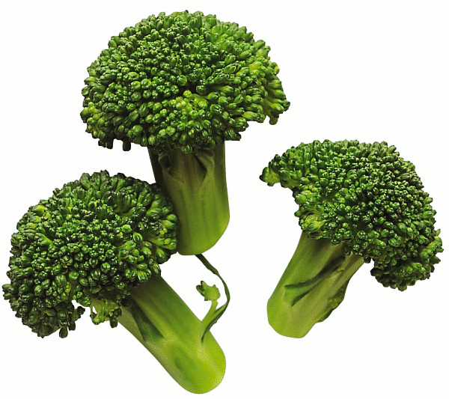
7. Cruciferous vegetables
Eliminates free radicals!
Notes:
What do broccoli, cauliflower, Brussels sprouts, kale, cabbage, and bok choy have in common? They're all members of the cruciferous, or cabbage, family of vegetables. And they all contain phytochemicals, vitamins and minerals, and fiber that are important to your health (although some have more than others.)
In fact, health agencies recommend that we eat several servings per week of cruciferous vegetables -- and for good reason.
Lower Cancer Risk?
One of the big reasons to eat plenty of cruciferous vegetables is that they may help to lower your risk of getting cancer.
A review of research published in the October 1996 issue of the Journal of the American Dietetic Association showed that 70% or more of the studies found a link between cruciferous vegetables and protection against cancer.
Various components in cruciferous vegetables have been linked to lower cancer risks. Some have shown the ability to stop the growth of cancer cells for tumors in the breast, uterine lining (endometrium), lung, colon, liver, and cervix, according to the American Institute for Cancer Research. And studies that track the diets of people over time have found that diets high in cruciferous vegetables are linked to lower rates of prostate cancer.
Lab studies show that one of the phytochemicals found in cruciferous vegetables - sulforaphane - can stimulate enzymes in the body that detoxify carcinogens before they damage cells, says Matthew Wallig, DVM, PhD. Through different mechanisms, two other compounds found in cruciferous vegetables -- indole 3-carbinol and crambene -- are also suspected of activating detoxification enzymes.

Slide 10
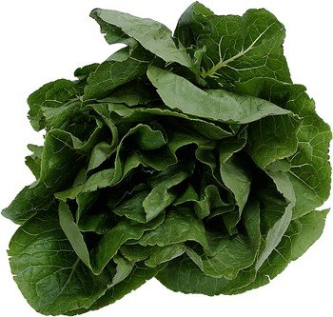
8. Greens
Reduces heart disease.
Notes:
Dark green leafy vegetables are, calorie for calorie, perhaps the most concentrated source of nutrition of any food. They are a rich source of minerals (including iron, calcium, potassium, and magnesium) that are linked with healthy levels of blood pressure and blood sugar and vitamins, including vitamins K, C, E, and many of the B vitamins.. contain beta-carotene as well as the carotenoid cousins called lutein and zeaxanthin. Beta-carotene, lutein and zeaxanthin are all powerful antioxidants that seem to play a role in blocking early stages in the development of cancer.
High in folate Some studies even link them with a lower risk of breast, lung and skin cancers. In addition, lutein seems to help slow the development of age-related macular degeneration (AMD), a cause of age-related blindness.
Folate is also necessary for DNA duplication and repair. Without repair, damaged cells can develop into cancer.
The importance of folate should not be underestimated. Even after considering the presence of other cancer-fighting nutrients, several large studies show that the risk of colon polyps, which are the source of most colon cancers, is 30 to 40 percent lower in people with a high folate intake compared to those with diets low in folate.

Slide 11
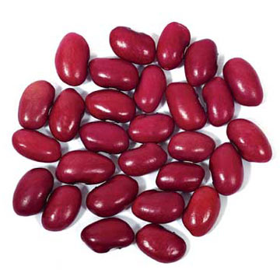
9. Beans and Legumes
Contains fiber and minerals
Notes:
Beans and legumes are a great source of soluble fiber, a useful source of vegetarian protein and a good source of energy. They are also good sources of phytochemicals and phytoestrogens - bioactive compounds like isoflavones which may protect against breast cancer.
Energy in Beans And Legumes
The calorie content of beans and legumes varies according to type. For example, garbanzo beans contain about 45 calories per 100 grams, while kidney beans contain about 125 calories per 100 grams.
Nutrients in Beans And Legumes
Dry beans are one of the richest plant sources of protein (6-12 percent protein by cooked weight), are high in carbohydrates especially dietary fiber and typically low in fat.
Vitamins in Beans And Legumes
Beans and legumes are a useful source of folate. Some types contain Vitamin A.

Slide 12
10. Green tea
Contains a powerful antioxidant EGCG.
Notes:
The secret of green tea lies in the fact it is rich in catechin polyphenols, particularly epigallocatechin gallate (EGCG). EGCG is a powerful anti-oxidant: besides inhibiting the growth of cancer cells, it kills cancer cells without harming healthy tissue. It has also been effective in lowering LDL cholesterol levels, and inhibiting the abnormal formation of blood clots. The latter takes on added importance when you consider that thrombosis (the formation of abnormal blood clots) is the leading cause of heart attacks and stroke.
Links are being made between the effects of drinking green tea and the "French Paradox." For years, researchers were puzzled by the fact that, despite consuming a diet rich in fat, the French have a lower incidence of heart disease than Americans. The answer was found to lie in red wine, which contains resveratrol, a polyphenol that limits the negative effects of smoking and a fatty diet. In a 1997 study, researchers from the University of Kansas determined that EGCG is twice as powerful as resveratrol, which may explain why the rate of heart disease among Japanese men is quite low, even though approximately seventy-five percent are smokers.
Why don't other Chinese teas have similar health-giving properties? Green, oolong, and black teas all come from the leaves of the Camellia sinensis plant. What sets green tea apart is the way it is processed. Green tea leaves are steamed, which prevents the EGCG compound from being oxidized. By contrast, black and oolong tea leaves are made from fermented leaves, which results in the EGCG being converted into other compounds that are not nearly as effective in preventing and fighting various diseases.
New evidence is emerging that green tea can even help dieters. In November, 1999, the American Journal of Clinical Nutrition published the results of a study at the University of Geneva in Switzerland. Researchers found that men who were given a combination of caffeine and green tea extract burned more calories than those given only caffeine or a placebo.
Green tea can even help prevent tooth decay! Just as its bacteria-destroying abilities can help prevent food poisoning, it can also kill the bacteria that causes dental plaque. Meanwhile, skin preparations containing green tea - from deodorants to creams - are starting to appear on the market.

Slide 13
Where can you find these superfoods?
They are available at local supermarkets, served at local restaurants, and they are easy to grow in a garden. Since superfoods are easy to find, they can be added to your daily diet.
Just think about adding color and variety consistently to meals, and you will be adding many of the important chemicals that are in superfoods!
Do it for you!

