Slide 1
Super Strong Calcium
Notes:
Say: Does anyone know why Calcium is so important to our daily diet?
(Allow students to respond before clicking to the next slide)

Slide 2
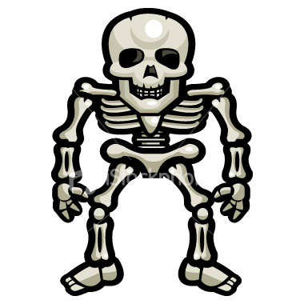
Calcium
Is Necessary For Strong Bones!
Notes:
Say: Calcium is necessary for strong bones both now and later in life.

Slide 3
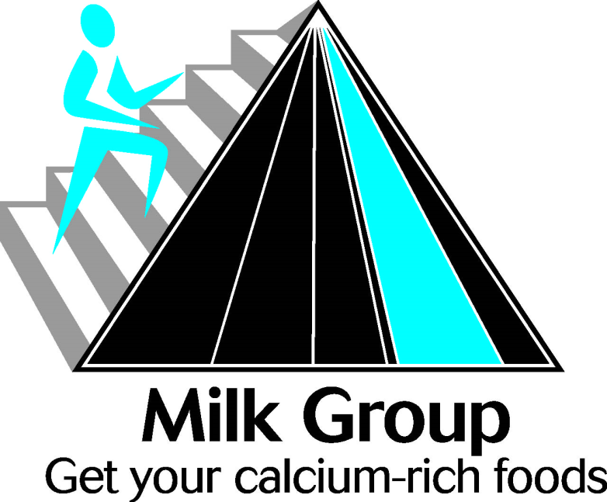
MyPyramid
The best sources of calcium are from the Milk Group of MyPyramid.

Slide 4
How much Calcium do you need?
Everyone needs calcium.
Calcium is used to make our bones strong.
If you are growing, you need more.
Notes:
Say: We all need calcium every day to keep our bones strong. Calcium is used to make our bones strong. What all is included as part of our bones? Long and short bones in our legs, hands, arms, feet and skeleton, and also our teeth. They are made of bone. If you are growing, you need more

Slide 5
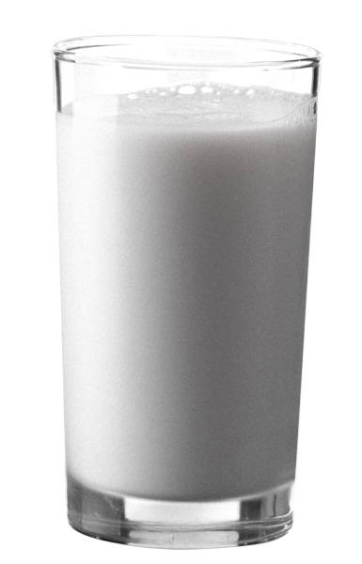
4 to 8 Year Olds
If you are in this age group, you need to have at
least 800 milligrams of Calcium daily
This is equal to 2 and 2/3 cups of milk
Notes:
Say: People between the ages of 4 and 8 years old should have at least 800 milligrams of Calcium per day. This is equal to a minimum of 2 and 2/3 cups of
milk daily.

Slide 6
9 to 18 Year Olds
If you are in this age group, you need to have at
least 1,300 milligrams of Calcium daily
This is equal to 4 and 1/3 cups of milk
Notes:
Say: People between the ages of 9 and 18 years old should have at least 1,300 milligrams of Calcium per day. This is equal to a minimum of 4 and 1/3 cups
of milk daily.

Slide 7
Adults 19 and Older
If you are in this age group, you need to have at
least 1,000 milligrams of Calcium daily
This is equal to 3 and 1/3 cups of milk
Notes:
Say: People ages 19 and older should have at least 1,000 milligrams of Calcium per day. This is equal to a minimum of 3 and 1/3 cups of
milk daily.

Slide 8
Benefits of calcium
Calcium helps with muscle contractions by helping you move your arms and legs.
Calcium prevents blood clots.
Calcium can help delay various chronic diseases and promote weight loss.
Notes:
Say: Some of the benefits of Calcium include that Calcium helps move your arms and legs. This movement is also known an as muscle contraction. Calcium can also help prevent blood clots from forming, which if formed and left untreated could lead to heart attack or stroke. It can also help delay chronic diseases and promote weight loss.

Slide 9
Where is it Stored in My Body?
Calcium is stored within the bones and is used up as needed.
Notes:
Say: Calcium is actually stored within our bones, and these stores are used up as our body needs them. If we don’t have adequate stores, our bones get weak and can break. It can lead to serous problems.

Slide 10
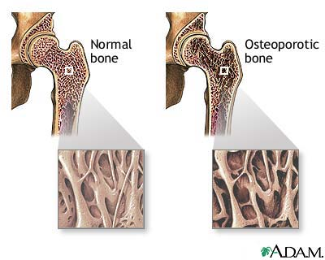
What if I Don’t Get Enough?
You may get Osteoporosis.
  - This makes bones weak and they are more likely to break.
Notes:
Say: When your body does not get enough Calcium, your bones will lose calcium and not be as strong as they could be. This condition is called Osteopenia. It increases the chance that your bones are more likely to break. In severe cases, especially as you age, if your bones continue to become weaker, it will lead to a condition called Osteoporosis, in which the bones almost become very weak, they break very easily.

Slide 11
What can you do to prevent this?
Continue to have adequate amount of milk and other dairy products and greens so you will get enough calcium every day as you are growing.
When we have adequate calcium, our bone is stronger than even the best reinforced concrete used to build buildings.

Slide 12
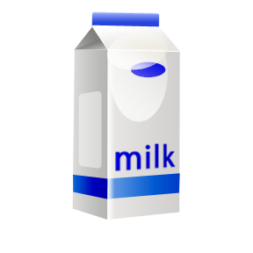

Sources of Calcium
Milk
Cheese
Yogurt
Ice Cream
Greens
Fish with bones
Beans
Fortified bread
Notes:
Say: We can get Calcium from foods like: milk, cheese, yogurt, ice cream, greens, fish, beans, and fortified bread; just to name a few.

Slide 13
Other factors that improve bone strength
Exercise
Make sure you are exposure to sunlight every day
Notes:
Say: if you exercise your bones will be stronger. Doing squats, running, push ups, weight training and walking and jogging can all help make stronger bones. Also, we need a vitamin that we get from sunlight to help build strong bones, and that is vitamin D. Vitamin D forms in our skin when exposed to sun. Vitamin D helps to bring the calcium in the bones and helps make them stronger.

Slide 14

Mission:
To promote healthier lives through research and education in nutrition and preventive medicine.
The Pennington Center has several research areas, including:
Clinical Obesity Research
Experimental Obesity
Functional Foods
Health and Performance Enhancement
Nutrition and Chronic Diseases
Nutrition and the Brain
Dementia, Alzheimer’s and healthy aging
Diet, exercise, weight loss and weight loss maintenance
The research fostered in these areas can have a profound impact on healthy living and on the prevention of common chronic diseases, such as heart disease, cancer, diabetes, hypertension and osteoporosis.
The Division of Education provides education and information to the scientific community and the public about research findings, training programs and research areas, and coordinates educational events for the public on various health issues.
We invite people of all ages and backgrounds to participate in the exciting research studies being conducted at the
Pennington Center in Baton Rouge, Louisiana. If you would like to take part, visit the clinical trials web page at www.pbrc.edu or call (225) 763-3000.
Authors:
Beth Kalicki
Heli Roy, PhD, RD
Division of Education
Pennington Biomedical Research Center
10/10

