Slide 1
IRBMANAGER

Slide 2
IRBManager Product Information
Over 200 institutions and 3000 sites use IRBManager, mostly in the academic setting.

Slide 3
IRBManager Product Information
Web-Based (you can access it anywhere you have internet)
Investigators and coordinators have access to protocols as well as attachments and documents
Investigators and coordinators know where their submission is in the IRB process
Automates approvals and submissions to save time
No more lost paperwork!
Has full support 24/7, including “forgot password” feature
Able to change forms and address problems “in-house”

Slide 4
DASHBOARD

Slide 5
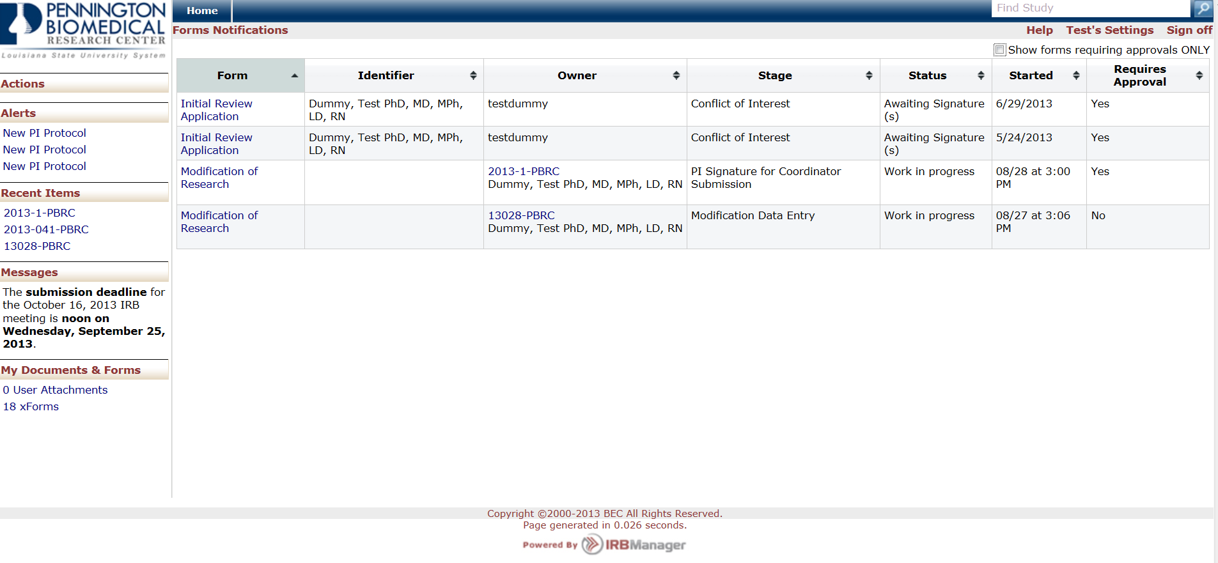
Studies Associated with User

Slide 6
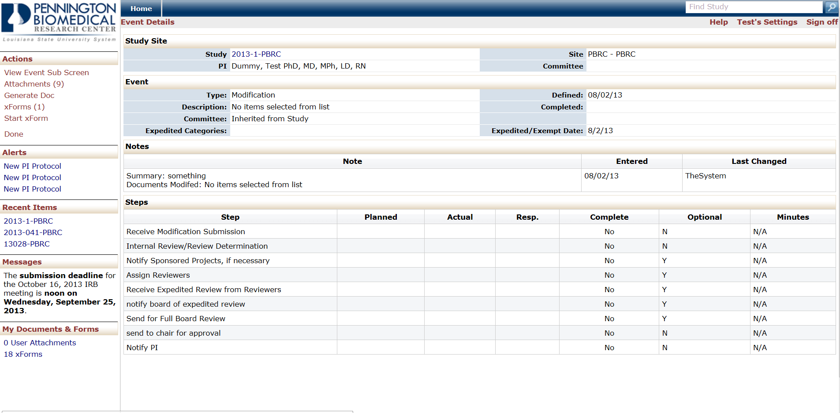
Steps to Completion

Slide 7
Sample Approval Documents

Slide 8
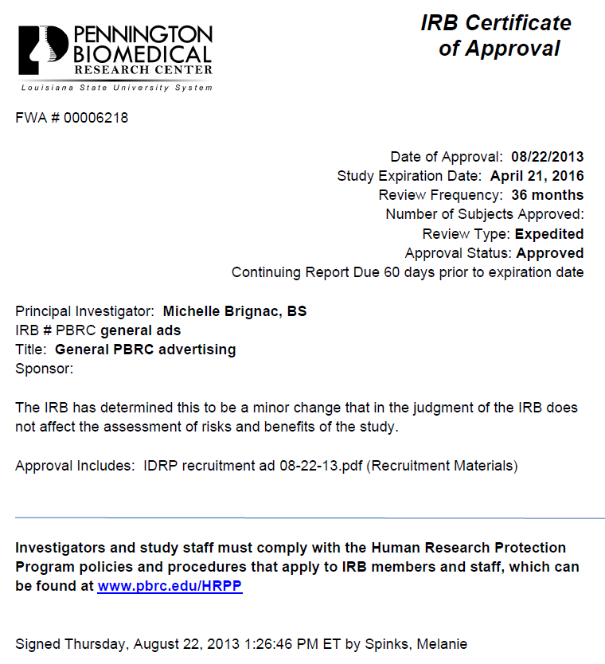
Sample Approval Documents

Slide 9
Sample Approval Documents

Slide 10
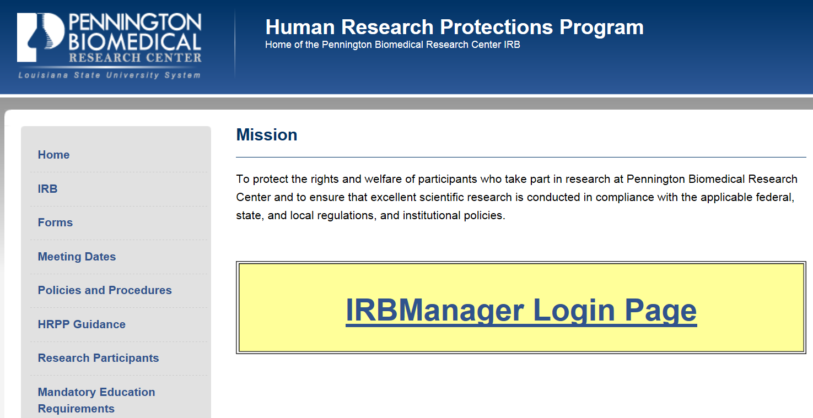
IRBManager Link
The link for IRB Manager can be found at www.pbrc.edu/HRPP

Slide 11
Coordinator View

Slide 12
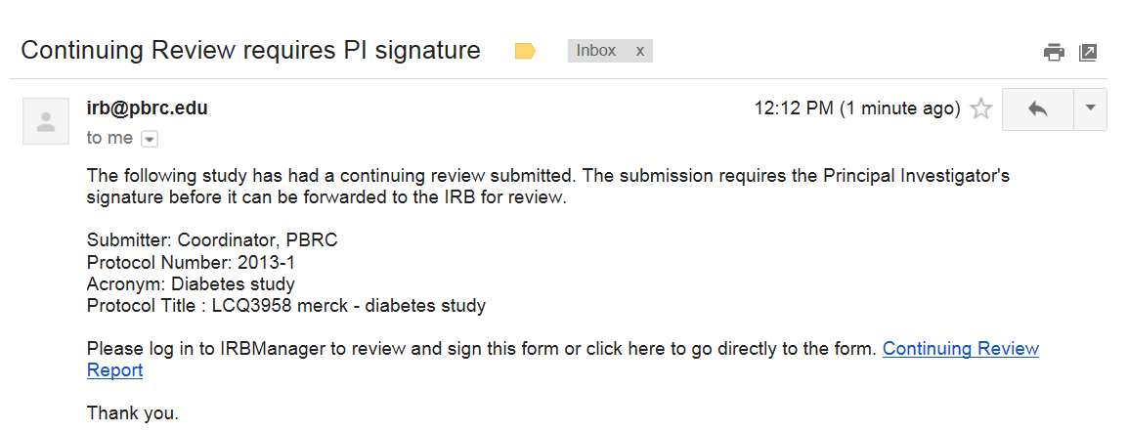
Email to PI

Slide 13
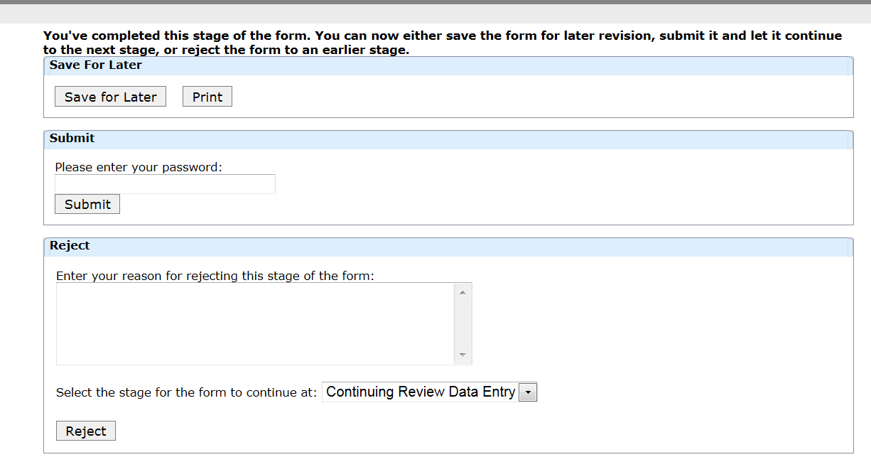
PI Signature

Slide 14
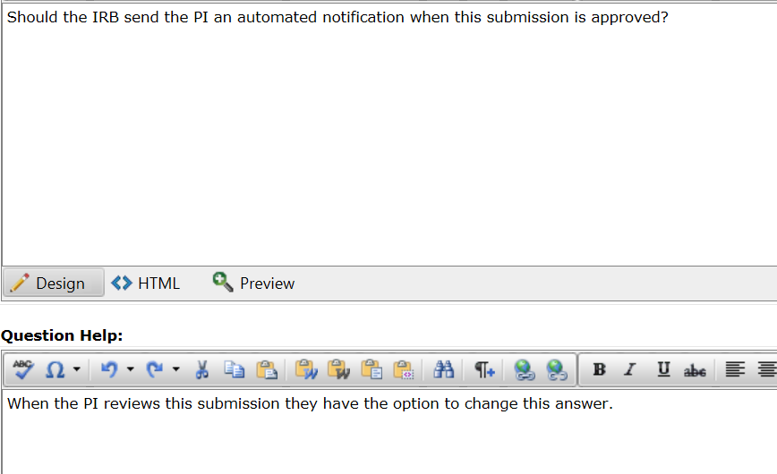
Option for Approval Signatures

