Slide 1
Stress and your heart
Beth Kalicki
Heli J. Roy, PhD, RD, MBA
Pennington Biomedical Research Center

Slide 2

Stress, what is it?
Stress is the body’s response to a physical, chemical, emotional, or environmental stress.
Stress reaction includes physiological changes in the body.
Stress can be short term of long term and the effects are different on the body.
Notes:
What is Stress?
Stress is the body’s response to your reaction to physical, chemical, emotional, or environmental factors.
Everyone feels stress. Some people have more than others, and we all react differently.
The way that people think, feel, and act as they cope with the daily stresses of life can have a profound or deadly effect on their heart.
Your body fights off stress better when you eat a well balanced diet, and eat a variety of foods daily.

Slide 3

Signs and Symptoms of Stress
Physical: muscle tension, increased heart rate, aches and pains.
Mental: forgetfulness, poor memory, constant worry.
Emotional: anger, depression, mood swings, negative thinking.
Behavioral: compulsive eating, explosive actions, withdrawal.
Notes:
Signs and Symptoms of Stress
Physical symptoms= dizziness, aches and pains, grinding teeth, clenched jaws, headaches, indigestion, muscle tension, difficulty sleeping, racing heart, ringing in the ears, poor posture, sweaty palms, fatigue, exhaustion, trembling, weight gain or weight loss, or upset stomach.
Mental symptoms= constant worry, difficultly making decisions, forgetfulness, inability to concentrate, lack of creativity, loss of sense of humor, and poor memory.
Emotional symptoms= anger, anxiety, crying, depression, feeling powerless, frequent mood swings, irritability, loneliness, negative thinking, nervousness, or sadness.
Behavioral symptoms= bossiness, compulsive eating, being critical of others, explosive actions, frequent job changes, impulsive actions, increased use of alcohol or drugs, withdrawal from relationships or social situations.

Slide 4

Types of Stress
  Emotional stress is
    related to our feelings
    linked to experiences with others
  Physical Stress
    is related to physical exertion
    can be healthy
Notes:
Types of Stress
The two types of stress are emotional stress and physical stress.
Emotional stress is related to our feelings. It may be caused by things such as wedding preparation, relationship problems, divorce, or even by emotionally downgrading experiences with others. Chronic emotional stress is associated with heart disease and early death. Studies have shown that people who have had recent major life changes, such as loss of a spouse or close relative, loss of a job, or moving to a new location causes an increase in emotional stress and a higher incidence of death. Social stressors, like divorce or death of a loved one, often triggers clinical depression or makes it worse and causes relapses in those who have recovered. Due to emotional stress, people without spouses tend to die younger than married people. This is because a spouse provides a degree of emotional support and stability. Chronic negative emotions can also have a huge impact on heart disease. Those who are always anxious or depressed, as a result of a heart attack, have a heightened chance of becoming ill, having a heart attack, or even a change in angina pain. It has been noted that women are more likely to develop heart problems that are due to emotional stress.
Physical Stress encompasses exercise or other forms of physical exertion. It is good for the heart as long as the heart is functioning normally. Lack of physical stress, also known as a sedentary lifestyle, constitutes a major risk factor for coronary artery disease.
**Both emotional and physical stress can cause an increase in heart rate, as well as elevation of blood pressure and the release of stress hormones. This makes the heart have to work harder.**

Slide 5
What Happens During Stress?
Body releases a stress hormone
Results in increased:
  Heart rate
  Oxygen demand and breathing rate
  Tensed muscles
  Blood flow
  Alertness
Notes:
What Happens During Stress?
Some common stressors in life include: illness, death of a friend or loved one, problems in a personal relationship, work overload, starting a new job, unemployment, retirement, pregnancy, crowds, relocation, daily hassles, legal problems, financial concerns, and perfectionism.
The body reacts to stressful situations by releasing the hormone adrenaline, a catecholamine, a stress hormones, from the adrenal glands.
This causes an increase in both breathing rate and heart rate.
During the fight or flight response, your body is flooded with adrenaline and cortisol. This increases your heart rate, redirects blood flow to the muscular system, releases fats into the bloodstream for use as energy, increases breathing rate, tenses muscles, and increases blood clotting ability.
When you are very stressed, your body is continually exposed to adrenaline and cortisol. Processes of blood clotting may also be altered, so there is an increased risk of heart attack.
Minor hassles, major life changes, or a combination of things all contribute to stress. If you are able to identify the cause of stress in your life and release tension from that, you will be better able to manage your stress.

Slide 6
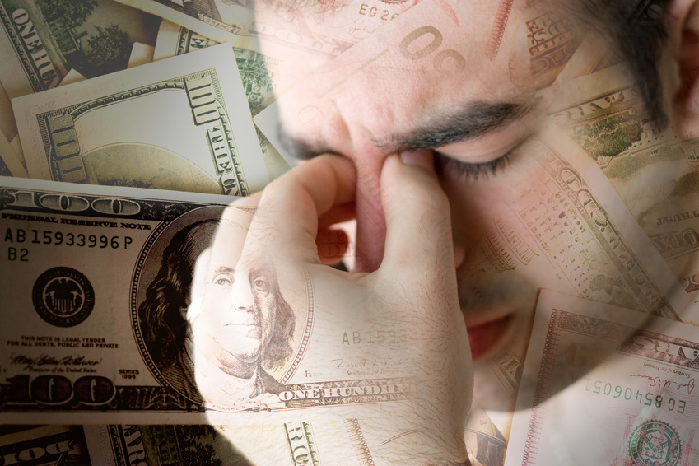
Effect of Stress on the Heart
Increased Heart Rate
Increased Blood Pressure
Increased risk of a heart attack.
Increased risk for cardiac arrhythmias
Notes:
Stress can cause a number of consequences on the heart.
Some of these include:
Increased heart rate, blood pressure, Lower threshold for cardiac arrhythmias such as ventricular tachycardia, ventricular fibrillation, and atrial fibrillation. This is due to the electrical instability in the heart muscle tissue. Spasm of the heart’s blood vessels, which can lead to ischemia.
The Journal of the American Medical Association reports that researchers at University Laval in Quebec noted that first time heart attack patients who returned to extremely stressful jobs were twice as likely to have a second heart attack when compared to those who went back to occupations that were relatively stress free. The study monitored 972 first time heart attack survivors who ranged in age from 35 to 59 years old. The study showed that patients who reported chronic job strain (high in psychological demands but low in feeling of control) were at a higher risk of having a second heart attack and possibly death.
A study tested the effect of emotions and anger on individuals who had heart disease & implantable heart defibrillators (which correct dangerous heart rhythm by sending an electric shock to the heart) by Dr. Rachel Lampert of Yale University. Researchers told patients to think about something that made them angry while they recorded T waves and cardiac electrical stability. The patients were tracked over three years to see who experienced a cardiac arrest and needed a shock from their defibrillator. The individuals who were most prone to anger had a higher T wave and an increased chance of experiencing an arrhythmia. Data concluded that therapy focused on helping patients deal with anger and other negative emotions may, in the long run, help to reduce the occurrence of arrhythmias.

Slide 7
Long Term Impact of Stress
Changes in heart rate
Increased blood pressure
Increased cholesterol level
Increased triglyceride level
Fat deposition around waist
  Metabolic syndrome
Notes:
Stress and Heart Disease risk:
If you have a great deal of stress in your life, you will be at an increased risk for heart disease. Those who are quick to get angry about different circumstances or those who display frequent hostility are at an increased risk of getting heart disease.
What kind of health problems can arise from stress?
Stress can cause heart attack, sudden cardiac death, heart failure, or abnormal heart rhythm. If you are under stress, you are more likely to have high blood pressure, over eat, be more sedentary, and be more likely to smoke. The way that your body reacts to stress plays a key role in the development of atherosclerotic heart disease.
Chronic Stress effects the heart by:
The increased heart rate may cause your heart to develop an abnormal heart rhythm, or else heart muscle problems may result.
The increased blood pressure may cause the cardiovascular system to have the usual symptoms associated with hypertension; thus causing an increase in the risk of heart disease and stroke.
The increase in cholesterol and triglycerides may cause arteries to thicken with plaque over time, which could lead to coronary artery disease or heart attack.
The increase in deposit of fat in the abdominal area leads to an apple shape. It signifies metabolic syndrome, a common risk factor for heart disease.

Slide 8

Factors Contributing to Stress
Lifestyle changes
Lack of sleep
Job
Exercise
Notes:
Factors Contributing to Stress
Minor hassles, major lifestyle changes or a combination of things all lead to stress. If you are able to identify the cause of stress in your life and release the tension from that, you will be better able to manage your stress.
What should you do if your stress levels begin to interfere with your sleeping patterns?
If sleep problems are adding to your stress, you should make a regular sleep schedule, keep your bedroom dark and quiet, make sure your bed and surroundings are comfortable, avoid caffeine, and do not exercise within two to three hours of bedtime.
How can your job effect your stress level?
Jobs having a high level of psychological demand and stress in people who have low self esteem and autonomy, were associated with an increase in heart disease.
Can exercise effect your stress level?
Regular aerobic exercise can decrease the level of stress related hormones circulating in the blood.

Slide 9

Simple Ways of Coping with Stress
  Eating and drinking sensibly
  Remembering that it is okay to say no
  Stopping smoking
  Exercising regularly
  Relaxing every day
  Taking responsibility for your actions
  Examining your values and living by them
  Setting realistic goals and expectations
  Reminding yourself about things that you do well
  Getting adequate rest

Slide 10
Managing Stress
Some ways to prevent/manage the stress in your life include:
  Avoiding situations that you know are stressful.
  Exercising 30 minutes daily.
  Eating a diet that is rich in fruits, vegetables, and whole grains.
  Stopping smoking.
  Limiting alcohol intake.
  Managing stress by having quiet time, participating in meditation, prayer, reading, yoga, and other relaxation techniques.
  Bonding with family and friends.
  Expressing your feelings.
  Making and keeping an appointment with a physician.

Slide 11
Treatment For Stress
Relaxation Techniques
Becoming Sensitive to Personal Needs
Deep Muscle Relaxation
Biofeedback Training
Anxiety Management
Anger Management/Stress Inoculation Therapy
Notes:
Treatments for Stress
Relaxation Techniques:
Relaxation techniques include deep breathing, progressive muscle relaxation, guided imagery, relaxing to music, biofeedback, or yoga. Caring for a pet can buffer some of the stress associated with everyday life.
Becoming Sensitive to Personal Needs:
True relaxation from stress requires you to become sensitive to your personal needs for peace, self awareness, and thoughtful reflection.
Biofeedback Training:
In biofeedback training, the patient is told how their body is responding to a particular event and then they are told how to control their stress related responses.
Anxiety Management:
Anxiety management provides the patient with stress management skills that are easily applied to tension causing sensations.
Anger Management/Stress Inoculation Therapy:
Anger Management and Stress Inoculation Therapy both help patients modify anger and hostility by teaching them effective coping skills.

Slide 12

Pennington Biomedical Research Center
Authors:
Beth A. Kalicki
Heli J. Roy, RD, PhD, MBA
Division of Education
Phillip Brantley, PhD, Director
Pennington Biomedical Research Center
Claude Bouchard, PhD, Executive Director

Slide 13
About Pennington
The Pennington Biomedical Research Center is a world-renowned nutrition research center.
Mission:
To promote healthier lives through research and education in nutrition and preventive medicine.
The Pennington Center has several research areas, including:
Clinical Obesity Research
Experimental Obesity
Functional Foods
Health and Performance Enhancement
Nutrition and Chronic Diseases
Nutrition and the Brain
Dementia, Alzheimer’s and healthy aging
Diet, exercise, weight loss and weight loss maintenance
The research fostered in these areas can have a profound impact on healthy living and on the prevention of common chronic diseases, such as heart disease, cancer, diabetes, hypertension and osteoporosis.
The Division of Education provides education and information to the scientific community and the public about research findings, training programs and research areas, and coordinates educational events for the public on various health issues.
We invite people of all ages and backgrounds to participate in the exciting research studies being conducted at the Pennington Center in Baton Rouge, Louisiana. If you would like to take part, visit the clinical trials web page at www.pbrc.edu or call (225) 763-3000.

Slide 14
References
American Heart Association. (2009). Something to Smile About: To Avoid Stress I Just Try to Keep it Simple. Reducing Stress. Retrieved August 11, 2009, from http://www.americanheart.org/print_presenter.jhtml?identifier=3047698
Brugg, Robert J. (2008). Heart Disease and Stress. Heart Disease Health Center. Retrieved August 12,2009, from http://www.webmd.com/heart-disease/
stress-heart-attackrisk?print=true
Burg, Matthew, PhD., et al. (2009). Stress Behavior and Heart Disease. How to Lower Your Risk of Heart Disease, 95-104
Burke, Alison E. (2007). Acute Emotional Stress and the Heart. Journal of the American Medical Association, 298, (3), 360
DeNoon, Daniel J. (2009). Stress Raises Belly Fat, Heart Risks. Heart Disease Health Center. Retrieved August 12, 2009, from http://www.webmd.com/
heart-disease/news/20090806/stress-ups-belly-fat-heart-risks

