Slide 1
Coconut Oil: Health Effects
Heli J. Roy, PhD, MBA, RD
LSU AgCenter
Pennington Biomedical Research Center

Slide 2
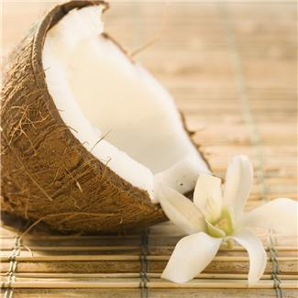
Introduction
Coconut oil comes from the meat of matured coconuts harvested from the coconut palm. It is used in food, medicine and in the industry. Coconut oil is high in saturated fat content, and because of it, it has a long self-life.

Slide 3
Fat and fatty acids in human health
Fat is an important component of the diet:
It is used for making many hormones
It protects our nerves and internal organs as a thermal covering
It is essential for growth
Some fatty acids are essential, we must get them from the diet, and they are used to make important compounds for growth and in metabolism
It is used for energy
Notes:
Fat is an important component of the diet:
It is used for making many hormones
It protects our nerves and internal organs as a thermal covering
It is essential for growth
Some fatty acids are essential, we must get them from the diet, and they are used to make important compounds that are used for growth and in metabolism
It is used for energy

Slide 4
Fatty Acids
Not all fats are created equal.
There are three types of fatty acids:
Short-chain fatty acids
Medium-chain fatty acids
Long-chain fatty acids
Because of the various lengths of the fatty acids, they are digested and metabolized differently.
Notes:
In nutrition, fatty acids are differentiated into three groups:
Short-chain fatty acids (2-6 carbon atoms)
Medium-chain fatty acids (8-12 carbon atoms)
Long-chain fatty acids (14 or more carbon atoms)
Long chain fatty acids are further divided into saturated and unsaturated, and the unsaturated into omega-3 and omega-6 fatty acids. Essential fatty acids that we need from the diet because we can’t synthesize them, are both long chain omega-3 and omega-6 fatty acids.

Slide 5
What’s the difference?
Fatty acid type | Coconut oil | Corn oil
Medium chain | 63% | None
Long chain saturated | 30% | 20%
Long chain unsaturated | 7% | 80%
The major difference between these oils and how they behave in the body is due to the different fatty acid compositions.
Notes:
What is the difference between coconut oil and other vegetable oils? I am using coconut oil and corn oil to represent other vegetable oils. Coconut oil is very high in medium chain fatty acids with smaller percent of long chain saturated and very small percent of long chain unsaturated fats, while corn oil has mainly long chain unsaturated fats and smaller percent of long chain saturated and no medium chain fatty acids. In the body, medium chain fatty acids are metabolized very differently than long chain fatty acids.

Slide 6
Difference in absorption and use
Short-chain fatty acids are formed in the intestines by friendly bacteria and are rapidly metabolized by the intestinal cells.
Medium-chain fatty acids are absorbed and transported directly to the liver where they are burned for energy.
Long-chain fatty acids are turned into triglycerides and then are taken up by cells and used for energy or are stored.
Bile from the gallbladder is needed to digest long chain fatty acids.
Notes:
Short-chain fatty acids (2-6) are formed in the intestines by friendly bacteria and are rapidly metabolized by the intestinal cells. They don’t normally exist in foods other than milk and milk products due to fermentation and in coconut and palm kernel oil;. It does not have a pleasant taste. Goat milk has other short chain fatty acids, hence the particular flavor of goat’s milk.
Medium-chain fatty acids (8-12) are absorbed and transported directly to the liver where they are burned for energy. Medium chain fatty acids occur in nature and in plants. They are used for malabsorption syndromes, in enteral and tube feeding and in infant formulas. Medium chain fatty acids are absorbed directly and used for energy by the liver and the cells. They are not stored in the body.
Long-chain fatty acids (>14) are turned into triglycerides and then are taken up by cells and used for energy or are stored. Long chain fatty acids have to become part of protein particles and travel in the bloodstream to be take up by cells and the liver and are used for energy or stored in the fatty deposits. Bile from the gallbladder is needed to digest long chain fatty acids.

Slide 7
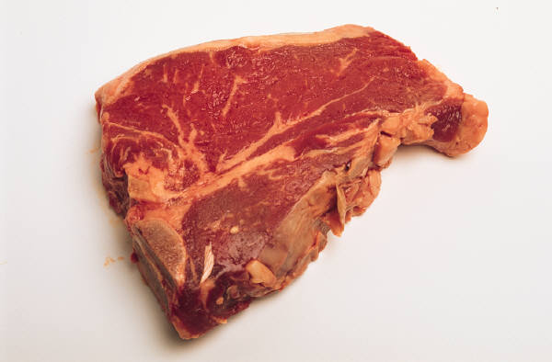
Long chain saturated fatty acids
Mainly from animal sources, also from some plants
Makes blood vessels less pliable
Increases heart disease risk
Increases diabetes risk
Increases blood pressure
Increases LDL
Increases triglycerides
Increases inflammation
Reduces HDL
Notes:
Animal sources are the main sources of saturated fatty acids in the diet: dairy and dairy products, meat and meat products, butter, margarine, hydrogenated vegetable oils
Makes blood vessels less pliable, more rigid when incorporated into cell walls.
Increases heart disease risk due to decreasing the pliability of blood vessels.
Increases diabetes risk because the rigid cell walls don’t allow insulin to pass glucose in and out of cells as easily or many other cellular compounds that are constantly passed in and out of cells.
Increases blood pressure due to the rigidity of vessel walls. Can also increase the risk for stroke.
Increases LDL
Increases triglycerides
Increases inflammation by synthesizing molecules in the cells that are inflammatory
Reduces HDL

Slide 8
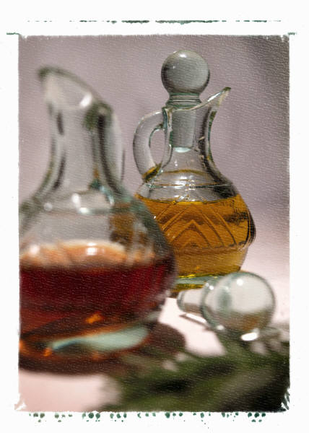
Long chain unsaturated omega-6 fatty acids
From vegetable oils (corn, soybean, safflower)
Tend to promote inflammation
Tend to promote chronic diseases (cancer, high blood pressure, diabetes, cardiovascular disease)
Lowers LDL
Essential fatty acids for humans
Notes:
From vegetable oils (corn, soybean, safflower)
Tend to promote inflammation due to production of short lived compounds in the cells that increase inflammation (reddening, swelling etc)
Tend to promote chronic diseases (cancer, high blood pressure, diabetes, cardiovascular disease)
Lowers LDL
Vegetable oils contain Essential fatty acid for humans, linoleic acid, because we can’t synthesize it in the body. Linoleic acid us used for synthesizing many important compounds that are used for a variety of reactions in the body, that influence our mood, behavior, skin, hair, growth (in infants), overall inflammatory response and more.

Slide 9
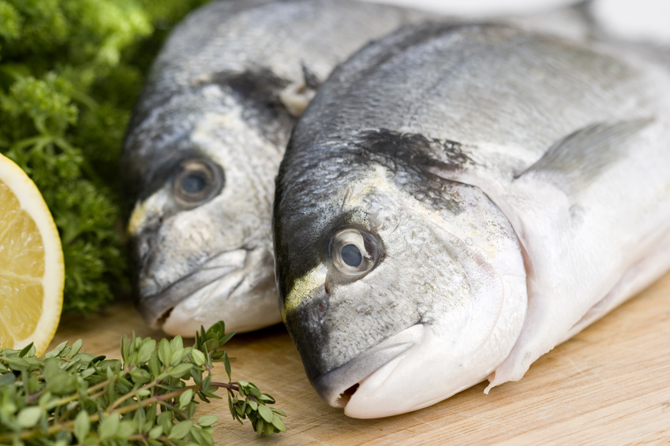
Long chain unsaturated omega-3 fatty acids
From plants and seafood
Most heart healthy
Reduces platelet stickiness
Dilates blood vessels
Reduces blood pressure
Reduces LDL cholesterol
Increases HDL
Reduces triglycerides
Has essential fatty acids for humans
Notes:
Long chain unsaturated fatty acids are obtained From plants and seafood
Most heart healthy
Reduces platelet stickiness by making cells walls more elastic and pliable.
Dilates blood vessels by increasing pliability and thereby helping
Reduces blood pressure
Reduces LDL cholesterol
Increases HDL
Reduces triglycerides
Has essential fatty acids for humans that are needed for a myriad of functions in the cell. Mostly beneficial type of reactions.

Slide 10
Medium chain triglycerides
Are used for source of fat in malabsorption conditions such as IBS,and ulcerative colitis, and in infant formulas. It is also used to increase the energy intake in cystic fibrosis patients.
Affects hormone release from intestines differently than LCFA’s
Inhibits bacterial and virus growth
Reduces LDL and increases HDL
Reduces abdominal fat
Increases fat burning
Not stored in adipose tissue
Reduces cholesterol synthesis by the liver
Does not provide essential fatty acids
Notes:
Are used for source of fat in malabsorption conditions such as Irritable bowel Syndrome, ulcerative colitis, and dysbiosis and in infant formulas. It is also used to increase the energy intake in cystic fibrosis patients.
Affects hormone release from intestines differently than LCFA’s
A certain from this group fatty acid has been identified to Inhibit fungal, bacterial and virus growth and has been used in test to inhibit many viruses. It actually destroys the cell walls and enables them from reproducing. It has been effective in herpes, the measles, influenza, hepatitis C and HIV.
Reduces LDL
Reduces abdominal fat because it promotes fat burning not storage.
Increases fat burning because it cannot be stored.
Not stored in adipose tissue
Reduces cholesterol synthesis by the liver
Does not provide essential fatty acids

Slide 11
Benefits of Coconut oil
Coconut oil contains antioxidants such as vitamin E, provitamin A, polyphenols and phytosterols.
Because coconut oil has a lot of medium-chain fatty acids it can be useful for malabsorption conditions.
May have some antibacterial, antiviral and antifungal properties.
May help support the immune system.
Maintains coagulation factors and therefore does not increase heart disease risk.
Reduces cholesterol and triglyceride levels.
Best result (i.e. reducing heart disease risk) is obtained when combined with safflower, corn, or olive oil.
Notes:
Coconut oil contains antioxidants such as vitamin E, provitamin A, polyphenols and phytosterols.
Because coconut oil has a lot of medium-chain fatty acids it can be useful for malabsorption conditions.
May have some antibacterial, antiviral and antifungal properties.
May help support the immune system.
Maintains coagulation factors and therefore does not increase heart disease risk.
Reduces cholesterol and triglyceride levels.
Best result (i.e. reducing heart disease risk) is obtained when combined with safflower, corn, or olive oil.

Slide 12
What happens if…
You replace vegetable oils (soy, corn, canola, olive) with coconut oil?
Vegetables oils contain more of the healthful fats (polyunsaturated and monounsaturated) that prevent heart disease and they have essential fatty acids.
Replacing all healthful fats with coconut oil is not prudent since coconut oil does not provide any essential fatty acids.
Will receive benefits from the other healthful components in coconut oil (phytosterols etc).
American Heart Association recommends that only 7% of total daily calories come from saturated fat.
Notes:
You replace vegetable oils (soy, corn, canola, olive) with coconut oil?
Coconut oil has a high percent of saturated fatty acids, but because they are medium chain, not long chain, they are not necessarily bad for your heart. If use virgin coconut oil, it has small percent of unsaturated fats as well. Hot extraction of coconut oil actually includes more beneficial phytochemicals than cold extracted oil (if mentioned in the label).
Vegetables oils contain more of the healthful fats (polyunsaturated and monounsaturated) that help prevent heart disease and they have essential fatty acids.
Replacing all healthful fats with coconut oil is not prudent since coconut oil does not provide any essential fatty acids.
Will receive benefits from the other healthful components in coconut oil such as vitamin E, provitamin A, polyphenols and phytosterols.
American Heart Association recommends that only 7% of total daily calories come from saturated fat. This should include saturated fat from coconut oil until there are new reputable research findings.

Slide 13
Coconut Oil in Cooking
Coconut oil is used in cooking because it:
Has a higher burning point.
Doesn’t go bad as quickly as some other fats.
Adds a nutty, vanilla-like flavor to foods.
Is solid at room temperature and can be used in cooking and baking.
Is used by certain cultures as the main cooking oil.
Photo by Amy Selleck, Flickr

Slide 14
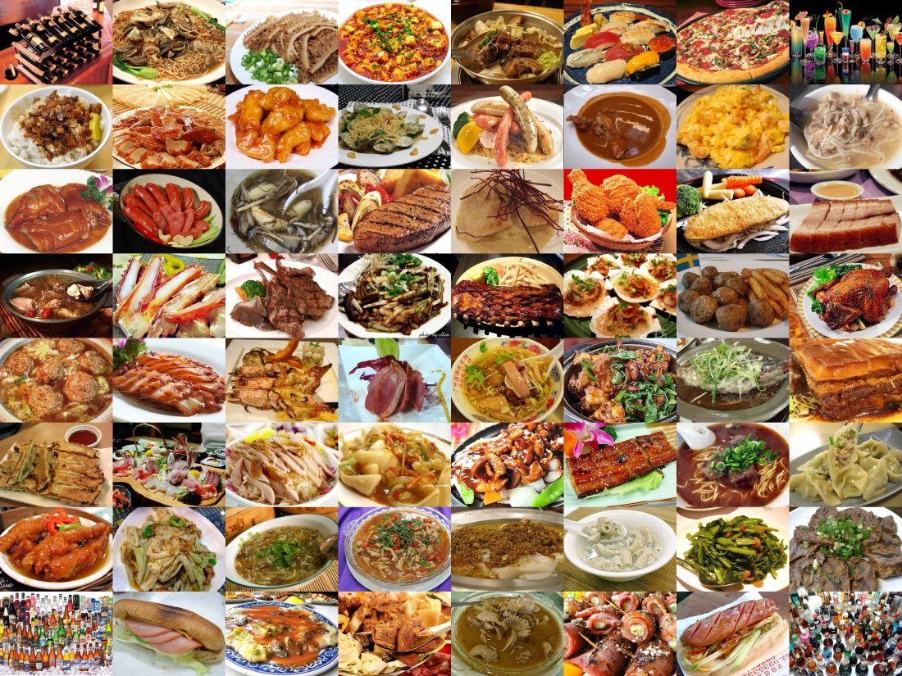
Conclusions
Can use virgin coconut oil prudently.
Does not seem to increase heart disease risk.
Is safe to use in small amounts.
Can add flavor to cultural foods.

Slide 15
References
Monica L. Assuncao, Haroldo S. Ferreira, Aldenir F. dos Santos, Cyro R. Cabral Jr., Telma M. M. T. Florencio. Effects of Dietary Coconut Oil on the Biochemical and Anthropometric Profiles of Women Presenting Abdominal Obesity. Lipids (2009) 44:593–601.
Andre C Bach and Vigen K Babayan. Medium-chain triglycerides: an update. Am. J. clin. Nutr. 36: 950-962, 1982.
Preeti Chandrashekar, B.R. Lokesh, A.G. Gopala Krishna. Hypolipidemic effect of blends of coconut oil with soybean oil or sunflower oil in experimental rats. Food Chemistry 123 (2010) 728–733.
William E Connor. Importance of n23 fatty acids in health and disease. Am J Clin Nutr 2000;71(suppl):171S–5S.
Eqbal M. A. Dauqan, Halimah Abdullah Sani, Aminah Abdullah and Zalifah Mohd Kasim. Fatty Acids Composition of Four Different Vegetable Oils (Red Palm Olein, Palm Olein, Corn Oil and Coconut Oil) by Gas Chromatography. IPCBEE vol.14 (2011).
Conrado S. Dayrit. Coconut oil in health and disease: Its and monolaurin’s potential as a cure for HIV/AIDS. Cocotech Conference. Chennai, India. July 25, 2000.
Nicole M. de Roos, Evert G. Schouten and Martijn B. Kata. Consumption of a Solid Fat Rich in Lauric Acid Results in a More Favorable Serum Lipid Proﬁle in Healthy Men and Women than Consumption of a Solid Fat Rich in trans-Fatty Acids. J. Nutr. 131: 242–245, 2001

Slide 16
References
Alan B. Feranil, Paulita L. Duazo, Christopher W. Kuzawa, and Linda S. Adair. Coconut oil predicts a beneficial lipid profile in pre-menopausal women in the Philippines. Asia Pac J Clin Nutr. 2011 ; 20(2):190–195.
William S. Harris, Dariush Mozaffarian, Eric Rimm, Penny Kris-Etherton, Lawrence L. Rudel, Lawrence J. Appel, Marguerite M. Engler, Mary B. Engler and Frank Sacks. Omega-6 Fatty Acids and Risk for Cardiovascular Disease : A Science Advisory From the American Heart Association Nutrition Subcommittee of the Council on Nutrition, Physical Activity, and Metabolism; Council on Cardiovascular Nursing; and Council on Epidemiology and Prevention. Circulation. 2009;119:902-907.
Edward D. Korn. Clearing factor, a Heparin activated lipoprotein lipase: II. Substrate specificity and activation of coconut oil. J. Biol. Chem. 1955, 215:15-26.
Charles S. Lieber, Andre LeFevre, Norton Spritz, Lawrence Feinman, and Leonore M. DeCarli. Difference in Hepatic Metabolism of Long- and Medium-Chain Fatty Acids: the Role of Fatty Acid Chain Length in the Production of the Alcoholic Fatty Liver. The Journal of Clinical Investigation Vol. 46, No. 9, 1967.
D Mozaffarian and R Clarke. Quantitative effects on cardiovascular risk factors and coronary heart disease risk of replacing partially hydrogenated vegetable oils with other fats and oils. European Journal of Clinical Nutrition (2009) 63, S22–S33.

Slide 17
References
K.G. Nevin, T. Rajamohan. Virgin coconut oil supplemented diet increases the antioxidant status in rats. Food Chemistry 99 (2006) 260–266.
K.G. Nevin, T. Rajamohan. Influence of virgin coconut oil on blood coagulation factors, lipid levels and LDL oxidation in cholesterol fed Sprague Dawley rats. European e-Journal of Clinical Nutrition and Metabolism (2008) 3, e1ee8.
John B. Ohlrogge. Regulation of fatty acid synthesis. Annu. Rev. Plant Physiol. Plant Mol. Biol. 1997. 48:109–136.
A.R. Oyi, J.A. Onaolapo and R.C. Obi. Formulation and Antimicrobial Studies of Coconut (Cocos nucifera Linne) Oil. Research Journal of Applied Sciences, Engineering and Technology 2(2): 133-137, 2010.
Andrea A. Papamandjaris, Diane E. MacDougall, and Peter J.H. Jones. Minireview. Medium chain fatty acid metabolism and energy expenditure: Obesity treatment implications. Life Sciences 62:14, 203-1215,1998.
Haji Ibrahim Haji Abr. Rahman. The chemistry of coconut oil. 2000.
Malongil B. Reena and Belur R. Lokesh. Hypolipidemic Effect of Oils with Balanced Amounts of Fatty Acids Obtained by Blending and Interesterification of Coconut Oil with Rice Bran Oil or Sesame Oil. J. Agric. Food Chem. 2007, 55, 10461–10469.

Slide 18
References
M.B. Reena , T.P.Krishnakantha , B.R.Lokesh. Lowering of platelet aggregation and serum eicosanoid levels in rats fed with a diet containing coconut oil blends with rice bran oil or sesame oil. Prostaglandins, Leukotrienes and Essential Fatty Acids 83 (2010) 151-160.
Patty W Siri-Tarino, Qi Sun, Frank B Hu, and Ronald M Krauss. Saturated fat, carbohydrate, and cardiovascular disease. Am J Clin Nutr 2010;91:502–9.
Kapila N. Seneviratne, Chamil D. HapuarachchI, Sagarika Eka. Comparison of the phenolic-dependent antioxidant properties of coconut oil extracted under cold and hot conditions. Food Chemistry 114 (2009) 1444–1449.
Marie-Pierre St-Onge and Peter J. H. Jones. Physiological Effects of Medium-Chain Triglycerides: Potential Agents in the Prevention of Obesity. J. Nutr. 132: 329–332, 2002.
M. K. Vu, M. Verkijk, E. S. M. Muller, I. Biemond, C. B. H. W. Lamers, A. A. M. Masclee. Medium chain triglycerides activate distal but not proximal gut hormones. Clinical Nutrition (1999) 18(6): 359-363.
Lih-ling Wang, Bao-kang Yang, Kirk L. Parkin and Eric A. Johnson. Inhibition of Listeria monocytogenes by Monoacylglycerols Synthesized from Coconut Oil and Milkfat by Lipase-Catalyzed Glycerolysis. J. Agrlc. Food Chem. 1993, 41, 1000-1005.

