Slide 1
Vitamin D…
Let the Sunshine In

Slide 2

What is Vitamin D?
Vitamin D is a fat soluble vitamin that is stored in the body’s fatty tissue.
It is found in both food and it’s made by your skin when you are out in the sun!
Notes:
Say: Does anyone have an idea of where we get Vitamin D from?
(Allow students to respond)
Say: Vitamin D is a fat soluble vitamin. This means that it readily dissolves within the presence of fat. It is stored within the body’s
fatty tissue. It is found in multiple foods and you can also get it by being out in the sun.

Slide 3

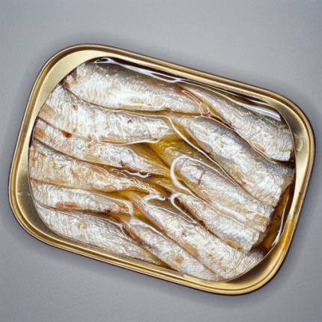

What Foods Contain
Vitamin D?
Salmon
Cod Liver Oil
Mackerel
Canned Tuna
Canned Sardines
Beef Liver
Oysters
Egg
Swiss Cheese
Milk
Numerous Fortified Products
Notes:
Say: We can get Vitamin D from eating foods like salmon, mackerel, canned tuna or sardines, beef liver, eggs, swiss cheese, milk, and oysters, just to name a few. There are also products that have Vitamin D added to them. They are known as fortified products. Some fortified products that are high in Vitamin D include orange juice, yogurt, and margarine.

Slide 4
Recommended Intake
Vitamin D Intake
Age | Men | Women
Birth to 50 years | 5 Micrograms | 5 Micrograms
51 to 70 years | 10 Micrograms | 10 Micrograms
71 and older | 15 Micrograms | 15 Micrograms
Source: The United States Food and Nutrition Board
Notes:
Say: The United States Food and Nutrition Board recommends the following for intake of Vitamin D. People who are between the ages of birth to 50 should ingest 5 micrograms of Vitamin D daily. Those who are 51 to 70 years old need to get 10 micrograms of Vitamin D per day. Finally, people who are 71 years and older need to get 15 micrograms of Vitamin D daily.

Slide 5
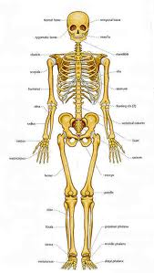

What Does Vitamin D Do?
Calcium Absorption
Strengthen Bones
Prevent Ricketts, Osteoporosis, and Osteomalacia
Notes:
Say: Some of you may be wondering what the benefits of getting the recommended dosage of Vitamin D are. Vitamin D helps to promote calcium absorption and make your bones strong. When it is combined with Calcium, it helps to strengthen bones and prevent the disease Ricketts. It has also been shown to help reduce the risk of osteomalacia, or softening of bones, as well as osteoporosis, the weakening of bones. Both of these conditions, if left untreated, place someone at a higher risk of bone fracture.

Slide 6
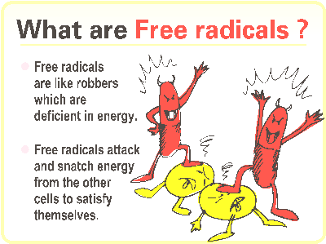
What Does Vitamin D do?
Assist Nerve Function
Decrease Inflammation and prevent free radical damage
Boost Immune System
May Prevent Certain Cancers
Notes:
Vitamin D even helps to assist nerve function. It decreases inflammation and keeps our immune system healthy and strong.
Vitamin D controls the expression of hundreds—and probably thousands—of genes. It is now recognized to play a crucial role in bone, cardiovascular, and colon and digestive-tract health; regulating blood pressure; guarding against cancer; and supporting healthy blood sugar levels in the human body.

Slide 7
Vitamin D deficiency can occur
In cold climates
Avoiding sun
Staying indoors
Avoiding foods high in Vitamin D
Notes:
Say: You may be wondering if you can get too much Vitamin D. The answer is yes, you can. When your body accumulates toxic levels of this vitamin, is it shown by muscle weakness, vomiting, and even kidney stones. You should limit your sun exposure
to 20 to 30 minutes per day, and avoid getting burned!

Slide 8

Mission:
To promote healthier lives through research and education in nutrition and preventive medicine.
The Pennington Center has several research areas, including:
Clinical Obesity Research
Experimental Obesity
Functional Foods
Health and Performance Enhancement
Nutrition and Chronic Diseases
Nutrition and the Brain
Dementia, Alzheimer’s and healthy aging
Diet, exercise, weight loss and weight loss maintenance
The research fostered in these areas can have a profound impact on healthy living and on the prevention of common chronic diseases, such as heart disease, cancer, diabetes, hypertension and osteoporosis.
The Division of Education provides education and information to the scientific community and the public about research findings, training programs and research areas, and coordinates educational events for the public on various health issues.
We invite people of all ages and backgrounds to participate in the exciting research studies being conducted at the
Pennington Center in Baton Rouge, Louisiana. If you would like to take part, visit the clinical trials web page at www.pbrc.edu or call (225) 763-3000.
Authors:
Heli Roy, PhD, RD
Beth Kalicki
Division of Education
Pennington Biomedical Research Center

