Slide 1
The Benefits of Seafood
Notes:
Say: Do you love seafood?
(Stop and allow students to respond)
Say: How many of you eat seafood at least once a week?
(Allow students to respond)

Slide 2


Seafood
Alligator
Crab
Shrimp
Fish
Crawfish
Oysters
Notes:
Say: There are a variety of types of seafood that are available to us. Examples of available seafood vary depending where you live. In Louisiana, we have a lot of shrimp, crawfish and oysters. In New England, they eat clams and lobsters. In Alaska and the Pacific west coast, they eat a lot of salmon.
Some examples of seafood that you can find at your local supermarket or meat store include: crawfish, shrimp, alligator, lobster, crab, oysters, as well as the many different varieties of fish. Common types of fish in Louisiana are catfish, redfish, gar, bass, trout, tuna and drum.

Slide 3

MyPyramid
Seafood is a part of the Meat and Bean Group in MyPyramid.
Notes:
Say: Seafood belongs to the Meat and Bean Group of MyPyramid. It is recommended that we eat more fish and seafood and chicken, and less red meat in order to reduce our risk for chronic diseases as we get older.
Name some of the common chronic diseases: diabetes, hypertension, heart disease, cancer, and stroke.

Slide 4

Why is Seafood Good for Us?
High in Protein
Low in Saturated Fat
Rich in Unsaturated Fat
Omega-3 Fatty Acids
Notes:
Say: Seafood is high in protein, low in saturated fats, rich in unsaturated fats, and an excellent source of Omega-3 fatty acids. The omega-3 fatty acid in seafood is the good kind of fat that prevents many chronic diseases.

Slide 5
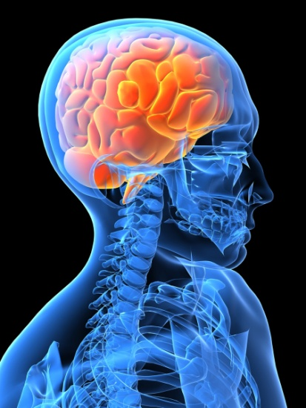
Omega-3 Fatty Acids
Health and Growth
Development
Blood Pressure
Brain Function and Memory
Triglyceride Levels
Decrease Possibility of
Numerous Diseases
Notes:
Say: You may be wondering why Omega-3’s are so good for you. Does anyone have any ideas?
(Stop and allow students to respond)
Say: Omega-3 fatty acids are valuable because they help cells grow and stay healthy. They also assist in lowering blood pressure,
improve brain function and memory, lower triglyceride levels, and decrease the possibility of heart disease, diabetes,
atherosclerosis, cancer, allergies, and other diseases. Omega-3’s can even help in the development of the brain and visual
system of young babies.

Slide 6

Types of Seafood High in Omega-3 Fatty Acids
Salmon
Rainbow Trout
Tuna
Mackerel
Black Cod
Sardines
Notes:
Say: Seafood that contains the greatest amount of Omega-3 fatty acids includes cold water fish such as salmon, rainbow trout, tuna, mackerel, black cod, and sardines.

Slide 7

How Much and How Often Should We Eat Seafood?
MyPyramid recommends 3 to 5 ounces of protein daily.
American Heart Association recommends that we eat two 3.5 ounce servings of fish a week.
Notes:
Say: The MyPyramid tells us that we should have 3 to 5 ounces of meat, fish, or poultry every day. The exact amount
depends on your size and weight. Based on research, it is recommended that we eat seafood two to three times a week.
(Suggest students go to <http://www.mypyramid.gov> and explore the website)

Slide 8
Recap
Seafood is part of the Meat and Bean Group in MyPyramid.
Seafood and cold water fish are good sources of omega-3 fatty acids.
Omega-3 fatty acids prevent many chronic diseases of aging.
It is recommend that we consume several servings of fish and seafood each week.

Slide 9

Mission:
To promote healthier lives through research and education in nutrition and preventive medicine.
The Pennington Center has several research areas, including:
Clinical Obesity Research
Experimental Obesity
Functional Foods
Health and Performance Enhancement
Nutrition and Chronic Diseases
Nutrition and the Brain
Dementia, Alzheimer’s and healthy aging
Diet, exercise, weight loss and weight loss maintenance
The research fostered in these areas can have a profound impact on healthy living and on the prevention of common chronic diseases, such as heart disease, cancer, diabetes, hypertension and osteoporosis.
The Division of Education provides education and information to the scientific community and the public about research findings, training programs and research areas, and coordinates educational events for the public on various health issues.
We invite people of all ages and backgrounds to participate in the exciting research studies being conducted at the
Pennington Center in Baton Rouge, Louisiana. If you would like to take part, visit the clinical trials web page at www.pbrc.edu or call (225) 763-3000.
Authors:
Beth Kalicki
Heli Roy, PhD, RD
Division of Education
Pennington Biomedical Research Center
10/10

