Slide 1
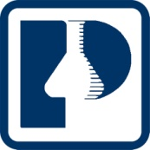
The DASH Diet Plan
Heli J. Roy, PhD, MBA, RD
Pennington Biomedical Research Center
LSU AgCenter

Slide 2
The DASH diet plan
Hypertension prevalence
What is blood pressure
Why is high blood pressure important?
How it affects the organ systems
What causes it
Blood pressure goals
Risk factors
Weight Loss
The DASH Diet
Reducing sodium
Physical activity
No smoking
Little alcohol

Slide 3

Hypertension Prevalence
72 million people in the US age 20 and older have high blood pressure, or 1 in 4.
One-third of people are unaware they have hypertension.
Less than half of American adults have optimal blood pressure.
Increases in prevalence and severity in African Americans.
Notes:
Hypertension affects 50 million American adults in the US. That’s about 1 in 4 adults.
NHANES: High blood pressure (HBP) is a major risk factor for heart disease and stroke, end-stage renal disease, and peripheral vascular disease and is a chief contributor to adult disability. Approximately one in four adults in the United States has hypertension . The prevalence of hypertension increases with age and is higher among women than men.

Slide 4

Hypertension Prevalence
African American men develop high blood pressure earlier in life than other men and are more likely to suffer serious side-effects from these diseases.
Within the African-American community, those with the highest rates of hypertension, are likely to be middle aged or older, less educated, overweight or obese, physically inactive and to have diabetes.
Notes:
There is increased prevalence of high blood pressure and increased severity in in African-Americans. It also tends to occur earlier in African Americans.
NHANES: The age-adjusted prevalence of hypertension is 40.5% among non-Hispanic blacks, 27.4% among non-Hispanic whites, and 25.1% among Mexican Americans.

Slide 5
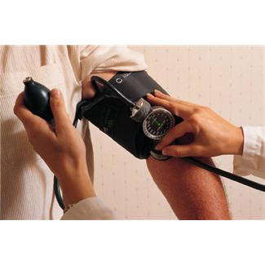
What is Blood Pressure?
The force of blood against the wall of the arteries.
Systolic means the pressure while the heart beats.
Diastolic pressure is measured as the heart relaxes.
Normal Blood pressure is less than 130 mm Hg systolic and less than 85 mm Hg diastolic.
130/85 mm Hg
Notes:
What is high blood pressure?
Blood pressure measures the force of blood against the walls of the blood vessels. Extra fluid in the body increases the amount of fluid in blood vessels and makes blood pressure higher. Narrow, stiff, or clogged blood vessels also raise blood pressure.

Slide 6
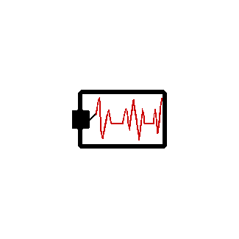
High Blood Pressure
A consistent blood pressure of 140/90 mm Hg or higher is considered high blood pressure.
It increases chance for heart disease, kidney disease, and for having a stroke.
Has no warning signs or symptoms.
Notes:
High blood pressure increases your chance for getting heart disease and kidney disease or for having a stroke. It is especially dangerous because it has no warning signs or symptoms. It is estimated that one in every four Americans has high blood pressure. Once it develops it can last a lifetime.

Slide 7
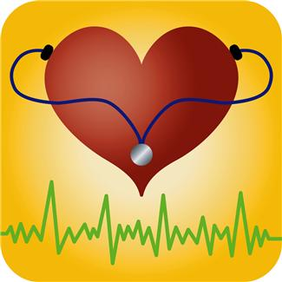
Why is High Blood Pressure Important?
Makes the Heart work too hard.
Increases the pressure on the walls of arteries and can cause hardening of arteries.
If left untreated, can cause heart failure, kidney disease, and blindness.
Increases risk for heart disease and stroke.
Notes:
Most people with high blood pressure have no signs or symptoms, even if blood pressure readings reach dangerously high levels. HBP can lead to headaches, being tired all the time, blurred vision, nosebleeds, ringing in the ears, chest pain, irregular heartbeat, feeling of confusion off and on and heart failure. Very high blood pressure, if untreated, could eventually lead to heart attack or stroke.

Slide 8
Untreated Hypertension
Target Organs that are Damaged:
The heart – heart disease
The brain - cerebrovascular disease
The kidneys - renal disease
Arteries - large vessel disease
Notes:
These are the reasons we want to get hypertension under control. It greatly increases the risk of chronic disease and there are higher health care costs associated with these diseases.
People with uncontrolled hypertension are:
3x more likely to develop coronary heart disease.
6x more likely to develop congestive heart failure
7x more likely to have a stroke
Heart disease is still the number one killer and stroke is still the number 3 killer in United States. (Cancer is number 2).
High blood pressure is a major risk factor for both.
Prevention is key. Your risk never goes back to where it was. Under the best of circumstances, a treated patient still has twice the risk of heart attack or stroke of someone who never had high blood pressure.

Slide 9
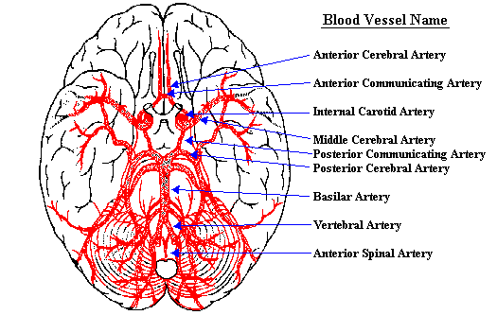
How Does It Effect the Body?
The Brain
High blood pressure is the most important risk factor for stroke.
Can cause a break in a weakened blood vessel which then bleeds in the brain.
Image: www.washington.edu
Notes:
How does it effect the body? High blood pressure is the most important risk facto for stroke. This can happen with a break in a weakened blood vessel which bleeds in the brain. A stroke can also happen when a blood clot blocks one of the narrowed arteries in the brain.

Slide 10
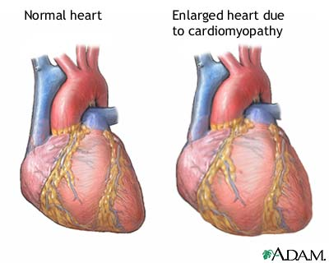
The Heart
High Blood Pressure is a major risk factor for heart attack.
Is the number one risk factor for Congestive Heart Failure.
Notes:
High blood pressure is a major risk for heart attack. The arteries bring oxygen carrying blood to the heart muscle. If the heart cannot get oxygen, chest pain know as angina can occur. If the flow of blood is blocked a hart attack results. Hypertension is also the number one risk facto of congestive heart failure. Which is a condition in which the heart cannot pump enough blood to meet the body’s needs.

Slide 11
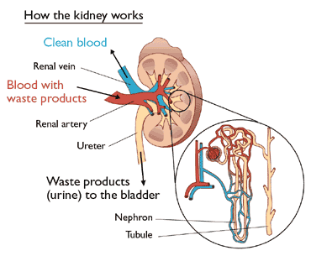
The Kidneys
Kidneys act as filters to rid the body of wastes.
High blood pressure can damage the small blood vessels in the kidneys.
Waste builds up in the blood leading to dialysis.
Image: www.umich.edu
Notes:
High blood pressure makes the heart work harder and, over time, can damage blood vessels throughout the body. Kidneys act as filters to rid the body of wastes. If the blood vessels in the kidneys are damaged, they may stop removing wastes and extra fluid from the body.
This results in waste building up in the blood and may result in the kidneys failing all together. Dialysis or kidney transplant my be needed in this situation.

Slide 12
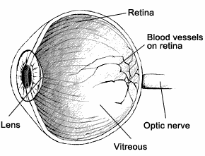
The Eyes
Can eventually cause blood vessels to break and bleed in the eye.
Can result in blurred vision or even blindness.
Image: www.diabetes.NIDDK.NIH.gov
Notes:
In addition to causing heart and kidney problems, untreated high blood pressure can also affect your eyesight and cause eye disease. Hypertension can cause damage to the blood vessels in the retina, the area at the back of the eye where images focus. This eye disease is known as hypertensive retinopathy. The damage can be serious if hypertension is not treated.

Slide 13
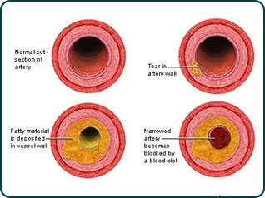
The Arteries
HBP can cause damage to arterial wall.
Arteries build scar tissue and attract lipid deposits at the damaged site.
Increased risk for stroke.
Image: http://www.cdc.gov
Notes:
As people get older arteries throughout the body harden especially those in the heart, brain, and kidneys. This in turn can cause damage to arterial wall which then can attract cells and lipid particles to the site, causing narrowing and hardening of arteries.

Slide 14
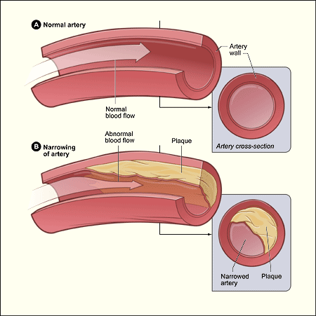
What causes High Blood Pressure?
Genetic factors
Being overweight or obese
High salt intake
Narrowing or stiffening of the arteries
Aging
Loss of elasticity of arterial wall
Stress
Too much alcohol
Organ system disorders
Image: http://www.nhlbi.nih.gov
Notes:
Any of these In as many as 95% of reported high blood pressure cases in the United States, the underlying cause cannot be determined. This type of high blood pressure is called essential hypertension.
Though essential hypertension remains somewhat mysterious, it has been linked to certain risk factors. High blood pressure tends to run in families and is more likely to affect men than women. Age and race also play a role. In the United States, blacks are twice as likely as whites to have high blood pressure, although the gap begins to narrow around age 44. After age 65, black women have the highest incidence of high blood pressure.
Essential hypertension is also greatly influenced by diet and lifestyle. The link between salt and high blood pressure is especially compelling.
The majority of all people with high blood pressure are "salt sensitive," meaning that anything more than the minimal bodily need for salt is too much for them and increases their blood pressure. Other factors that have been associated with essential hypertension include obesity; diabetes; stress; insufficient intake of potassium, calcium, and magnesium; lack of physical activity; and chronic alcohol consumption.
conditions will cause pressure against arterial walls.

Slide 15
Who can develop High Blood Pressure?
Anyone, but it is more common in:
African Americans. They tend to get it earlier and more often then Caucasians.
Older individuals. 60% of Americans over 60 have hypertension.
The overweight and obese.
Those with family history.
High normal bp:135-139/85-89 mm Hg.

Slide 16
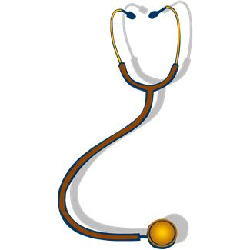
Detection
Dr.’s will diagnose a person with 2 or more readings of 140/90mm Hg or higher taken on more than one occasion with hypertension.
Measured using a spygmomameter.
Notes:
Doctors will diagnose a person with two or more readings of 140/90 or higher taken on several occasions. A reason that it has to be more than one occasion is the occurrence of “White Coat Hypertension.” Some people experience high blood pressure simply from the stress of being in the Doctor’s office. If your Doctor suspects this they may send you home with a heart monitor to get appropriate readings.

Slide 17
Blood Pressure Categories - Adults
 | Systolic (mm Hg) | Diastolic (mm Hg)
Optimal | <120 and | <80
Normal | <130 and | <85
High-Normal | 130-139 or | 85-90
High Stage 1 Stage 2 Stage 3 | 140-159 or 160-179 or >180 or | 90-99 100-109 >110
Notes:
Before discussing the DASH diet, I want to review a little about high blood pressure and then review some information related to mineral intake on hypertension.
These are the categories of blood pressure. To be considered optimal or normal, your systolic and diastolic pressures must fall within the recommended ranges. For high-normal and high, you fall into those categories if your systolic or diastolic pressure is high.
They not only define what high blood pressure is, they also help determine, along with other factors, how high blood pressure is treated.
For example, if your blood pressure is high normal and you have no major risk factors such as smoking, lipid abnormalities, diabetes, age over 60 years, etc. then treatment is lifestyle modifications.
Lifestyle modifications include changing dietary habits, increasing physical activity, stopping smoking, moderating alcohol intake, etc.
If your pressure is high normal and you already have target organ damage or clinical CVD, then treatment
changes to include drug therapy along with lifestyle modification.
Also, if your normal, don’t assume it’s low enough to ignore. As I showed you on the previous slide, only one out of two adults has blood pressure low enough to be considered optimal.

Slide 18
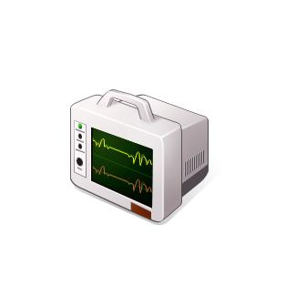
Blood Pressure Goals
Less than 140/90
Less than 130/80 if have diabetes
Ideally 120/80 or less
Lifestyle Changes when over 135/85
Notes:
Most doctors will not prescribe high blood pressure medicine until your blood pressure is 140/90. If you have diabetes, the American Diabetes Association recommends that blood pressure be treated at 130/80 since people with diabetes are at such high risk for heart attack, stroke, kidney failure and even blindness from damage to the blood vessels in the eyes. But researchers who study the effects of high blood pressure feel that lifestyle changes to lower blood pressure, even for those without diabetes, probably should be started when blood pressures approach 135/80. In fact, you have the lowest risk for complications associated with high blood pressure when your blood pressure is 120/80 or less. Any lifestyle change you can do to reduce your blood pressure to this level will be good for you and your body.

Slide 19
Risk Factors
Non-Modifiable
Modifiable
Age
Race/ethnicity
Gender
Family history
Overweight
Abnormal lipid metabolism
Smoking
Physical inactivity
Unhealthy diet
Excessive alcohol intake
Notes:
Who Is at Risk for High Blood Pressure?
High blood pressure (HBP) is a common condition. In the United States, about 1 in 3 adults has HBP.
Certain traits, conditions, and habits—known as risk factors—can raise your risk for HBP. The major risk factors for HBP are described below.
Older Age: Blood pressure tends to rise with age. If you're a male older than 45 or a female older than 55, you're at increased risk for HBP. Over half of all Americans aged 60 and older have HBP.
Isolated systolic hypertension (ISH) is the most common form of HBP in older adults. ISH occurs when only systolic blood pressure (the top number) is high. About 2 out of 3 people over age 60 with HBP have ISH.
HBP doesn't have to be a routine part of aging. You can take steps to keep your blood pressure at a normal level. (For more information, go to "How Is High Blood Pressure Treated?")
Race/Ethnicity: HBP can affect anyone. However, it's more common in African American adults than in Caucasian or Hispanic American adults. In relation to these groups, African Americans: Tend to get HBP earlier in life, Often have more severe HBP, Are more likely to be aware that they have HBP and to get treatment, Are less likely than Caucasians and about as likely as Hispanic Americans to achieve target control levels with HBP treatment, Have higher rates than Caucasians of early death from HBP-related problems, such as coronary heart disease, stroke, and kidney failure.
HBP risks vary among different groups of Hispanic American adults. For instance, Puerto Rican American adults have higher rates of HBP-related death than all other Hispanic groups and Caucasians. However, Cuban Americans have lower rates of HBP-related death than Caucasians.
Overweight or Obesity: You're more likely to develop prehypertension or HBP if you're overweight or obese. The terms "overweight" and "obesity" refer to body weight that's greater than what is considered healthy for a certain height.
Gender: Fewer adult women have HBP than adult men. But, younger women (aged 18–59) are more likely than men to be aware of and get treatment for HBP. Women aged 60 and older are as likely as men to be aware of and treated for HBP. However, among treated women aged 60 and older, blood pressure control is lower than it is in men in the same age group.
Family History: A family history of HBP raises your risk for the condition. Long-lasting stress also can put you at risk for HBP.
Modifiable risk factors: Abnormal blood lipid levels, that is high total cholesterol, high levels of triglycerides, high levels of low-density lipoprotein or low levels of high-density lipoprotein (HDL) cholesterol all increase the risk of heart disease and stroke. Changing to a healthy diet, exercise and medication can modify your blood lipid profile.
Tobacco use, whether it is smoking or chewing tobacco, increases risks of cardiovascular disease. The risk is especially high if you started smoking when young, smoke heavily or are a woman. Passive smoking is also a risk factor for cardiovascular disease. Stopping tobacco use can reduce your risk of cardiovascular disease significantly, no matter how long you have smoked.
Physical inactivity increases the risk of heart disease and stroke by 50%. Obesity is a major risk for cardiovascular disease and predisposes you to diabetes. Diabetes is a risk factor for cardiovascular disease.
A diet high in saturated fat increases the risk of heart disease and stroke. It is estimated to cause about 31% of coronary heart disease and 11% of stroke worldwide.
Having one to two alcohol drinks a day may lead to a 30% reduction in heart disease, but above this level alcohol consumption will damage the heart muscle.

Slide 20
Overweight and Obesity
Measure BMI routinely at each regular check-up.
Classifications:
  BMI 18.5-24.9 = normal
  BMI 25-29.9 = overweight
  BMI 30-39.9 = obesity
  BMI ≥40 = extreme obesity
Notes:
Many Americans are becoming overweight or obese. These conditions can lead to chronic diseases such as high blood pressure, diabetes, stroke, cancer, and diseases of the gallbladder, heart, and lungs. Such diseases can reduce the quality of life and can also lead to death. Body
Mass Index (BMI) is one of the commonly used measures of obesity. Body Mass Index (BMI) is a number calculated from a person's weight and height. BMI provides a reliable indicator of body fatness for most people and is used to screen for weight categories that may lead to health problems.
BMI values between 18.5 and 24.9 are considered “normal” or “healthy” weight. BMI values between 25 and 29.9 are considered “overweight” and 30 and above are considered “obese.” BMIs above 25 are unhealthy and have been shown to increase the risk of certain chronic diseases. BMIs under 18.5 are considered “underweight.
For most people, BMI provides a good measure of obesity. However, BMI does not provide actual information on body composition (i.e. the proportions of muscle, bone, fat, and other tissues that make up a person’s total body weight), and may not be the most appropriate indicator to determine health status for certain groups of people. For example, athletes with dense bones and well developed muscles or people with large body frames may be obese by BMI standards (i.e. they have BMIs greater than 30), but yet have little body fat. On the other hand, inactive people may seem to have acceptable weights when, in fact, they may have too much body fat.

Slide 21
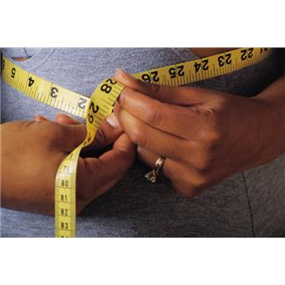
Measuring Waist Circumference
Large waist circumference (WC) can be used to assess increased risk for type 2 diabetes, high blood pressure, high cholesterol, and heart disease
A high-risk waist circumference is:
  A man with waist measurement over 40 inches (102 cm).
  A woman with waist measurement over 35 inches (88 cm).
A high waist circumference means you have too much abdominal fat. It means you need to lose weight.
Notes:
Besides shedding pounds, you should also keep an eye on your waistline. Carrying too much weight around your waist can put you at greater risk of high blood pressure. In general:
Men are at risk if their waist measurement is greater than 40 inches (102 centimeters, or cm).
Women are at risk if their waist measurement is greater than 35 inches (88 cm).
Asian men are at risk if their waist measurement is greater than 36 inches (90 cm).
Asian women are at risk if their waist measurement is greater than 32 inches (80 cm).

Slide 22
Lose Weight if Overweight
If follow DASH diet and increase activity, weight loss should occur gradually
Even 10 pounds can make a big difference!
Notes:
Losing weight if you are overweight is also something you probably would like to hear less about, but weight loss is very effective for blood pressure control. Even just a 10-20 pound weight loss can drop your blood pressure significantly. The good news is that if you follow the DASH diet and get more active, you may see the pounds slip away without even thinking about it.

Slide 23
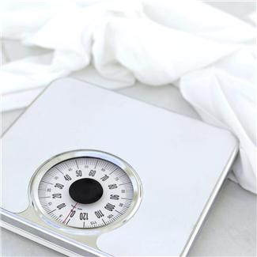
Reducing Overweight and Obesity
Lifestyle modification:
Reduce caloric intake by 500-1000 kcal/day (depending on starting weight)
Target 1-2 pound/week weight loss
Increase physical activity
Healthy diet
Notes:
Weight loss, sodium reduction, increased physical activity, and limited alcohol intake are established recommendations that reduce blood pressure (BP). Blood pressure often increases as weight increases. Losing just 10 pounds can help reduce your blood pressure. In general, the more weight you lose, the lower your blood pressure. Losing weight also makes any blood pressure medications you're taking more effective. You and your doctor can determine your target weight and the best way to achieve it.
It isn't easy to change your eating habits, but with these tips, you can adopt a healthy diet:
Keep a food diary. Writing down what you eat, even for just a week, can shed surprising light on your true eating habits. Monitor what you eat, how much, when and why.
Consider boosting potassium. Potassium can lessen the effects of sodium on blood pressure. The best source of potassium is food, such as fruits and vegetables, rather than supplements. Talk to your doctor about the potassium level that's best for you.
Be a smart shopper. Make a shopping list before heading to the supermarket to avoid picking up junk food. Read food labels when you shop, and stick to your healthy-eating plan when you're dining out, too.
Cut yourself some slack. Although the DASH diet is a lifelong eating guide, it doesn't mean you have to cut out all of the foods you love. It's OK to treat yourself occasionally to foods you wouldn't find on a DASH diet menu, like a candy bar or mashed potatoes with gravy.

Slide 24
Diet and Hypertension
Non-pharmacologic way of treating hypertension
DASH diet
  Dietary Approaches to Stop Hypertension
  High in whole grains, fruits, vegetables, and low-fat dairy
  Adequate Calcium, Potassium, Magnesium
  Low in red meat, sweets and sugar beverages
  Low in saturated and trans fat, cholesterol
Notes:
he DASH diet is physician-recommended for people with hypertension (high blood pressure) or prehypertension. The DASH diet eating plan has been proven to lower blood pressure in studies sponsored by the National Institutes of Health (Dietary Approaches to Stop Hypertension). In addition to being a low salt (or low sodium) plan, the DASH diet provides additional benefits to reduce blood pressure. It is based on an eating plan rich in fruits and vegetables, and low-fat or non-fat dairy, with whole grains. It is a high fiber, low to moderate fat diet, and is rich in potassium, calcium, and magnesium. The DASH diet is a healthy plan, designed for the whole family. New research continues to show additional health benefits of the plan.
In addition to being recommended by your physician, DASH is also endorsed by:
The National Heart, Lung, and Blood Institute (one of the National Institutes of Health, of the US Department of Health and Human Services)
The American Heart Association
The 2010 Dietary Guidelines for Americans
US guidelines for treatment of high blood pressure
and, the DASH diet formed the basis for the USDA MyPyramid.

Slide 25
DASH is Unique
Tested dietary pattern rather than single nutrients
Experimental diets used common foods that can be incorporated into recommendations for the public
Investigators planned the DASH diet to be fully compatible with dietary recommendations for reducing risk of CVD, osteoporosis and cancer
Notes:
Many studies of nutrition and high blood pressure have looked at individual nutrient supplements. DASH is unique because it examined effect of dietary patterns. With their much higher burden in terms of hypertension and cardiovascular disease compared to whites, AFRICAN AMERICANS could likely realize the greatest gains from improved diet quality.
The DASH diet can be also be incorporated into any diet for those with diabetes. It emphasizes an eating plan that is low in saturated fat, cholesterol, and total fat and higher in fruits, vegetables, and low-fat dairy foods. It also is lower in sodium than many dietary patterns.

Slide 26
Mineral Intake and Hypertension
Potassium
Clinical trials and meta-analyses indicate potassium (K) supplementation lowers BP
Adequate K intake, preferably from food sources, should be maintained
Evidence is strong enough to support a health claim on high potassium foods
Best sources are fruits and vegetables
Notes:
Potassium Health Claim
FDA announced that after October 31, 2000 that manufacturers whose foods met the criteria, could claim on the label, “Diets containing foods that are good sources of potassium and low in sodium may reduce the risk of high blood pressure and stroke.”
Qualifying foods must be a “good source” of potassium (10% or more of the DV of 3500mg), and be low in sodium, low fat and low saturated fat and low cholesterol.
It’s important to note that under the provisions of the FDA Modernization Act of 1997, a manufacturer may submit notification of a health claim based on an authoritative statement from an appropriate scientific body of the US government of the NAS or any of it’s subdivisions.
If FDA does not act to prohibit or modify such a claim, it may be used 120 days after receipt of the claim.

Slide 27
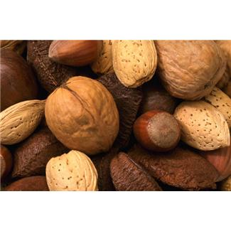
Mineral Intake and Hypertension
Magnesium
Evidence suggests an association between lower dietary magnesium intake and high blood pressure
Food sources are nuts, beans, vegetables
Notes:
Epidemiologic evidence suggests that magnesium may play an important role in regulating blood pressure. Diets that provide plenty of fruits and vegetables, which are good sources of potassium and magnesium, are consistently associated with lower blood pressure. The DASH study (Dietary Approaches to Stop Hypertension), a human clinical trial, suggested that high blood pressure could be significantly lowered by a diet that emphasizes fruits, vegetables, and low fat dairy foods. Such a diet will be high in magnesium, potassium, and calcium, and low in sodium and fat.

Slide 28
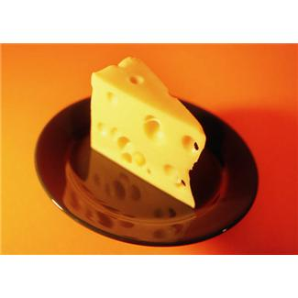
Mineral Intake and Hypertension
Calcium
American Heart Association Statement
  Increasing calcium intake may preferentially lower blood pressure in salt-sensitive people
  Benefits more evident with low initial calcium intakes
  (300-600 mg/day)
Best food sources are dairy products.
Notes:
In 2004, according to a study published in Journal of the National Cancer Institute, drinking two glasses of milk
per day decreases the risk of colorectal cancer by 12 percent.
The National Institute of Child Health and Human Development released new blood pressure guidelines
for children. The guidelines, published in Pediatrics, recommended prevention by incorporating a healthy
diet that includes lowfat dairy.
The Surgeon General’s Report on Osteoporosis and Bone Health suggests that the recent rise in bone
diseases among men and women of all ages and ethnicities is linked to the decline in the nutritional
quality of American’s diets. The report recommends lifestyle changes for all Americans – through regular
physical activity and consumption of calcium- and vitamin D-rich foods, such as milk, cheese and yogurt,
each day.
In 2005, the ﬁrst study to look at the effects of food intake on blood pressure in children appears in
Epidemiology. The researchers found that children who consistently ate more servings of dairy foods,
fruits and vegetables had the lowest blood pressure over time.
Several clinical trials have demonstrated a relationship between increased calcium intakes and both lower blood pressure and risk of hypertension. In the Women's Health Study, calcium intake was inversely associated with risk of hypertension in middle-aged and older women. Calcium's effects on blood pressure might depend upon the population being studied.

Slide 29

DASH Reduces Homocysteine Levels
Effect a result of diet high in vitamin B-rich milk and milk products, fruits and vegetables
Lowering homocysteine with DASH may reduce CVD risk an additional 7%-9%
Appel, et al. Circulation, 102:852, 2000
Notes:
Homocysteine is an amino acid that is synthesized in the body and at high levels it can increase the risk for cardiovascular disease. Homocysteine is used to synthesize an amino acid methionine in the body with an adequate intake of B vitamins such as folic acid (from greens), B12 (from animal sources and intestinal synthesis), and pyridoxine (whole grains, vegetables, fruits).

Slide 30
DASH Diet Pattern based on a 2,000 calorie diet
Food Group Servings*
Grains 6-8
Vegetables 4-5
Fruits 4-5
Low-fat or fat free dairy 2-3
Meats, poultry, fish less than 6
Nuts, seeds, dry beans and peas 4-5/week
Fats and oils 2-3
Sweets 5/ week
Sodium 2300 mg
* Per day unless indicated
Notes:
These are the serving based on the DASH diet. Based on a 2000 calorie diet, a person should consume 6-8 servings of grains, with half of them being whole grain; 4-5 servings of vegetables; 4-5 servings of fruit; 2-3 servings of low fat or fat free dairy; 6 or less servings of meat, poultry of fish; 4-5 servings of nuts, seeds or legumes a week; 2-3 servings of fats and oils, 5 or less servings of sweets and added sugars; and limit sodium to 2300 mg.

Slide 31

Dash Diet
Slowly increase intake of fruits and vegetables to 8 or more per day
Three servings of low fat and non-fat dairy products a day
Nuts, seeds and dried beans 4-5 times per week
Notes:
Now let’s look at the specifics of the DASH diet. As I said, it really emphasizes fruits and vegetables. While 5 a day is a nice start, this study actually found 8 servings a day is even better. That sounds like a lot, but if you have 2 servings of fruits and/or vegetables at each meal, plus one serving at two snacks you have hit your daily quota. Remember servings are not huge. (Show food models of vegetables or fruits or actual food portioned appropriately) One serving is ½ cup cooked vegetable or fruit, 1 cup raw or a medium piece of fresh fruit. The study also found that getting 3 servings of low fat or non-fat dairy products also was beneficial. A serving would be 8 ounces of skim or reduced fat milk, 1 cup low fat or non-fat yogurt or 1 ½ ounces of reduced fat cheese.
Again by adding one serving to each meal, you could meet the goal. The study also found that using nuts, seeds and dried beans as meat substitutes 4-5 times per week also seemed to lower blood pressure.

Slide 32
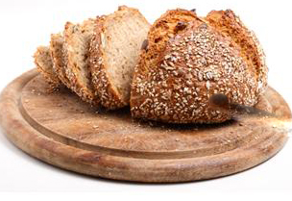
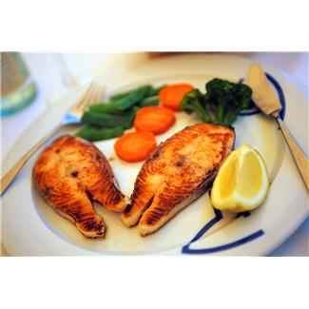
DASH Diet continues...
More whole grain cereals and breads
6 ounces or less of meat, fish or poultry per day
Small amounts of liquid or soft margarine or oil
Notes:
DASH also substituted whole grain breads and cereals for breads and grains that were highly processed. These whole grains provide beneficial magnesium and fiber. Meat, fish and poultry servings were kept small – no more than 3 ounces per meal to control fat and cholesterol. (Show food model of portion sizes) Very little added fat was recommended and what fat was added was from soft or liquid margarines or liquid vegetable oils which are lower in cholesterol, saturated fat and trans fatty acids.
Activity: Divide the group into smaller groups of 3 people. Have each group plan either a breakfast, lunch or dinner using the DASH recommendations. Have recorder from each group write down on a piece of paper from a flip chart what they plan. Tape the planned meals on the wall. Have each report to the whole group what they decided. Then have the entire group suggest snack ideas to round out the day.

Slide 33
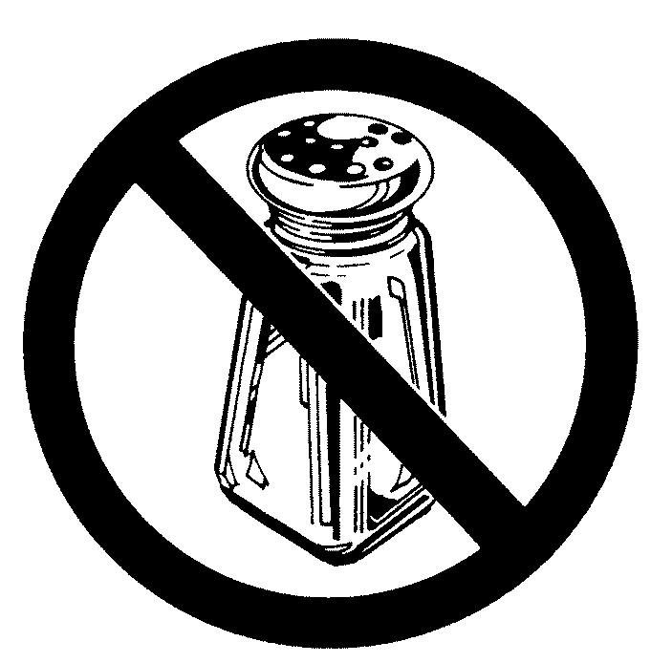
Eat Less Sodium
DASH is more effective if also reduce sodium
Less than 2400 milligrams per day
Reduce slowly in 2-3 weeks so that taste buds will get use to less salt
Notes:
As I said, DASH was even more effective if the sodium level was restricted to around 2400 milligrams per day. Frankly that is not very high, and most people would have to make some big changes in their cooking and eating habits to hit that level, but it can be done. Your “Cutting the Salt” handout details what you can do to reduce your sodium intake. While your food at first will taste rather bland, in just 2-3 weeks you will be surprise how salty food begins to taste bad. You will begin to enjoy the real flavor of food instead of the overwhelming taste of salt.

Slide 34
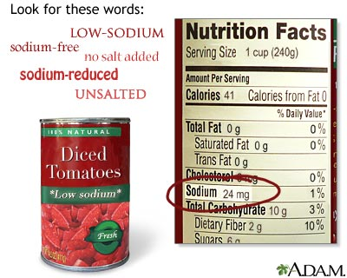
Ways to Cut Sodium
Remove salt shaker
Add little if any salt to cooking
Buy more fresh or plain frozen “no added salt” veggies
Use more herbs and spices
Make soups and stews ahead without salt and let flavors blend
Use fresh poultry, lean meat, and fish
Notes:
Of course the most obvious way to lower your sodium intake is to take the salt shaker off the table. Another is to either cut in half or leave out entirely the table salt added to recipes like quick breads, casseroles, cooked vegetables and even the water you cook pasta in. Most frozen vegetables, unless they have a sauce, are relatively low in sodium if you don’t add salt. Canned vegetables, however, can be very high in sodium. If you must use canned, rinse them in a colander for one minute and then cook them in fresh water. Season vegetables, meats, chicken, fish and casseroles with a squeeze of lemon or a tablespoon of table wine instead of salt. Lemon juice and wine both naturally contain potassium chloride which is what is used in most salt substitutes. But don’t use cooking wine, it contains salt! Your handout also lists some common spices and herbs you can use instead of salt in various foods. Can any of you recommend another herb or spice that seems to enhance a favorite food or dish of yours? Finally, make soups and stews without salt, or at least half the salt, and let them blend overnight to enhance their flavors without so much salt.

Slide 35
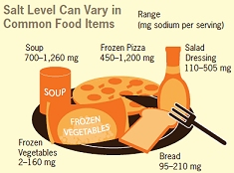
Ways to Cut Sodium
We get most of our salt from convenience foods.
Use unsalted canned or frozen vegetables. If use regular, rinse canned foods to reduce sodium.
Choose convenience foods low in salt when available.
Use fewer convenience foods
Compare labels
Image: http://www.nlm.nih.gov
Notes:
Most Americans eat way to much salt in their diets. The current recommendation is to consume less than 2.4 grams of sodium a day. 2 grams of sodium is equal to 1 teaspoon of salt. All our bodies actually need is 500 mg or ¼ teaspoon. Americans consume on the average 4000 to 6000 mg of sodium a day. For a person with high blood pressure the doctor my recommend a 1500 mg sodium diet. These low sodium diets can keep blood pressure from rising and help medications work better.

Slide 36

Ways to Cut Sodium
Most restaurant foods are very high in sodium
Eat out less often
Make more foods from scratch.
Notes:
If you look at the nutrition label of most convenience foods, you will see that many are very high in sodium. Also if you get nutrition information on foods we eat at restaurants, they are very high. IF you seriously want to cut the sodium level in your diet you need to eat convenience foods that are lower in sodium and eat out less often. In fact, you may want to eat out only once a week if that often.

Slide 37
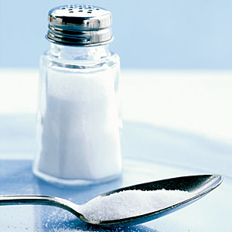
Using the Food Label to Cut Sodium
Sodium is a chemical that makes up ½ of table salt
Limit to 2400 milligrams per day
Look for “low sodium” or “salt free” – watch “reduced sodium”
Choose more foods with Daily Value less than 10%
Balance higher sodium foods with lower sodium foods
Notes:
Activity: Hand out food labels with a variety of sodium levels. Include lower sodium and regular canned soups, instant and regular cooked cereals, Healthy Choice and regular frozen entrees, regular and low sodium canned and frozen vegetables, cottage cheese and natural cheese, regular and reduced sodium soy sauce, regular, reduced sodium and low sodium bouillon. Sodium makes up ½ the molecule of table salt and it seems to be what raises some people’s blood pressure. The goal is to consume an average of 2400 milligrams or less per day. Use the food label to choose foods that are lower in sodium. Look at the labels I’ve given you. Do any of you have a food that says it is low sodium or reduced in sodium? Foods that are low sodium contain less than 140 milligrams of sodium. Very low sodium foods contain 35 milligrams or less. However a reduced sodium food onlly has its sodium reduced by at least 25% from the amount found in the regular product. For example, tell me how much sodium is in the reduced soy sauce and bouillon versus the regular soy sauce and bouillon. That is still pretty high, right? The Nutrition Facts label lists the total milligrams of sodium and the Daily Value. The Daily Value tells you the % of the total recommended 2400 milligrams for the day the product provides. If the Daily Value is 5% or less, it is a very low sodium food. If it is 10-19%, it is moderately high and over 20% means the food is very high in sodium. Look at your labels and tell me whether your food is low, medium or high in sodium. To really keep your sodium intake low, try to select more foods with less than 10% of the Daily Value and balance higher sodium foods with lower sodium foods.

Slide 38
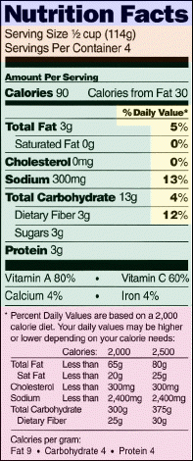
Look for the amount of sodium in foods by finding it on the Nutrition Facts Label.
Choose foods that have lower amount of sodium based on the label.
Notes:
Look for the amount of sodium in foods by finding on the Nutrition Facts Label.
Choose foods that have lower amount of sodium based on the label.

Slide 39

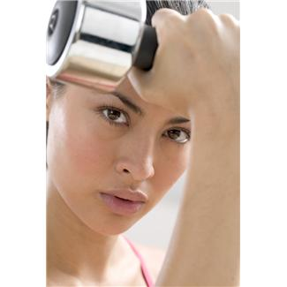
Be Physically Active
Helps lower blood pressure and lose/ maintain weight.
30 minutes of moderate level activity on most days of week. Can even break it up into 10 minute sessions.
Use stairs instead of elevator, get off bus 2 stops early, Park your car at the far end of the lot and walk!
Notes:
Physical activity not only helps control your blood pressure, it also helps you manage your weight, strengthen your heart and manage your stress level. A healthy weight, a strong heart and general emotional health are all good for your blood pressure.

Slide 40
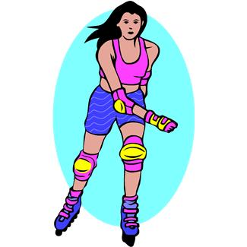
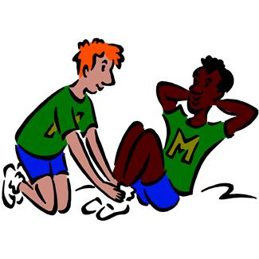
Be Physically Active
30 minutes at least 5 days a week
Can divide into 10-15 minute periods
Work up gradually
Do something that you enjoy
Notes:
Being more active is very important for controlling your blood pressure. I am sure some of you wish we’d quit talking about exercise, but we can’t deny the facts – those who are more physically active usually stay younger and healthier. Now we say you need to be physically active at least 5 days a week for 30 minutes a day total. The 30 minutes can be divided into smaller segments of 10-15 minutes so you can work it in better, but there is no denying activity counts as much as healthy food when controlling your blood pressure. Just don’t try to be an Olympic athlete. Do less than you think you can at first, and gradually increase your time and intensity over a few weeks.

Slide 41
Physical Activity
Guidelines
Fit into daily routine
Aim for at least 150 minutes/week of moderate aerobic exercise
Start slowly and gradually build intensity
Wear a pedometer (10,000 steps)
Take stairs, park further away or walk to another bus stop, etc.
Notes:
Regular physical activity helps improve your overall health and fitness, and reduces your risk for many chronic diseases.
or Important Health Benefits
Adults need at least:
2 hours and 30 minutes (150 minutes) of moderate-intensity aerobic activity (i.e., brisk walking) every week and muscle-strengthening activities on 2 or more days a week that work all major muscle groups (legs, hips, back, abdomen, chest, shoulders, and arms).
1 hour and 15 minutes (75 minutes) of vigorous-intensity aerobic activity (i.e., jogging or running) every week and muscle-strengthening activities on 2 or more days a week that work all major muscle groups (legs, hips, back, abdomen, chest, shoulders, and arms).
An equivalent mix of moderate- and vigorous-intensity aerobic activity and muscle-strengthening activities on 2 or more days a week that work all major muscle groups (legs, hips, back, abdomen, chest, shoulders, and arms).

Slide 42
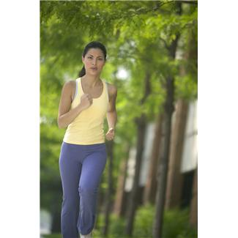
Physical Activity
Benefits of Exercise
Lower blood pressure
Weight control
Increased insulin sensitivity
Improved lipid levels
Improved blood glucose control
Reduced risk of CVD
Prevent/delay onset of type 2 diabetes
Notes:
The Benefits of Physical Activity
Regular physical activity is one of the most important things you can do for your health. It can help:
Control your weight
Reduce your risk of cardiovascular disease
Reduce your risk for type 2 diabetes and metabolic syndrome
Reduce your risk of some cancers
Strengthen your bones and muscles
Improve your mental health and mood
Improve your ability to do daily activities and prevent falls, if you're an older adult
Increase your chances of living longer
If you're not sure about becoming active or boosting your level of physical activity because you're afraid of getting hurt, the good news is that moderate-intensity aerobic activity, like brisk walking, is generally safe for most people.

Slide 43

Be Physically Active
brisk walking
house cleaning
lawn care
gardening
swimming
cycling
walking a golf course
racket sports
dancing
Notes:
Fortunately the activity doesn’t have to be too strenuous. Good examples are brisk walking (15 minutes a mile is good), house cleaning, lawn care (no rider mowers), gardening, swimming, cycling, walking a golf course (getting in and out of the cart doesn’t count), racket sports like tennis and racket ball and dancing. Add some lively music to your walk or chores and you may be surprised how much faster you do them and how much more fun it is. It is also wise to enlist others to do these activities with you since you are more likely to stick with them if you have a partner.

Slide 44
Don’t Smoke!
Notes:
This slide says it all. Each time you smoke your heart has to work harder and your blood pressure goes up. Not smoking is the best thing you can do for your cardiovascular system. Most people have to stop smoking at least 3 times before they can really quit for good so don’t give up. See your doctor and the Lung Association for help.

Slide 45
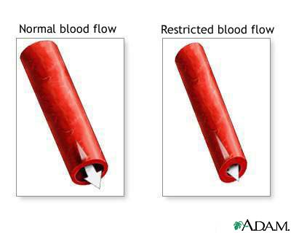
Quit Smoking
Injures blood vessel walls
Speeds up process of hardening of the arteries.
Notes:
Smoking injures blood vessel walls and speeds up the process of hardening of the arteries. Smoking causes shrinking of the arteries and restricted blood flow. So even though it doesn’t cause high blood pressure it is a bad idea for anyone, especially those with high blood pressure. Once you quit, your risk of having a heart attack is reduced after one year.

Slide 46
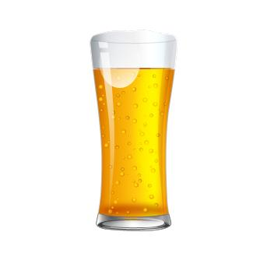
Limit Alcohol Intake
Excessive alcohol raises blood pressure and can harm liver, brain, and heart. Alcohol is an oxidant.
What counts as a drink?
12 oz beer
5 oz of wine
1.5 oz of 80 proof whiskey
Notes:
Alcohol can be both good and bad for your health. In small amounts, it can potentially lower your blood pressure by 2 to 4 mm Hg. But that protective effect is lost if you drink too much alcohol — generally more than one drink a day for women and more than two a day for men. Also, if you don't normally drink alcohol, you shouldn't start drinking as a way to lower your blood pressure. There's more potential harm than benefit to drinking alcohol.
If you drink more than moderate amounts of it, alcohol can actually raise blood pressure by several points. It can also reduce the effectiveness of high blood pressure medications.
Alcohol Quiz:
People with high blood pressure don’t have to limit the amount of alcoholic beverages they drink. False – alcoholic beverages raise blood pressure.
Alcoholic drinks contain calories which is another good reason to cut back on them if you are trying to lose weight and control high blood pressure. True, 5 oz of wine = 100 calories.
A 12 ounce beer counts as one drink the same as 5 ounces of wine or 1.5 ounce of whiskey. True – They are all considered one drink. The beer is 150 calories, the others are 100 calories.

Slide 47
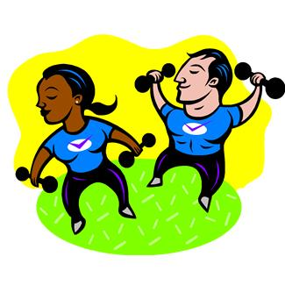
Try to -
Follow a healthy eating pattern.
Be Active
Not Smoke
Control Your Weight
Take Your Medicine
Notes:
And try to stop smoking, control your weight, get more active and take your high blood pressure medicine every day. The best treatment is prevention. Adopt a healthy life by: following a healthy eating pattern. Research as shown that following a healthy eating plan can both reduce the risk of developing high blood pressure and lowering an already elevated blood pressure. Maintain a healthy weight. Be physically active, limit alcohol and quit smoking

Slide 48
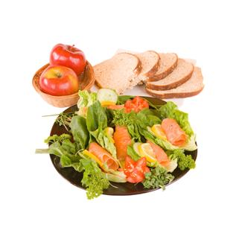
In Summary
Make a “Dash” for more –
  fruits and vegetables
  whole grains and breads
  non-fat and low fat dairy foods
  nuts, seeds and beans
Notes:
To summarize what we have said today, make a DASH to more fruits and vegetables, whole grain breads and cereals, non-fat and low fat dairy foods and nuts, seeds, and dried beans.

Slide 49
Conclusion
Hypertension is a very controllable disease, with drastic consequences if left uncontrolled.
Hypertension can be treated by diet and lifestyle measures that are as, or more effective than medication.
Notes:
Hypertension is dangerous if left untreated. Fortunately, research shows that hypertension can be treated by diet and lifestyle measures.

Slide 50
Resources
www.nhlbi.nih.gov
http://www.nhlbi.nih.gov/health/public/heart/hbp/dash/new_dash.pdf
http://emall.nhlbihin.net/hbpSubLink.asp?p=2&h=3&g=27&r=1
http://dashdiet.org
Notes:
Here are some resources about the DASH diet and about reducing sodium.

