Slide 1
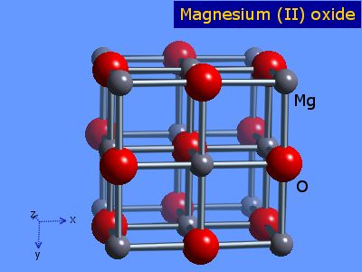
Magnificent
Magnesium

Slide 2
Fun Facts
Magnesium is essential for good health.
According to the National Institute of Health, it is the 4th most abundant mineral in the body.
Half of magnesium is in the bones.
It is needed for more than 300 different reactions in the body!
Notes:
Say: Some interesting facts about Magnesium include that it is essential for good health. The National Institute of Health states that Magnesium is the fourth most abundant mineral in the body and is essential to good health. Only 1% of magnesium is found in blood, but the body works very hard to keep blood levels of magnesium constant

Slide 3
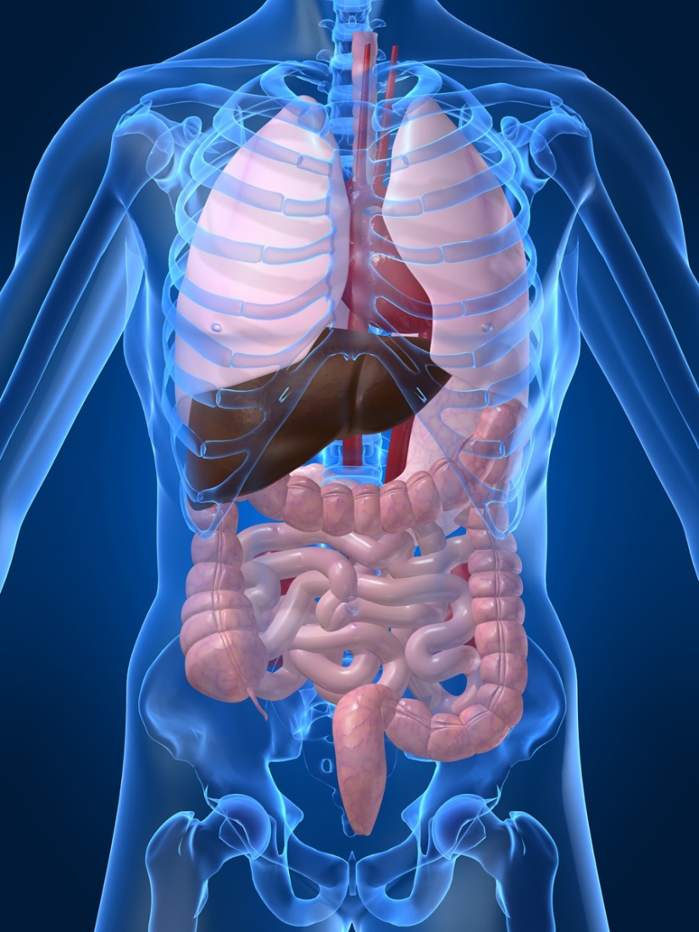
Where is Magnesium in My Body?
Bones
Cells of Tissues
Organs
Notes:
Say: You may be wondering where magnesium is stored within your body. Well, the majority of magnesium in the body can be
found in bones, but it may also be present in the cells of both tissues and organs. Approximately 50% of total body magnesium is found in bone. The other half is found predominantly inside cells of body tissues and organs.

Slide 4
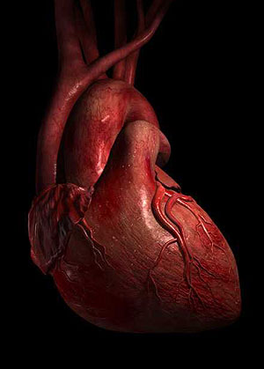
What Are the Benefits?
Aides muscle and nerve function
Keeps the heart rhythm steady
Helps keep bones strong
Boosts immune system
Excess is removed from the body via the kidneys.
Notes:
Say: There are multiple benefits to consuming foods high in magnesium. Magnesium helps with both muscle and nerve function. It even keeps the heart rhythm steady and bones strong. Some sources say that magnesium may boost immunity, which decreases the likelihood of becoming sick. Any excess magnesium that is consumed is removed from the body by the filtration process within the kidneys.

Slide 5
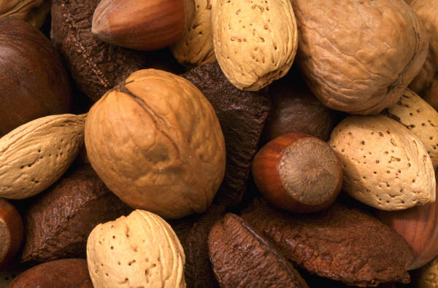

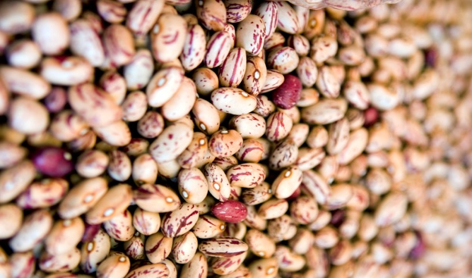
What Are Some Sources of Magnesium?
Various Nuts
Various Beans
Various Grain Product
Various Dairy Product
Spinach and Other Green Vegetables
Potato
Banana
Raisins
Notes:
Say: Does anyone know an example of a food containing high levels of magnesium?
(Allow students to respond then click screen for answers to appear)
Say: Some examples include various nuts, such as almonds, cashews, and peanuts. Various beans, which include soybeans, kidney beans, and pinto beans. Various grain products such as cereal, oatmeal, rice, and whole wheat bread. Various Dairy like plain yogurt, milk, and chocolate pudding. Other examples include: spinach, potatoes, black eyes peas, bananas, and raisins.
Green vegetables are a great source of magnesium. This is due to them containing a molecule called chlorophyll. This is actually the chemical that is responsible for giving them their green color.

Slide 6
Recommended Daily
Intake
Intake of Magnesium
Age | Male | Female
4 to 8 years | 130 mg/day | 130 mg/day
9 to 13 years | 240 mg/day | 240 mg/day
14 to 18 years | 410 mg/day | 360 mg/day
19 to 30 years | 400 mg/day | 310 mg/day
31 and older | 420 mg/day | 320 mg/day
Notes:
Say: The information presented represents the recommended intake of magnesium for both males and females throughout the lifespan. There is currently not a recommendation for children under the age of 4. It is stated that both boys and girls ages 4 to 8 years old are required to get 130 milligrams of magnesium daily. Once they are in the age bracket of 9 to 13 years old, the requirement increases to 240 milligrams per day.
It is during the teenage years that consumption by males and females begins to differ. Males between the ages of 14 and 18 are required to get 410 milligrams daily, while females are only required to have 360 milligrams per day. People who are between 19 and 30 years of age need to have 400 milligrams for males and 310 milligrams for females. Finally, once you are 31 or older, men must consume 420 milligrams of magnesium per day, and females are required to have 320 milligrams daily.

Slide 7
Magnesium and Health
Magnesium helps control blood pressure within normal levels.
Magnesium can help in controlling blood sugar and insulin levels.
Adequate magnesium level may also lower the risk for heart disease.
Having enough magnesium can help increase exercise time.
Adequate magnesium may also keep osteoporosis at bay.
Notes:
Say: The National Institute of Health recommends that if you have diabetes, you take additional amounts of magnesium in order to help with high blood sugar levels.

Slide 8

How Do I Know I am
Getting Enough?
Most individuals have adequate magnesium levels. Only those with specified medical conditions may require magnesium supplements.
Notes:
Say: You may wonder whether or not you are getting enough magnesium within your diet. If you are not getting enough, chances are, you may experience symptoms such as loss of appetite, nausea, vomiting, weakness, fatigue, muscle cramps, abnormal heart rhythm, or even seizures.

Slide 9

Mission:
To promote healthier lives through research and education in nutrition and preventive medicine.
The Pennington Center has several research areas, including:
Clinical Obesity Research
Experimental Obesity
Functional Foods
Health and Performance Enhancement
Nutrition and Chronic Diseases
Nutrition and the Brain
Dementia, Alzheimer’s and healthy aging
Diet, exercise, weight loss and weight loss maintenance
The research fostered in these areas can have a profound impact on healthy living and on the prevention of common chronic diseases, such as heart disease, cancer, diabetes, hypertension and osteoporosis.
The Division of Education provides education and information to the scientific community and the public about research findings, training programs and research areas, and coordinates educational events for the public on various health issues.
We invite people of all ages and backgrounds to participate in the exciting research studies being conducted at the
Pennington Center in Baton Rouge, Louisiana. If you would like to take part, visit the clinical trials web page at www.pbrc.edu or call (225) 763-3000.
Authors:
Heli Roy, PhD, RD
Beth Kalicki
Division of Education
Pennington Biomedical Research Center

