Slide 1

Green Tea
Beth Kalicki
Heli Roy, PhD, RD
Division of Education
Pennington Biomedical Research Center

Slide 2

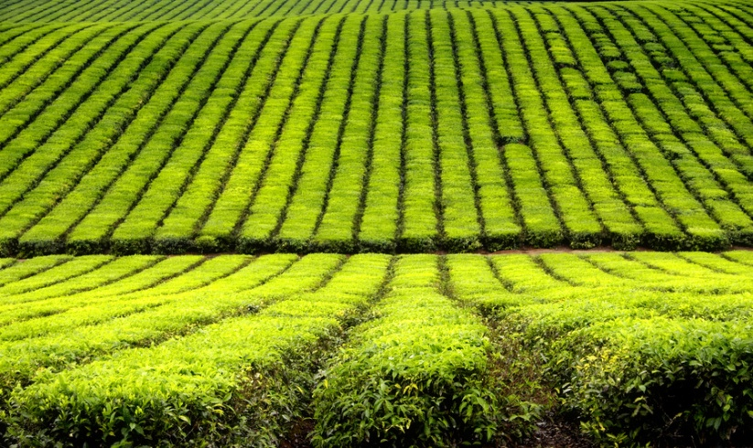
Types of tea
Green tea is one of four types of tea that come from the plant Camellia Sinensis. The types include:
  White Tea
  Green Tea
  Black Tea
  Oolong Tea
Notes:
Green tea is one of four types of tea that come from the plant Camellia sinensis. The types include:
White Tea
Green Tea
Black Tea
Oolong Tea

Slide 3


Processing of teas
White tea is the least processed form of tea, while black tea leaves are fermented.
Green tea leaves are steamed, not fermented, and hence preserve more polyphenols.
Notes:
Tea has been consumed as a beverage for thousands of years, first in the Orient and then Europe and the Americas. Green tea has long been used in oriental medicine because of its beneficial effects.
White tea is the least processed form of tea, while black tea leaves are fermented.
Green tea leaves are steamed, not fermented, and hence preserve more polyphenols.

Slide 4

Green Tea and Chronic Diseases
Many studies have found beneficial effects associated with the consumption of green tea in six different areas:
  Cardiovascular Diseases
  Obesity and Weight Loss
  Diabetes
  Cancer
  Microbial Diseases
  Neurodegenerative Diseases
    Aging
    Parkinson’s Disease
    Alzheimer’s Disease
Notes:
Research on green tea and its components shows an impact on obesity and weight gain in both laboratory animals and human subjects. Green tea has an impact on food intake, body weight, and body fat, as well as on cholesterol, triglycerides, and glucose levels. With the high rates of overweight and obesity seen in the US, green tea could prove to be a valuable natural obesity prevention option. Green tea is also effective in preventing and delaying other chronic diseases.

Slide 5

Why is Green Tea Beneficial?
The benefits are attributed to polyphenols called catechins, which make up 30% of the dry weight of green tea leaves.
Green tea has the highest content of polyphenols compared to black or oolong tea.
Notes:
The benefits are attributed to polyphenols, particularly catechins, which make up 30% of the dry weight of green tea leaves.
These catechins are present in higher quantities in green tea than in black or oolong tea, because of the differences in the processing of tea leaves after harvest.

Slide 6

EGCG
Active ingredients in green tea:
(-)epigallocatechin-3-gallate or EGCG, one of six catechins in green tea and the most abundant.
65% of green tea’s catechin content is due to EGCG.
One cup of green tea contains approximately 100-200 milligrams of EGCG.
Other components found in green tea include: caffeine, theanine, theaflavins, theobromine, theophylline, and phenolic acids such as gallic acid.
Notes:
Green tea has polyphenols that are the active ingredients. (-)epigallocatechin-3-gallate or EGCG is one of the most active ones.
Green tea has polyphenolic catechins (flavonols), of which EGCG is one of six. EGCG is the most abundant catechin, accounting for 65% of green tea’s catechin content, and seems to produce most of the beneficial effects found in green tea. One cup of green tea contains approximately 100-200 milligrams of EGCG. Other components found in green tea include: caffeine, theanine, theaflavins, theobromine, theophylline, and phenolic acids such as gallic acid.

Slide 7

Health Benefits of Green Tea
EGCG has been linked to
Reduced fat absorption
Increased energy expenditure
Weight loss
Reduced number of cavities
Reduced LDL oxidation
Reduced heart disease risk
Increases insulin sensitivity
Inhibition of cancer development

Slide 8
Green Tea and Weight Loss
Catechins influence intestinal and cell metabolism in several ways:
  Inhibiting intestinal lipases
  Decreasing fat absorption
  Increasing fat excretion
  Increasing uncoupling proteins
  Increasing thermogenesis
  Decreasing lipogenic enzymes
  Suppressing appetite
Notes:
Catechins influence intestinal and cell metabolism in several ways:
Inhibiting intestinal lipases – reduces fat absorption
Decreasing fat absorption – by tying fat particles so they are passed through
Increasing fat excretion – by inhibiting absorption, fat is eliminated through the intestinal track
Increasing uncoupling proteins – green tea promotes use of energy as heat
Increasing thermogenesis – expending energy as heat increases thermogenesis without increasing heart rate
Decreasing lipogenic enzymes – lipogenic enzymes in the liver are not as active with EGCG intake
Suppressing appetite – EGCG actually has an anorexic effect on appetite

Slide 9

Green Tea and Weight Loss
Increased thermogenesis:
  Green tea extract resulted in a significant (4%) increase in energy expenditure.
  Caffeine in amounts equivalent to those found in green tea extract (50 mg) had no effect on energy expenditure of fat oxidation.
Notes:
Intake of green tea was found to increase thermogenesis. The thermogenic effect was found to be greater than that due to the amount of caffeine found in tea.
A study in 10 subjects found that compared to a placebo, green tea extract resulted in a significant (4%) increase in energy expenditure. In addition, the excretions of norepinephrine was higher during treatement with the green tea extract than the placebo. This supports the finding that there was an increase in thermogenesis due to increased norepinephrine levels in the body.
Researchers then treated the subjects with caffeine in amounts equivalent to those found in gree ntea extract (50 mg) and found that caffeine had no effect on energy expenditure of fat oxidation.

Slide 10

Cardiovascular Disease
Consumption of ~32 ounces of green tea by Japanese men resulted in a 58% lower risk of dying from coronary heart disease than those who consumed about 10 ounces per day.
Dutch men and women who consumed about 13 ounces daily of black tea had a 68% lower risk of myocardial infarction (heart attack) than those who did not drink tea.
Notes:
Consumption of black tea which is notably lower in catechins, was also shown to provide significant benefits. In a 6 year old Dutch stud of over 4,500 men and women, those who consumed more that 3 cups (about 13 ounces daily) of black tea had a 68% lower risk of myocardial infarction (heart attack) than those who did not drink tea. Therefore, even moderate amounts of tea consumption can potentially provide significant cardiovascular protection.

Slide 11
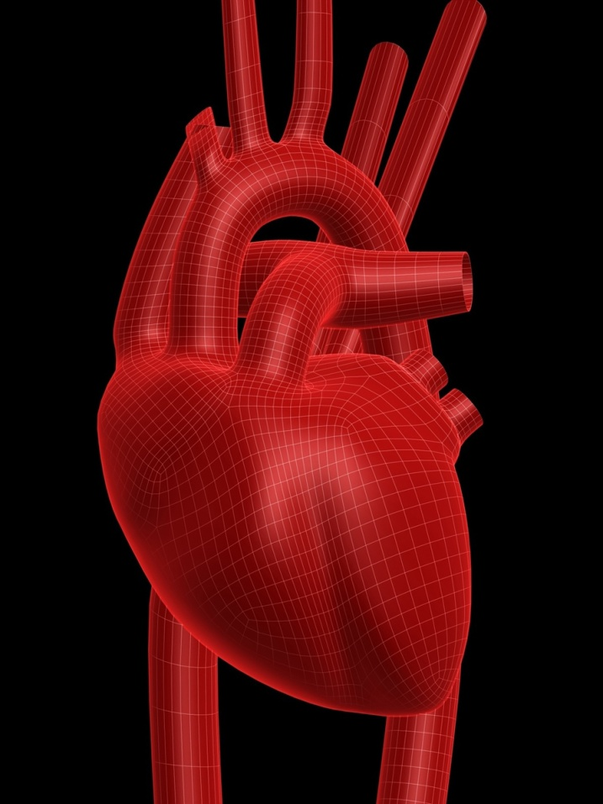
Cardiovascular Disease
Green tea polyphenols (catechins) prevent the oxidation of LDL cholesterol. This inhibits the formation of atherosclerotic plaques. Therefore, the consumption of green tea is believed to be linked to a lower risk of heart disease.
Notes:
Green tea polyphenols (catechins) are potent antioxidants which reduce free radical damage to cells and prevent the oxidation of LDL cholesterol. Preventing oxidation of the LDL particle inhibits the formation of atherosclerotic plaques. Therefore, the consumption of green tea is believed to be linked to a lower risk of heart disease.

Slide 12

Diabetes
Tea:
Improves glucose tolerance.
Increases insulin sensitivity.
EGCG is the most active catechin in increasing insulin sensitivity and glucose uptake..
Notes:
Green tea consumption can also benefit diabetics. In a study on human subjects, the consumption of green tea was shown to improve glucose tolerance. Basal blood glucose levels did not change.
In laboratory animals, long-term administration of green tea extract increased insulin sensitivity.
In cell culture studies, EGCG was the most active catechin in increasing insulin sensitivity and glucose uptake in isolated fat cells.

Slide 13

Cancer
Studies have clearly demonstrated the preventative effects of green tea and EGCG against many types of cancers at any stage (initiation, promotion, or progression).
The National Cancer Institute (NCI) has funded extensive research with green tea as a potential cancer chemoprotective agent.
Notes:
In the scientific world, green tea is probably best known and most studied for its effects on cancer prevention. Although epidemiological studies have not shown a clear link between cancer prevention and green tea, animal studies have been very convincing. They have clearly demonstrated the preventative effects of green tea and EGCG against liver, stomach, breast, prostate, lung, and skin cancers at any stage (initiation, promotion, or progression)
The National Cancer Institute (NCI) has funded extensive research with green tea as a potential cancer chemoprotective agent. A study is underway to see the chemoprotective effect of POLYOHENON E (a decaffeinated green tea extract currently in phase 2 clinical trials).

Slide 14
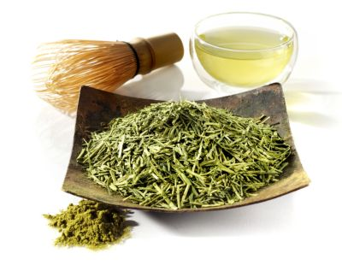
Tea Catechins and
Cancer Growth
Tea catechins act as powerful inhibitors of cancer growth in several ways. They:
  Remove harmful chemicals before cell injuries occur
  Reduce the incidence and size of tumors
  Inhibit the growth of tumor cells
Notes:
Some of the cancer preventive activity of green tea is due to its antioxidant activity. Smoking increases oxidative damage in cells. In a study, smokers were encouraged to consume several cups of green tea each day. The consumption of green tea was associated with decreases in the levels of 8-OHdG, a marker of oxidative DNA damage in smokers.

Slide 15

Dental Benefits
Prevents dental caries (cavities) by preventing bacterial growth
Increases the resistance of tooth enamel to acid induced erosion, and displays anti-inflammatory properties by reducing gum disease (gingivitis)
Notes:
Green tea has been known to prevent dental caries (cavities) by preventing the attachment of the bacteria associated with dental caries to the teeth. Green tea increases the resistance of tooth enamel to acid induced erosion, and displays anti-inflammatory properties by reducing gum disease (gingivitis)

Slide 16
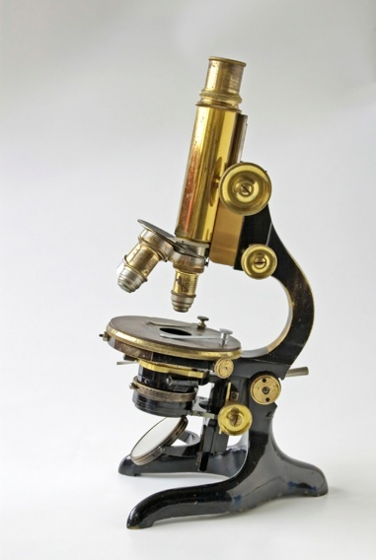

Microbial Diseases
Increases antibiotic effectiveness
Effective in preventing HIV infection at the initial step in the HIV-1 infection process
Notes:
Recently, green tea has been successful in increasing antibiotic effectiveness in multi-drug resistant Staphylococcus aureus infections. In addition, EGCG has been shown to be effective in preventing HIV infection at the initial step in the HIV-1 infection process.

Slide 17


Neurodegenerative Diseases
Free radical damage and oxidative stress are thought to lead to:
Parkinson’s disease
Alzheimer’s disease
and other diseases such as diabetes and cancer. Green tea have shown significant protection against the development of these diseases.
Notes:
According to the free radical theory of aging, increased free radical generation and oxidative stress are the basis for changes that lead to age associated functional deterioration and neurodegeneration. Several age associated diseases such as cancer, Parkinson’s disease, Alzheimer’s disease, cardiovascular disease, and diabetes have their etiologies linked to free radical damage. Due to the antioxidant properties of green tea and it’s extracts, several studies have examined the effects of green tea consumption on these age related conditions.
Oxidative stress, especially death of dopaminergic neurons is believed to be a major contributor to the pathogenesis of Parkinson’s Disease. Recently, misregulated iron metabolism in the brain has also been implicated as a potential contributor. Several studies using green tea have shown significant protection against the development of this disease. Because of its antioxidant and iron chelating properties, EGCG was believed to be the protective agent responsible for these results.
Although there is currently no epidemiological evidence on the benefit of green tea for Alzheimer’s Disease in humans, there have been several studies in laboratory animals and cell cultures which suggest that EGCG may delay this disease.
In laboratory animals, EGCG had a significant antioxidant effect and protected against neurological deficits.

Slide 18
Summary
The beneficial effects of green tea are attributed to the polyphenols, particularly the catechins, which make up 30% of the dry weight of green tea leaves.
These catechins are present in higher quantities in green tea than in black or oolong tea, because of the differences in the processing of tea leaves after harvest.
Green tea polyphenols are effective in preventing many chronic diseases such as cancer, diabetes, and heart disease and they are effective in helping to maintain healthy weight.

Slide 19

Mission:
To promote healthier lives through research and education in nutrition and preventive medicine.
The Pennington Center has several research areas, including:
Clinical Obesity Research
Experimental Obesity
Functional Foods
Health and Performance Enhancement
Nutrition and Chronic Diseases
Nutrition and the Brain
Dementia, Alzheimer’s and healthy aging
Diet, exercise, weight loss and weight loss maintenance
The research fostered in these areas can have a profound impact on healthy living and on the prevention of common chronic diseases, such as heart disease, cancer, diabetes, hypertension and osteoporosis.
The Division of Education provides education and information to the scientific community and the public about research findings, training programs and research areas, and coordinates educational events for the public on various health issues.
We invite people of all ages and backgrounds to participate in the exciting research studies being conducted at the Pennington Center in Baton Rouge, Louisiana. If you would like to take part, visit the clinical trials web page at www.pbrc.edu or call (225) 763-3000.
Authors:
Beth Kalicki
Heli Roy, PhD, RD
2011
Division of Education
Pennington Biomedical Research Center

