Slide 1
Fantastic
Fiber
Notes:
Say: Does anyone know what dietary fiber is?
(pause to let students respond, then click to next slide.)

Slide 2
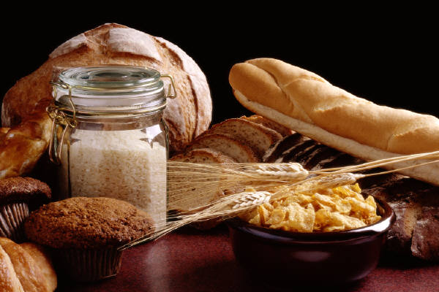
What’s So Good About Fiber?
Fiber is also known as bulk or roughage.
It helps promote digestion of food, as well as elimination of waste from the body
Notes:
Say: Fiber is also known as bulk roughage. It helps your body to digest food, as well as get rid of wastes. Fiber helps us feel full after a meal because if fills our stomach, and it helps us eliminate waste and go to the bathroom regularly.

Slide 3
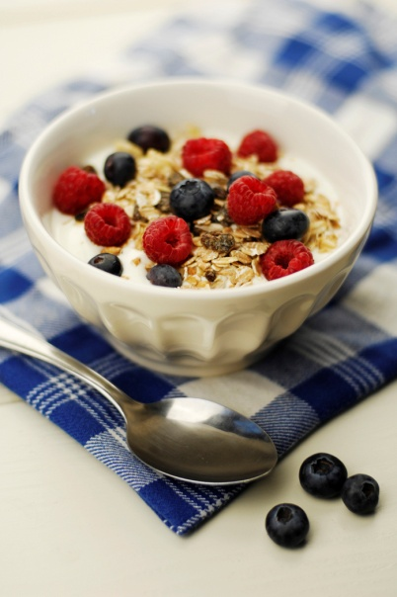

What are the Two Types of Fiber?
Soluble Fiber:
  - Is only partially digested within the body.
Insoluble Fiber:
  - Is not digested by the body
Notes:
Say: There are two types of fiber. So, who can tell me the two types of fiber are?
(wait for student response and verify whether or not their answer is correct)
Say: That’s correct. Soluble fiber and Insoluble fiber are the two types of fiber. Does anyone know the difference between the two?
(wait for student response and verify whether or not their answer is correct. If no one raises their hand, proceed to tell them…)
Say: Soluble fiber is only partially digested within the body, while Insoluble fiber is not digested by the body at all. Both types of fiber are healthy for us and we should have some of each every day.

Slide 4
What do the two fibers do?
Soluble Fiber:
Slows down digestion
Reduces cholesterol
Reduces insulin and glucose levels
Insoluble Fiber:
Helps move food through the digestive track
Traps and removes harmful substances from the intestinal track

Slide 5

What are Some Common Examples of Soluble Fiber?
Oat Bran
Rice Bran
Beans
Barley
Citrus Fruits
Apples
Oatmeal
Peas
Strawberries
Notes:
Say: Does anyone know an example of soluble fiber?
(Pause and let students respond)
Say: As you all now know, soluble fiber is partially digested within the body. Some common examples include: oat bran, rice bran, beans, barley, citrus fruits, apples, oatmeal, peas, and strawberries. How many of you eat some of these foods?
(Pause and let students respond)
Say: Foods that are rich in soluble fiber have been shown to reduce low density lipoproteins or LDL (bad) cholesterol levels. It may
also decrease your risk for heart disease.

Slide 6
What are Some Common Examples of Insoluble Fiber?
Whole wheat breads
Wheat cereals
Wheat bran
Barley
Beets
Brussels Sprouts
Turnips
Apples (eat with skin)
Rice
Cauliflower
Rye
Notes:
Say: Does anyone know any examples of insoluble fiber?
(Pause and let students respond)
Say: Some examples of insoluble fiber may include: whole wheat breads, wheat cereals, wheat bran, barley, beets, Brussels sprouts,
turnips, apple skins, rice, cauliflower, and rye. Are any of these common in your diet?
(Pause and let students respond)
Say: Does anyone know what insoluble fiber does for your body?
(Pause and let students respond)
Say: Insoluble fiber has been shown to improve the speed at which food moves through the body and decreases the risk of heart
disease. It helps you be able to feel fuller longer, causing you to eat less.

Slide 7



MyPyramid
The best sources of fiber in foods come from these three groups in MyPyramid.
Notes:
Say: The best sources of fiber in foods come from three different groups from MyPyramid:
the grain group. This provides both soluble and insoluble fiber. Wheat fiber is mainly insoluble while oatmeal and beans have a lot of soluble fiber.
The vegetable group. Most vegetables have fiber in them. Vegetables such as sweet potatoes, potatoes, broccoli, particularly in the stalk, peas, beans, corn, lentils, and carrots are good sources of fiber.
The fruit group. Many fruits have fiber in them: apples, oranges, peaches, melons, bananas, grapes, berries etc. If you eat your fruit with the skin on, such as apples, you get more fiber. The fiber is in the skin and cell walls.

Slide 8

Serving Sizes
The National Institute of Health recommends that we should get between 25 and 38 grams of fiber per day.
Notes:
Say: The National Institute of Health recommends that men over age and younger, should get 38 pounds of fiber per day.
Women ages 50 and younger should get 25 grams of fiber daily. So the next time that you plan on preparing a meal, question
yourself about how much fiber you are getting. Your body will be thankful you did.

Slide 9
Total fiber intake/day
Food (high fiber foods only) Fiber Grams Total Grams
Breakfast
Cereal, Raisin Bran, 1 cup 5 5
Snack
Apple 3 8
Lunch
Salad with broccoli 4.3 12.3
Brown rice, ½ cup 5.5 17.8
Dinner
Baked potato, small 4.2 22
Strawberries, 1 cup 3 25

Slide 10
Recap
Dietary fiber comes mainly from cereals, fruits and vegetables.
There are two types of fiber: soluble and insoluble.
We should consume at least 25 grams of total fiber a day.
It is not difficult to get enough fiber if we eat whole grain foods and fruits and vegetables.

Slide 11
Do You
Have
Any Questions?

Slide 12

Mission:
To promote healthier lives through research and education in nutrition and preventive medicine.
The Pennington Center has several research areas, including:
Clinical Obesity Research
Experimental Obesity
Functional Foods
Health and Performance Enhancement
Nutrition and Chronic Diseases
Nutrition and the Brain
Dementia, Alzheimer’s and healthy aging
Diet, exercise, weight loss and weight loss maintenance
The research fostered in these areas can have a profound impact on healthy living and on the prevention of common chronic diseases, such as heart disease, cancer, diabetes, hypertension and osteoporosis.
The Division of Education provides education and information to the scientific community and the public about research findings, training programs and research areas, and coordinates educational events for the public on various health issues.
We invite people of all ages and backgrounds to participate in the exciting research studies being conducted at the
Pennington Center in Baton Rouge, Louisiana. If you would like to take part, visit the clinical trials web page at www.pbrc.edu or call (225) 763-3000.
Authors:
Heli Roy, PhD, RD
Beth Kalicki
Division of Education
Pennington Biomedical Research Center
10/10

