Slide 1
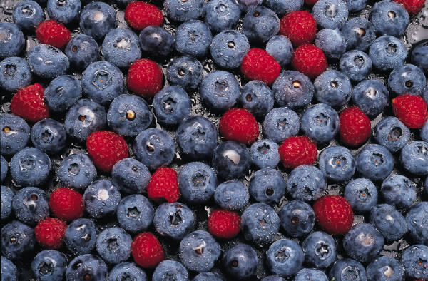
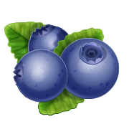
Blueberries

Slide 2
True Blue Facts
Genus Vaccinium, section Cyanoccus.
Blueberries have many health benefits.
Blueberries have antioxidant compounds that may delay chronic diseases.
Blueberries are eaten fresh and are used in cooking.
Notes:
Blueberries are the common name for the group of flowering plants in the genus Vaccinium, section Cyanoccus.
The USDA reports that between the years of 1994 and 2003 that the annual US consumption of fresh blueberries rose about 1.6 times!
This increased consumption is likely due to health benefits associated with regular blueberry consumption.
Blueberries have antioxidant compounds that may delay chronic diseases.
Blueberries are used in jellies, jams, and pies. They are baked into muffins and are an ingredient in many other snacks.

Slide 3
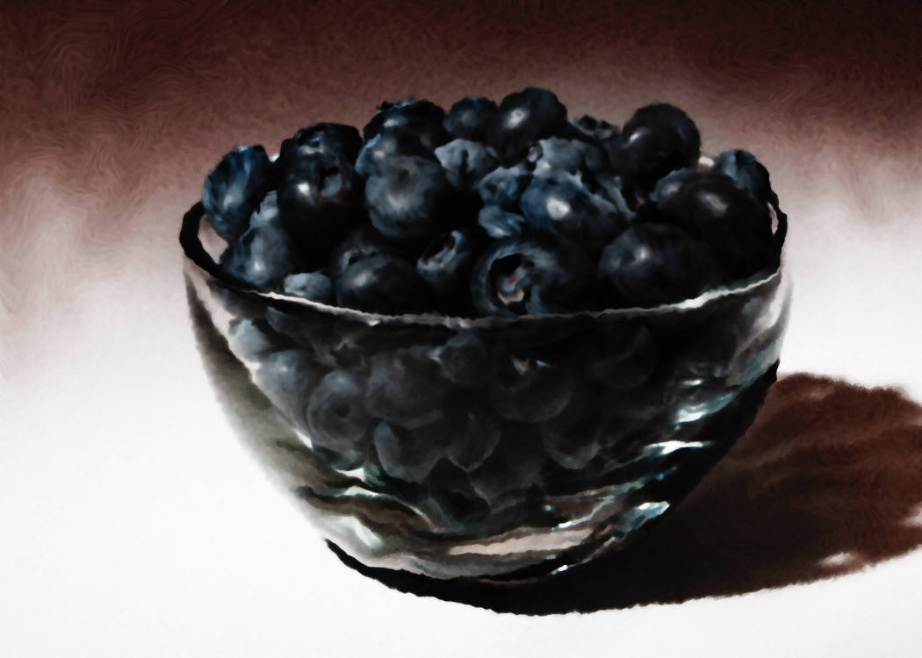
True Blue Facts Cont’d
Blueberries are related to cranberries, bilberries, and cowberries.
Blueberries are both cultivated and picked wild.
Notes:
Other sections in the genus, native to other parts of the world, like Europe, include other wild shrubs which produce edible berries, such as cranberries, bilberries, and cowberries. These berries are also known for having important health benefits.
Blueberries are both cultivated and picked wild. In North America, Vaccinium Corymbosum (aka Northern Highbush Blueberry) is the most common cultivated species.

Slide 4

Research
Blueberries have the highest concentration of antioxidants.
Reduce the markers of oxidative stress in chronic smokers.
Are beneficial in inhibiting oral, breast, colon and prostate cancers.
Notes:
Regular consumption of fruit and vegetables lowers the risk for developing heart disease due to their antioxidant properties.
Blueberries have the highest concentration of antioxidants.
A daily intake of 250 grams of blueberries (about 1.5 cups) for 3 weeks reduced the markers of oxidative stress in chronic smokers. Blueberries were effective if they were consumed as a regular past of the diet, not if taken occasionally.
Several animal studies show that it may be beneficial in inhibiting oral, breast, colon and prostate cancers.

Slide 5
What’s Healthy about Blueberries?
The health benefits of blueberries are believed to be due to the many phytochemicals that act as:
Antioxidants
Anti-cancer agents
Anti-neurodegenerative agents
Anti-inflammatory agents
Blueberries are low in calories and fat, they are a good source of fiber, Vitamin K and Manganese and an excellent source of vitamin C.

Slide 6
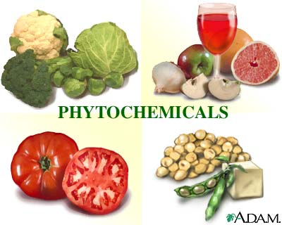
What are Phytochemicals?
Phytochemicals are naturally-occurring non-nutritive constituents of fruits and vegetables.
Notes:
Phytochemicals, commonly referred to as phytonutrients, are naturally-occurring non-nutritive (not required in the diet like nutrients) constituents of fruits and vegetables. They are said to be bioactive and are considered to have a beneficial effect on human health.

Slide 7
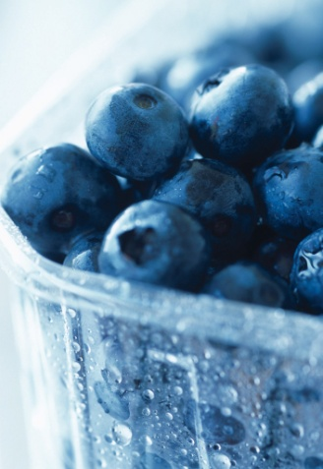
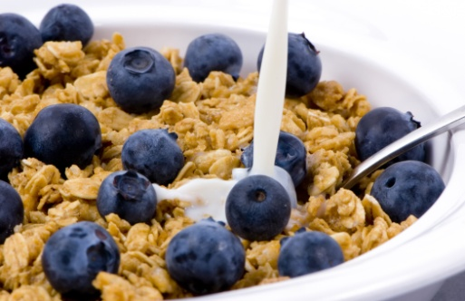
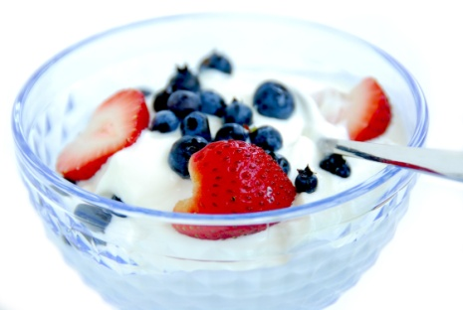
Use and Popularity
Jellies and jams
Pies and dessert
Baking
Dried as snacks
Juice and juice blends
Notes:
Blueberries are used in jellies, jams and pies. They are baked into muffins and are an ingredient in many other snacks and delicacies.
A more recent use of blueberries includes blueberry juice, which has now entered the market and is considered a whole new category of juice on the beverage aisle.
Blueberries have increasingly gained attention; USDA reports indicate that between the years of 1994 and 2003, annual US consumption of fresh blueberries rose approximately 1.6 times.
This gain in attention is likely due to the increased recognition of the potential human health benefits of regular blueberry consumption.

Slide 8
Cancer Risk
Cancers related to blueberry intake include oral, breast, colon and prostate cancers.
Studies show that blueberry extract inhibits the growth of human oral, breast, colon and prostate tumor cell lines that is concentration dependent. Greater concentration is more effective.
Out of 10 different extracts of fruits and berries, blueberry extract had the greatest effects on colon cancer cells.
Notes:
Overview: Berry fruits, particularly blueberries, have been under recent investigation in regards to their role in cancer prevention. Several different cancers have been investigated, including oral, breast, colon and prostate cancers.
Reporting the Studies
One study evaluating the ability of 6 different berry extracts (including blueberry extract) to inhibit the growth of human oral, breast, colon and prostate tumor cell lines at differing concentrations (25 to 200 μg/ml) found all extracts to be concentration dependent. The greater the concentration of berry extract, the greater the inhibition of cell proliferation in all cell lines observed, translating to lower risks for cancer.
Another in vitro study looked at the effects of 10 different extracts of fruits and berries on cell proliferation of colon cancer cells HT29 and breast cancer cells MCF-7. This study also found the effects of these extracts to be concentration dependent and noted that of the 10 extracts tested (at the highest concentration used), blueberry extract exhibited the greatest effects on colon cancer cells.
In order to determine which component of blueberry extract is most responsible for these anticancer properties observed among several in vitro studies, one study separated blueberry extract based on phenolic compounds known to be present. This separation resulted in 4 different fractions: the flavanol, tannin, phenolic acid, and Anthocyanin fractions. Although all four fractions did show inhibition of cell proliferation, the Anthocyanin fractions were shown to be the strongest, inhibiting cancer cell proliferation at much lower concentrations than the other fractions.
**In vitro studies take place in an artificial environment outside of the living organism.

Slide 9

Heart Disease Risk
Consuming one cup of blueberries a day for three weeks can result in reduction of heart disease risk factors.
A single dose of berries is not effective.
Notes:
It is known that regular consumption of fruits and vegetables lowers the risk for developing heart disease. A study examined the effects of blueberry consumption in relation to heart disease risk. Participants (chronic cigarette smokers) consumed either 250 grams of blueberries a day for three weeks or one dose of 250 grams of fruit. Several markers of oxidative stress were examined along with a marker of antioxidant potential. A significant decrease in one marker of oxidative stress was found among those who consumed fruit on a daily basis but not in those with one dose. This suggests that in order to obtain the greatest level of benefits comes from regular consumption.

Slide 10


Alzheimer’s Risk
The development of neurodegenerative diseases, such as Alzheimer's disease may be reduced with blueberry intake.
This may be due to the colorful compounds in blueberries called anthocyanins that can enter the brain.
Notes:
The consumption of blueberries is also believed to possibly play a role in delaying the development of neurodegenerative diseases, such as Alzheimer's disease. There have been several studies in laboratory animals that show promising results.
One study fed blueberry extracts to laboratory animals for 8 weeks. After the 8-week feeding, the researchers noted a reversal of age-related deficits in both neuronal signaling and behavioral parameters. Although the researchers believed that the improvements seen were due to the polyphenols in the blueberry (BB) extract, it was not evident whether or not these phytonutrients entered the brain.
A further study for 8-10 weeks on spatial learning and memory measures was repeated. Results showed that several anthocyanin were found in the brain and there was a positive relationship between spatial learning/memory and anthocyanin content of the cortex. Researchers concluded that the polyphenols can enter the brain.

Slide 11
GI Health
Many compounds in berries have been found to inhibit the growth of several intestinal pathogens, such as Salmonella, Staphylococcus and Helicobacter pylori. Blueberry extracts also increased the susceptibility of H. pylori to clarithromycin, a medication used for the treatment of ulcers.
Notes:
The consumption of phenolic compounds in berries has also been suggested to play a role in gastrointestinal (GI) health. One study found that these compounds inhibited the growth of several intestinal pathogens, such as Salmonella and Staphylococcus. Another study examined the effect of six different berries (raspberries, straw-berries, cranberries, elderberries, blueberries, and bilberries) on inhibiting the growth of Helicobacter pylori. H pylori is a bacterial infection that can become serious if left untreated. It has the potential to progress to gastritis (irritation and inflammation of the lining of the stomach), peptic ulcer disease [PUD] (characterized by sores in the stomach or the duodenum) and possibly even stomach cancer later in life. This particular study was done in order to determine the effects of the berries alone and also in combination with a drug, clarithromycin, which H. pylori. H pylori can become resistant to clarithromycin. The study found that, when compared with the controls, all berries significantly inhibited growth of H. pylori, and that the berry extracts also increased the susceptibility of H. pylori to clarithromycin.

Slide 12

Mission:
To promote healthier lives through research and education in nutrition and preventive medicine.
The Pennington Center has several research areas, including:
Clinical Obesity Research
Experimental Obesity
Functional Foods
Health and Performance Enhancement
Nutrition and Chronic Diseases
Nutrition and the Brain
Dementia, Alzheimer’s and healthy aging
Diet, exercise, weight loss and weight loss maintenance
The research fostered in these areas can have a profound impact on healthy living and on the prevention of common chronic diseases, such as heart disease, cancer, diabetes, hypertension and osteoporosis.
The Division of Education provides education and information to the scientific community and the public about research findings, training programs and research areas, and coordinates educational events for the public on various health issues.
We invite people of all ages and backgrounds to participate in the exciting research studies being conducted at the Pennington Center in Baton Rouge, Louisiana. If you would like to take part, visit the clinical trials web page at www.pbrc.edu or call (225) 763-3000.
Authors:
Beth Kalicki
Heli Roy, PhD, RD
Division of Education
Pennington Biomedical Research Center

